Slide 1







Democratizing Spatial Planning for
Nature and People
Richard Schuster
Research Scientist, Carleton University
Conservation Prioritization Consultant, NCC
prioritizr.net
richard.schuster@glel.carleton.ca
@RicSchuster

Slide 2










Acknowledgements
Jeff Hanson
Matt Strimas-Mackey
Nina Morrell
Matt Watts
Joe Bennett
Peter Arcese
Hugh Possingham

Slide 3


The Why?
Conservation planning = challenging
Range of objectives and constraints
Analytical tools tailored to specific tasks
Proposal:
Flexible, powerful framework
+
User friendly (browser) interface
Notes:
researchers, managers, and stakeholders must consider a range of different objectives and constraints, and require analytical tools tailored to specific tasks.

Slide 4
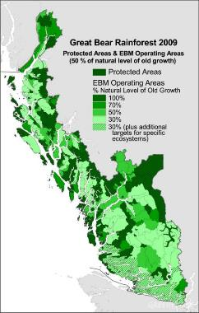
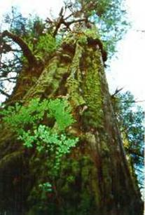




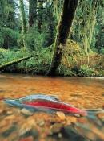
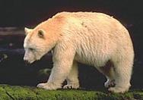
Traditional Goal of Conservation Area Design
Prioritize and Conserve ‘Intact’ or ‘Relic Ecosystems’
Multiple criteria
Decision support tools
Impractical in Human-dominated Landscapes
No Benchmark Ecosystems
Biological Survey Data Often Biased
Many Threats Hard to Map

Slide 5
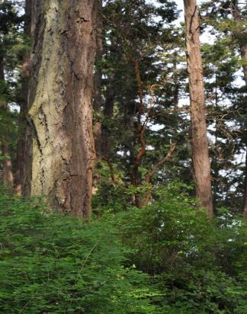
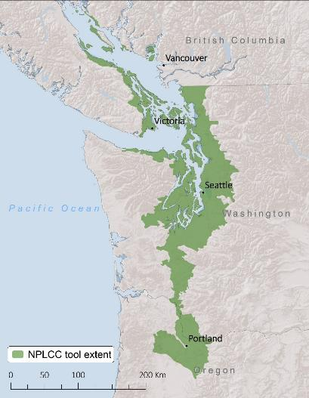
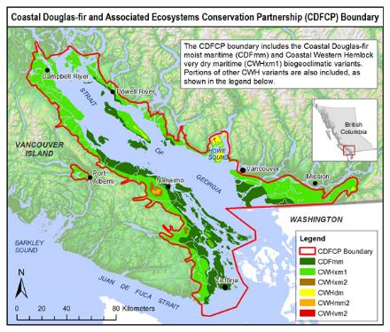

Dry Forest / Savanna Habitats of the Georgia Basin
49% Converted to Human Use
< 3% Pre-settlement Forest Intact
> 80% Privately-owned
>153 Species At Risk
Most Imperiled Ecosystem in BC
Vancouver
And Throughout the Pacific Northwest

Slide 6
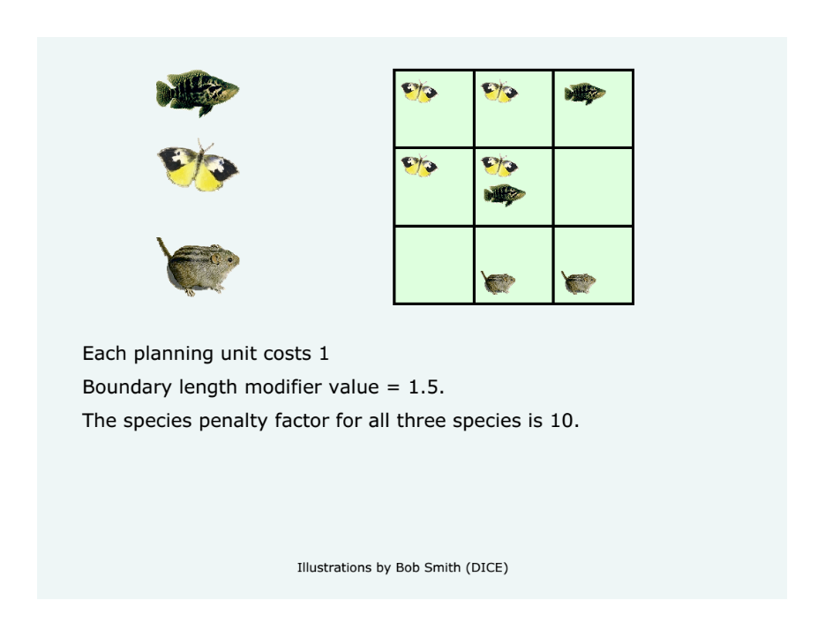

Slide 7

What problem do we want to solve?
Score of the configuration being tested =
$$Cost$$
+
$Boundary Length Modifier×Boundary Cost of the reserve system$
+
$$\begin{aligned}Species Penalty Factor × \\ Penalty incurred for unmet targets\end{aligned}$$

Slide 8
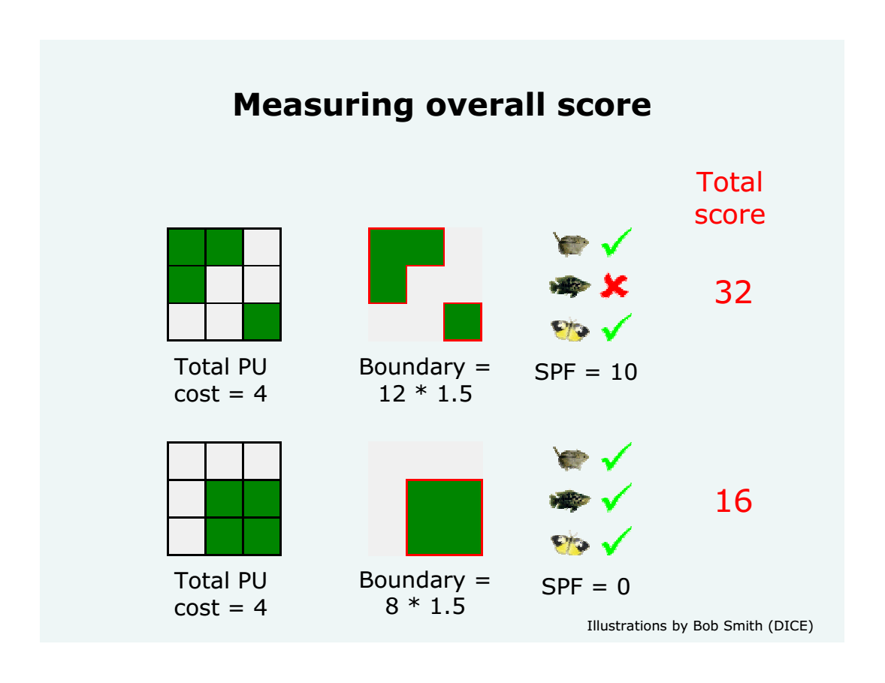
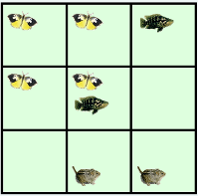

Slide 9
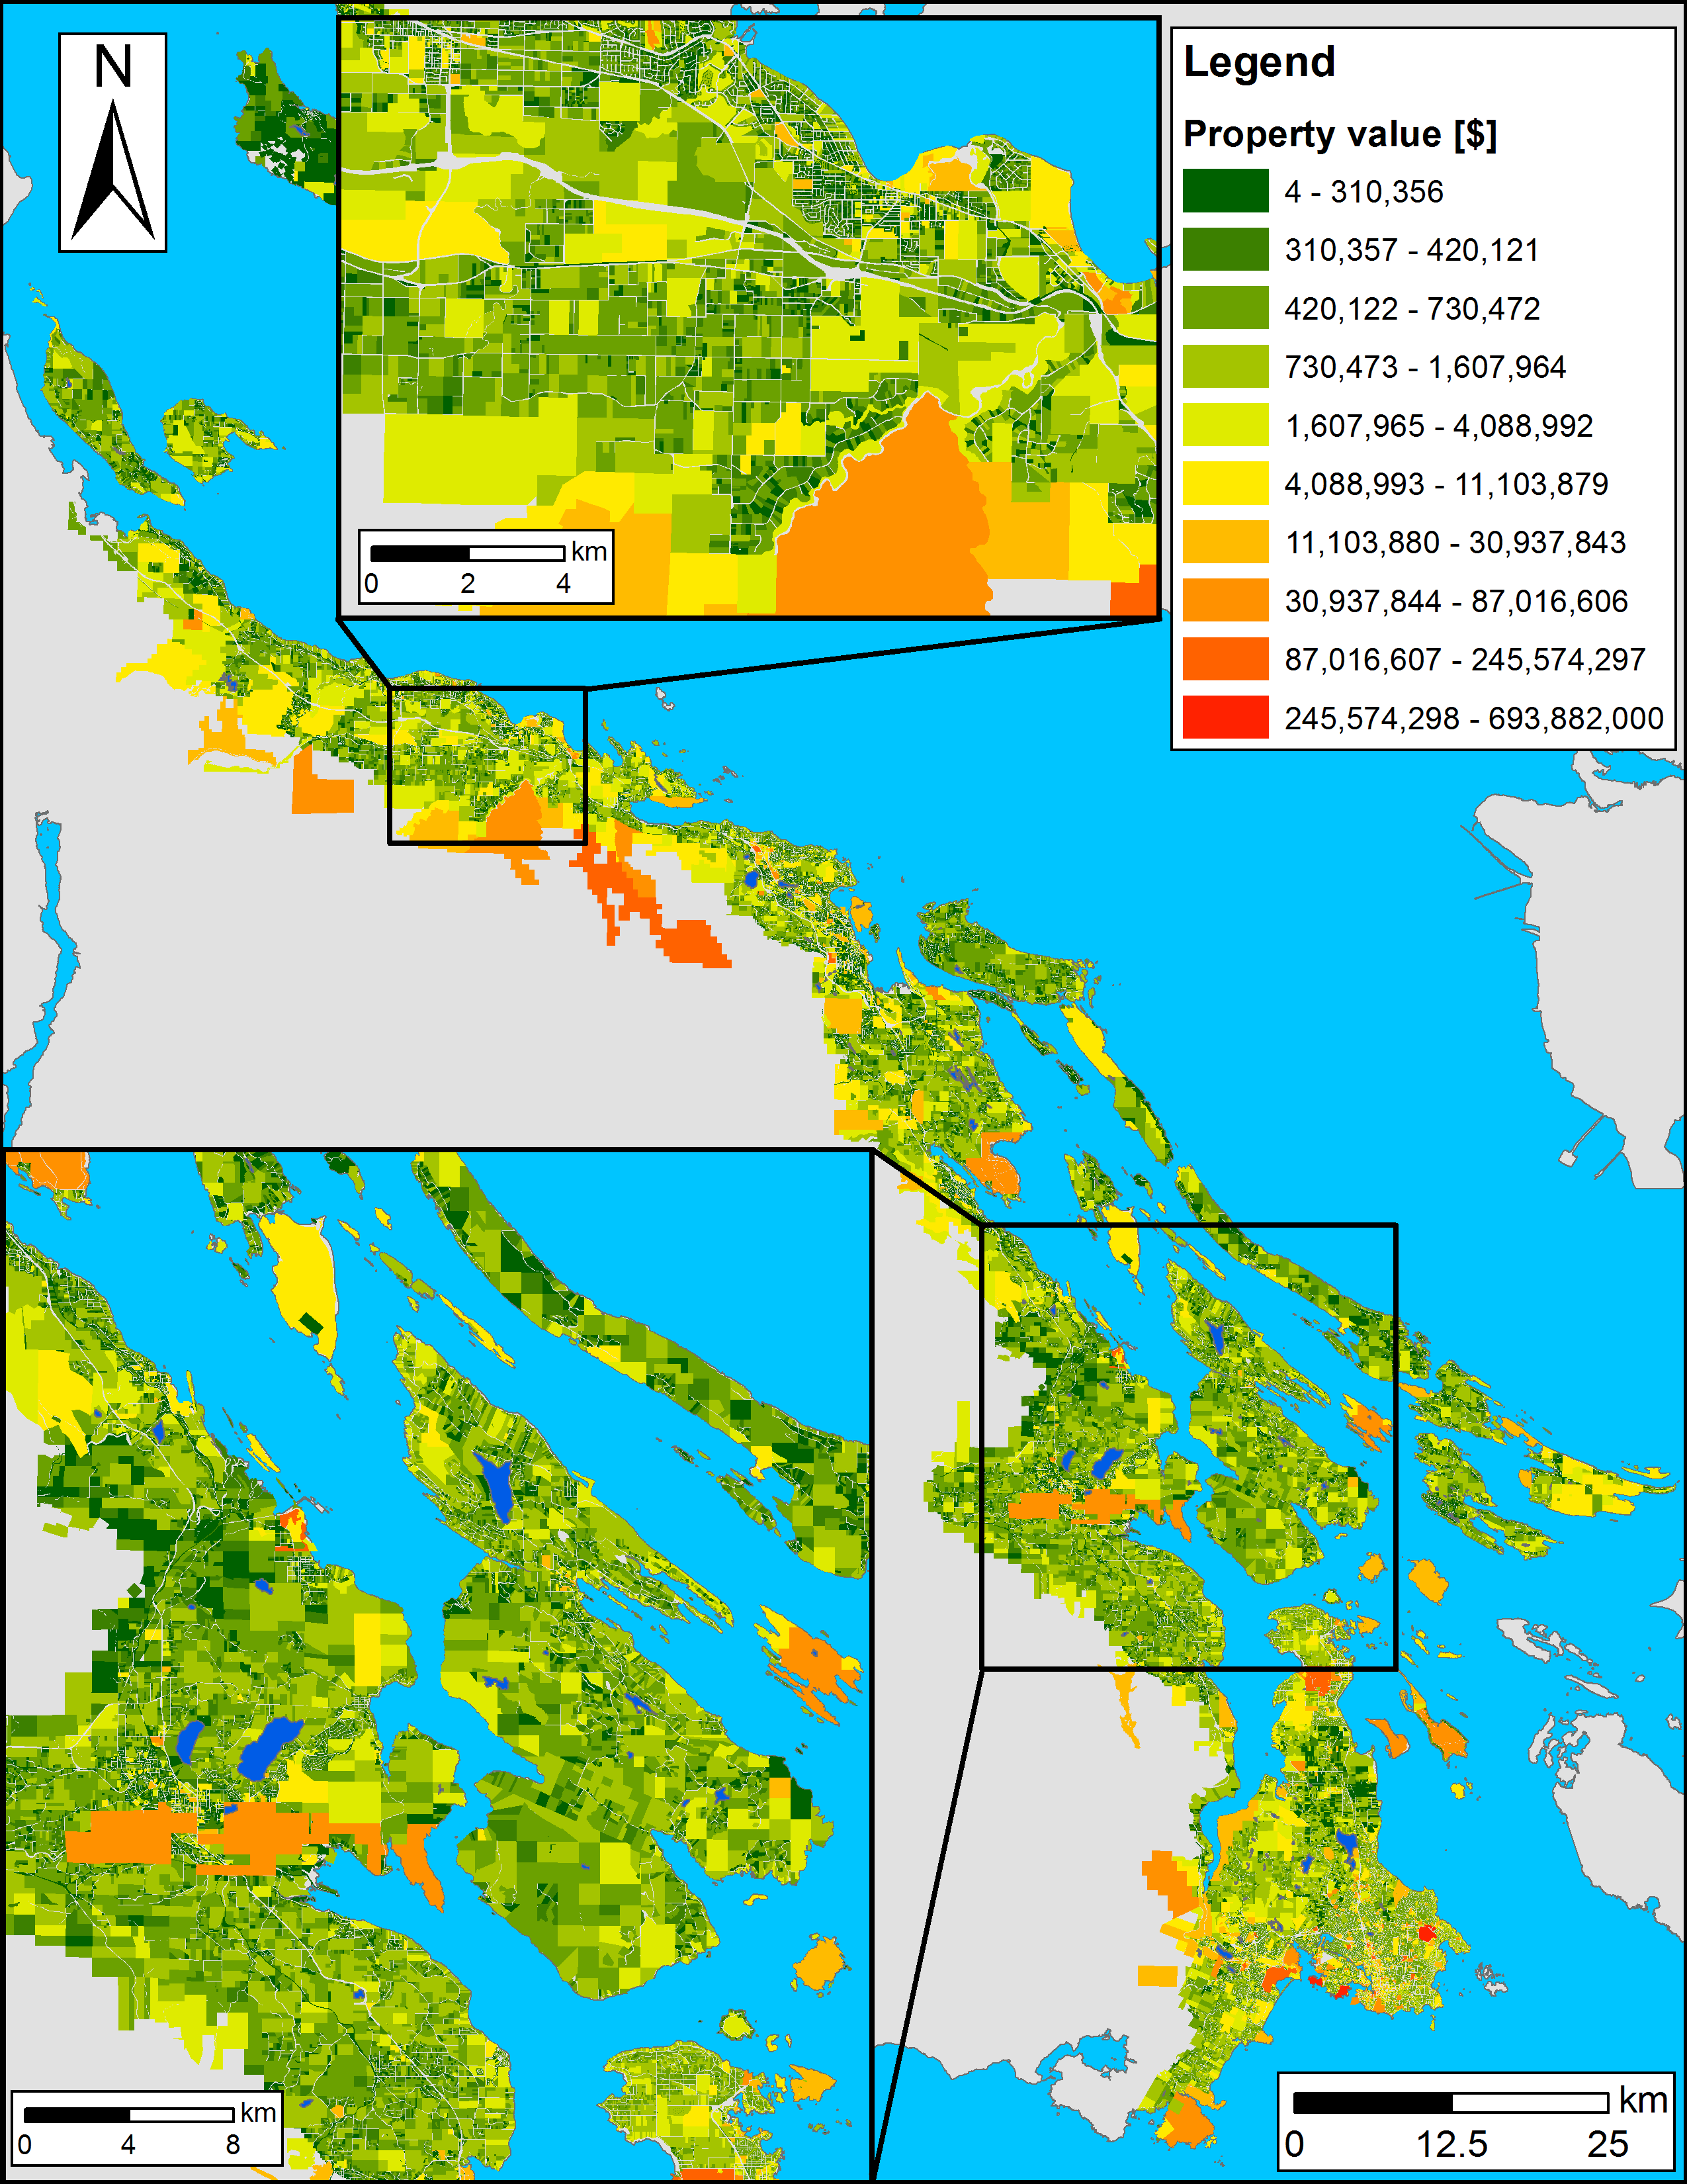
Planning units
Land base of the
planning area: ~198,000
properties
Possible solutions for a
reserve system:
2^198,000 > atoms in the
Universe
How to optimize
prioritization?

Slide 10
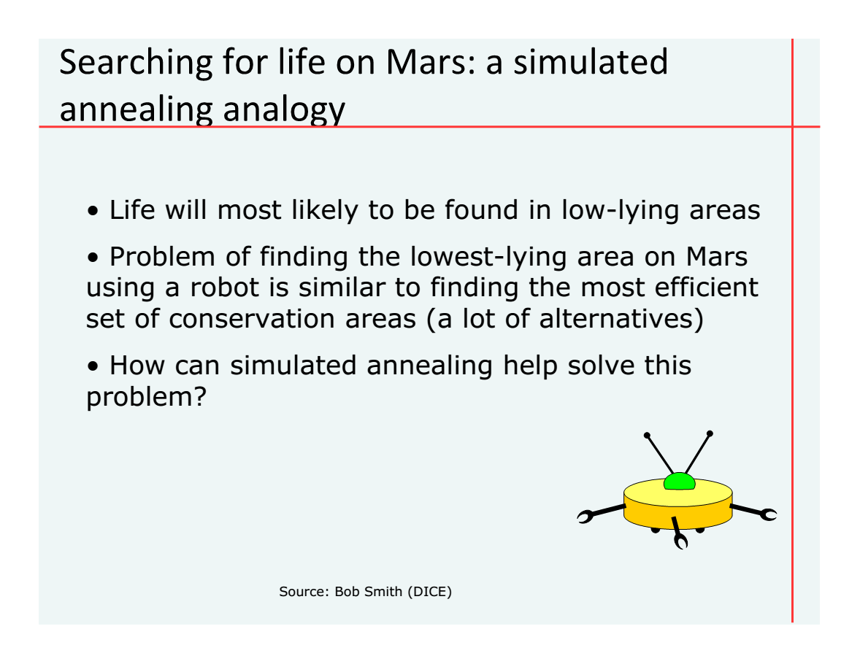

Slide 11
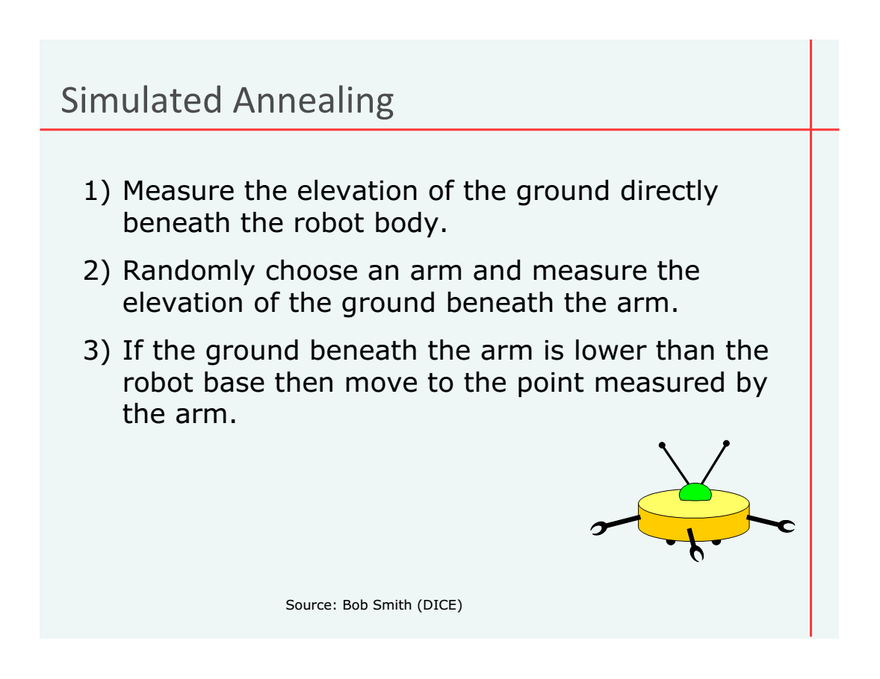

Slide 12
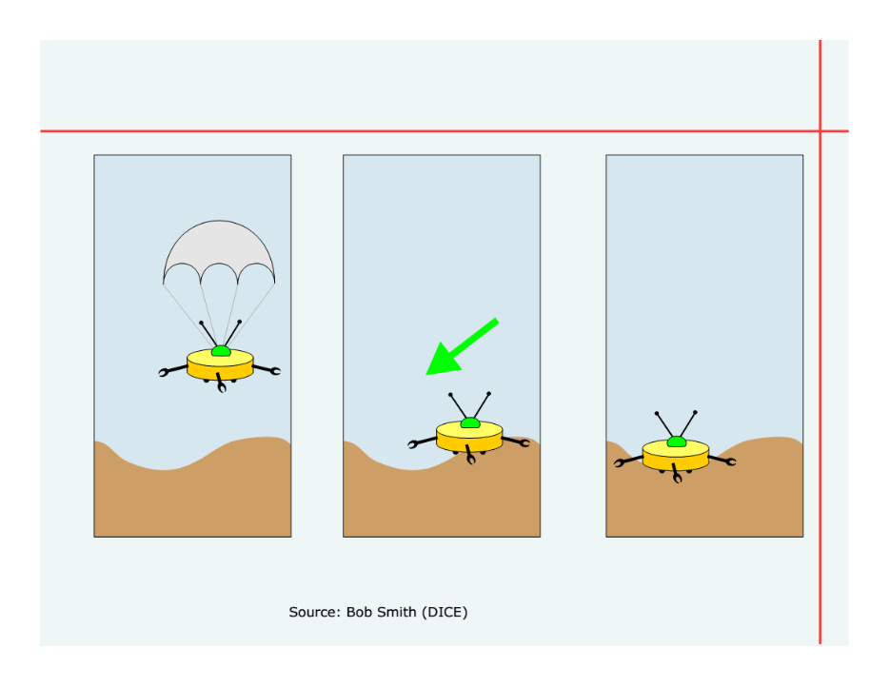

Slide 13
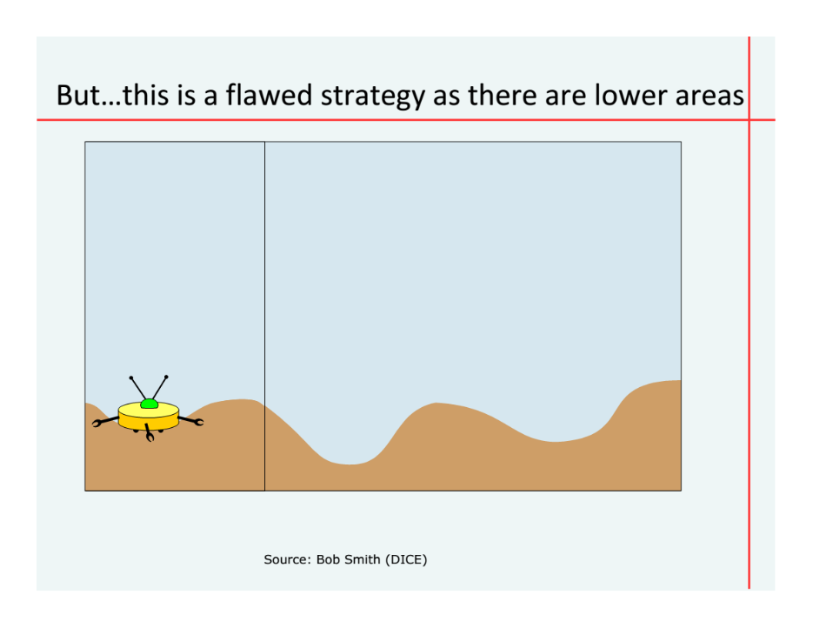

Slide 14
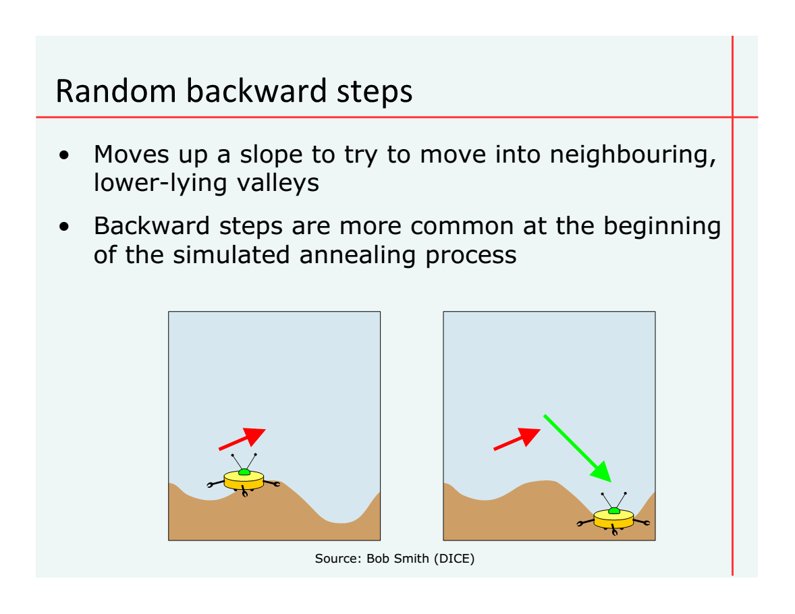

Slide 15
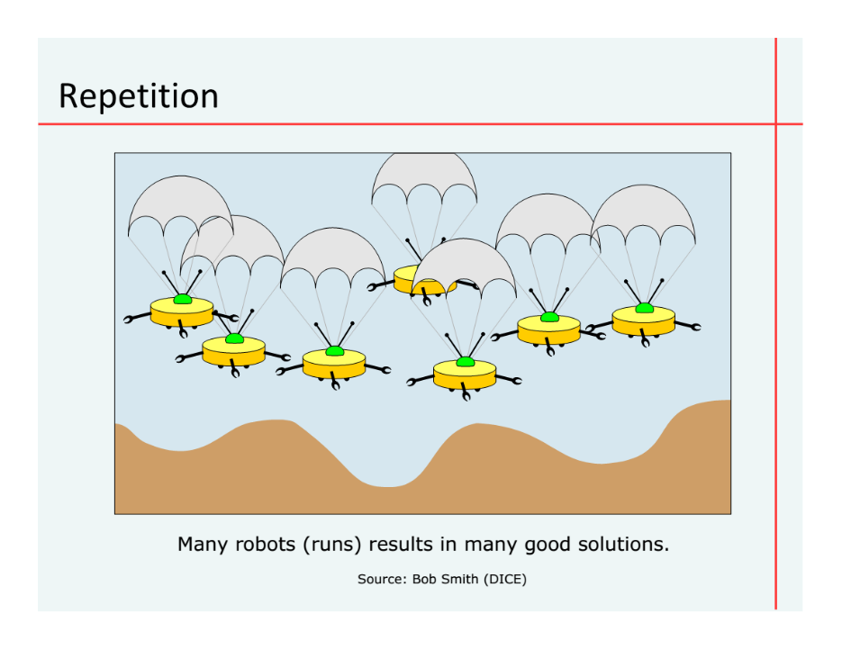

Slide 16

Where do we start?
Conservation planning = challenging
Range of objectives and constraints
Analytical tools tailored to specific tasks
Flexible, powerful framework
+
User friendly (browser) interface
Notes:
researchers, managers, and stakeholders must consider a range of different objectives and constraints, and require analytical tools tailored to specific tasks.

Slide 17

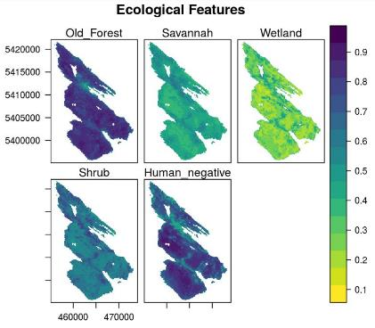
prioritizr.net
Hanson JO, Schuster R, Morrell N, Strimas-Mackey M, Watts ME, Arcese P, Bennett J, Possingham HP (2019). prioritizr: Systematic Conservation Prioritization in R. R package version 4.1.4.

Slide 18

Why ?
It’s free
Reproducibility
Flexible interface
Diverse package ecosystem
So many resources: Stackoverflow, tutorials, blogs, twitter, slack channels, mailing lists

Slide 19
Decision science
Goal: what is our vision for the future?
Objective: what quantity are we maximizing/minimizing to help achieve the goal?
Constraints: what things must our solution do to help achieve the goal?
Decisions: what actions could we do to maximize/minimize the objective?

Slide 20





Case-study: Reserve design
Goal: conserve biodiversity
Objective: min. # of islands
Constraints: sufficient habitat for each species
Decisions: which places should be protected?

Slide 21
Design your problem
Mental model
Code
problem <- data +
objective +
constraints +
penalties
solution <- solve(problem)
p <- problem(cost, features) %>%
add_min_set_objective() %>%
add_relative_targets(0.1) %>%
add_boundary_penalties(5)
solution <- solve(p)

Slide 22
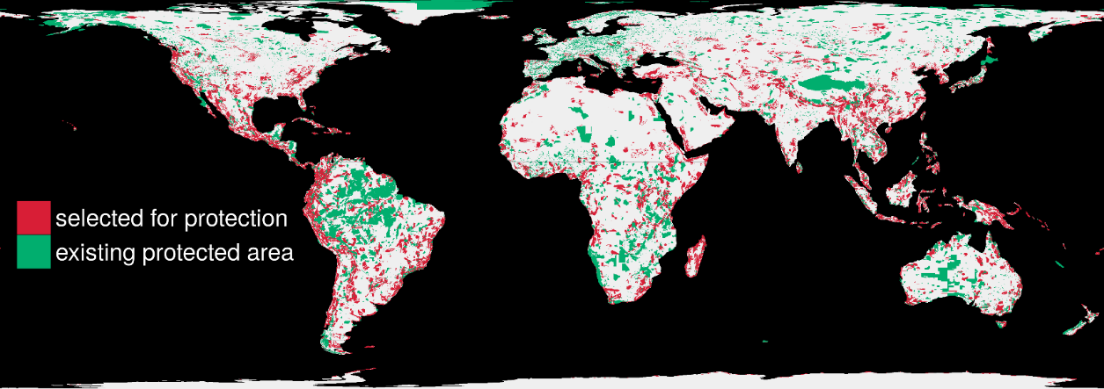
Solve it fast!
1.5 million planning units + 22,644 species: 76 minutes

Slide 23
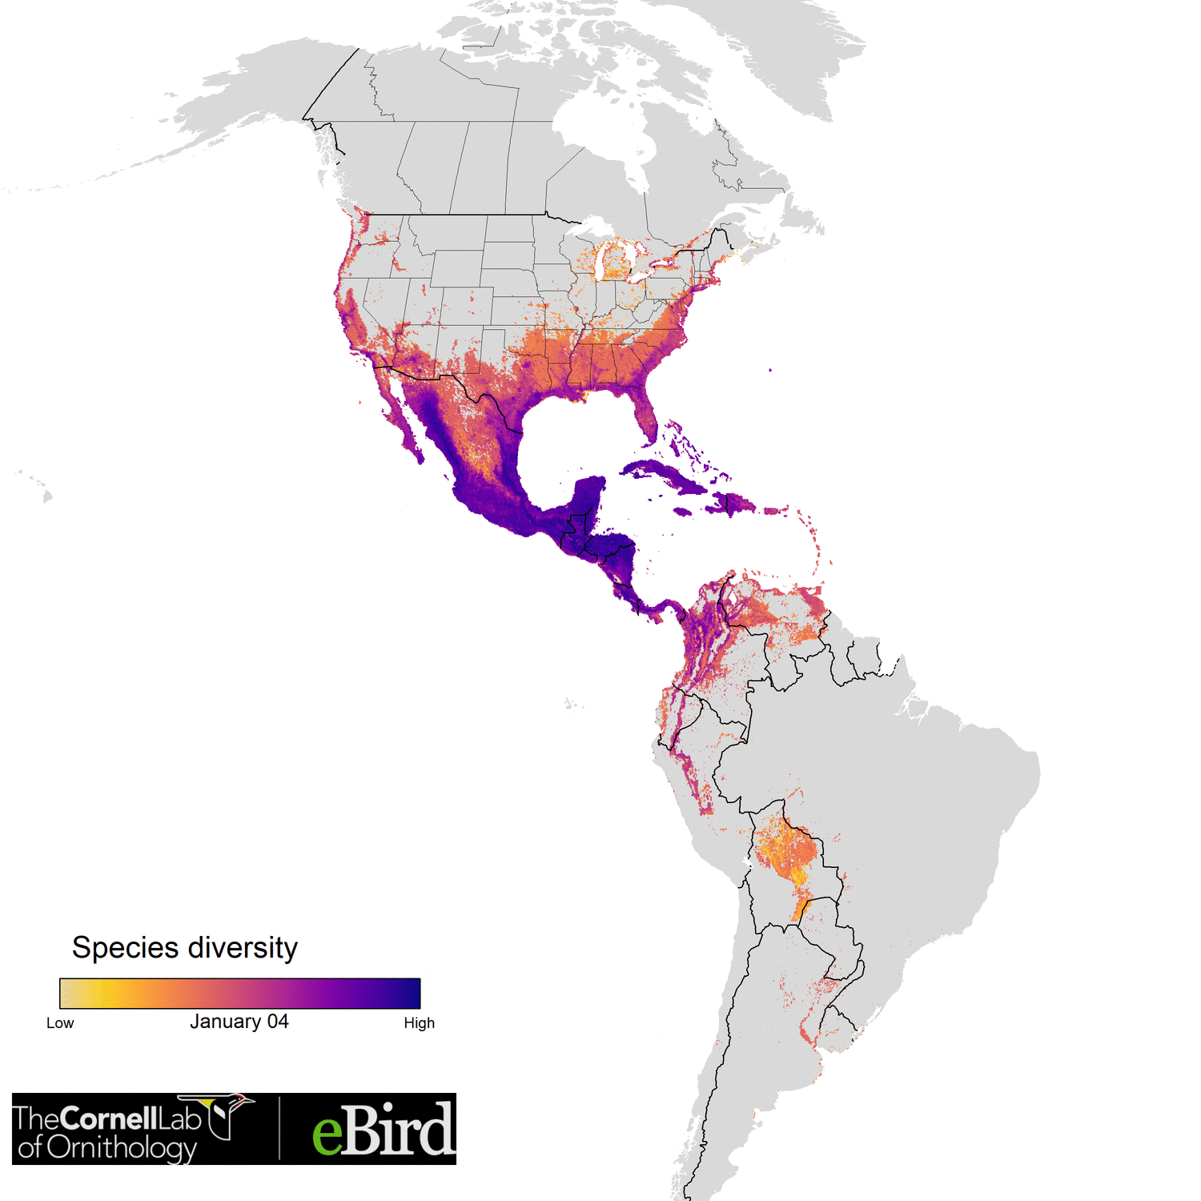

Optimizing the conservation of migratory species over their full annual cycle
117 species
73 million km²
1.7 million unique locations
14 million checklists
≤ 30,420 features
1.05 million planning units
Analysis powered by:
Schuster et al. (2019) Nature Communications

Slide 24










Facilitate Consensus Decisions on Protection

Slide 25

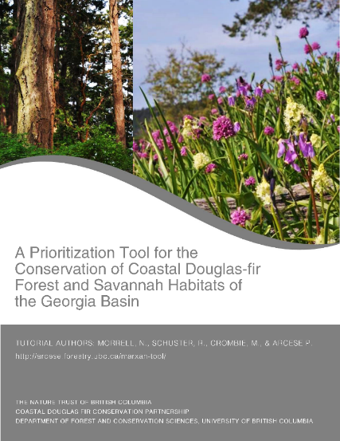
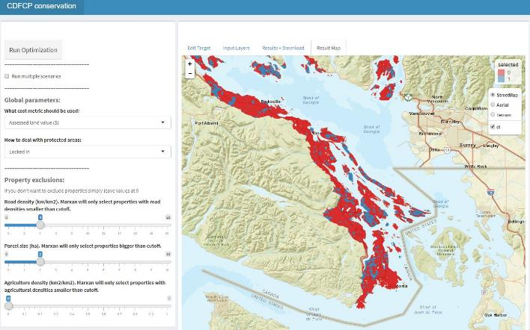
Making prioritizr user friendly:

Slide 26
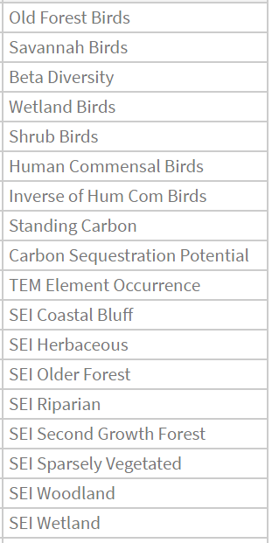
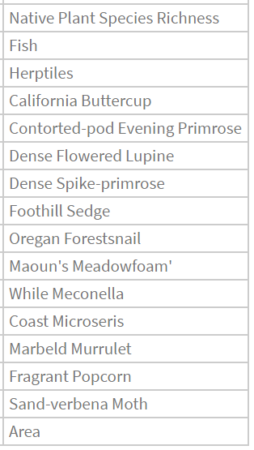

Slide 27
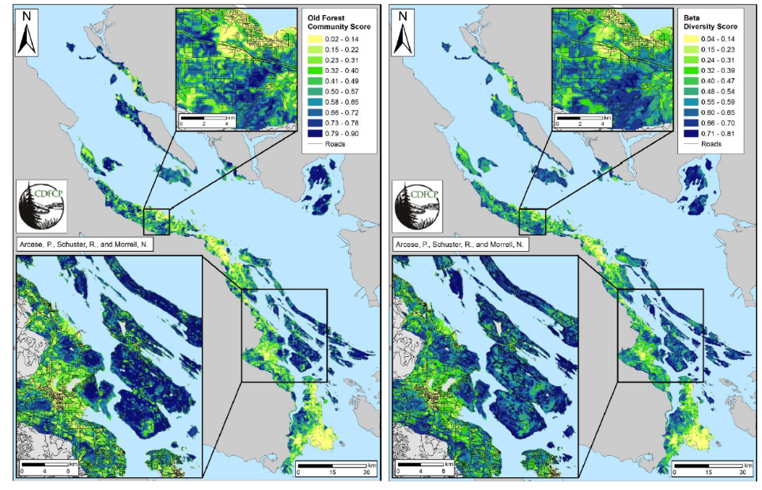
Old forest community Beta diversity

Slide 28
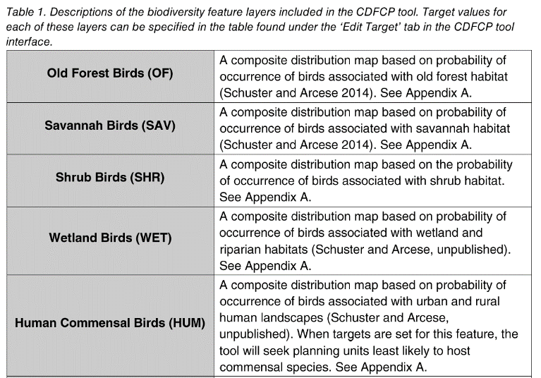
CDFCP tool tutorial (p.15+) http://arcese.forestry.ubc.ca/marxan-tool-cdfcp/

Slide 29
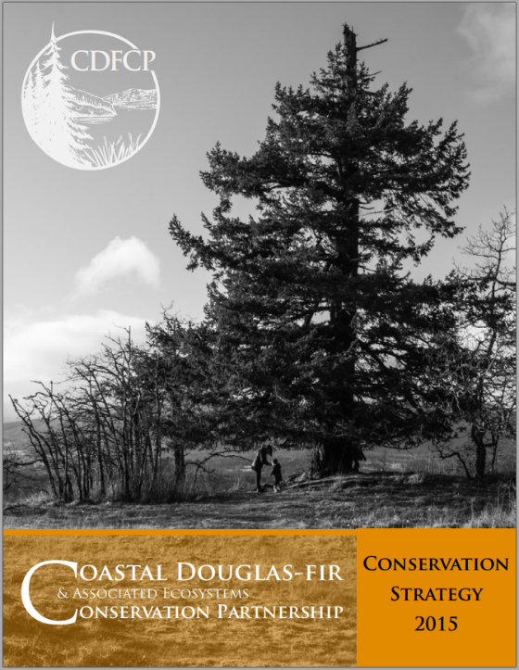

Slide 30
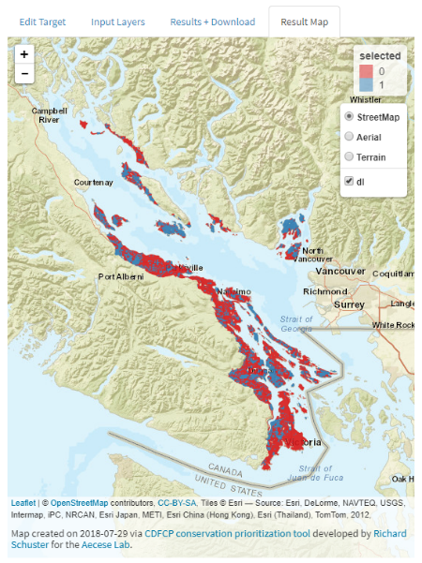
Applications?
Acquire Biodiverse Parcels
Minimize Management Costs, Maximize Return on Conservation Investments
Develop Contact Lists to Engage Private Landowners in Conservation at Landscape Scales

Slide 31
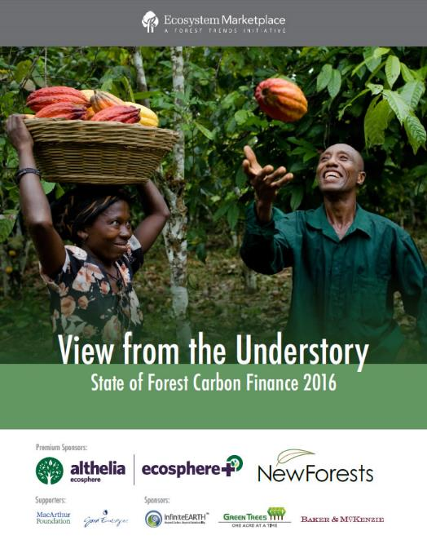
Payments for Ecosystem Services
$6 Billion Invested
to 2016 in Carbon

Slide 32
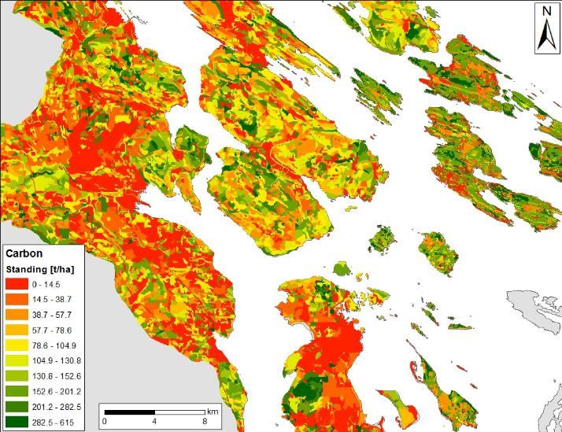
Synergies: High Value Forests Have Standing Carbon In Excess of 200 t/ha
Standing Carbon in High Value Forests in the Georgia Basin is Currently Worth $4-10K/ha
~3-15% of Acquisition Cost

Slide 33
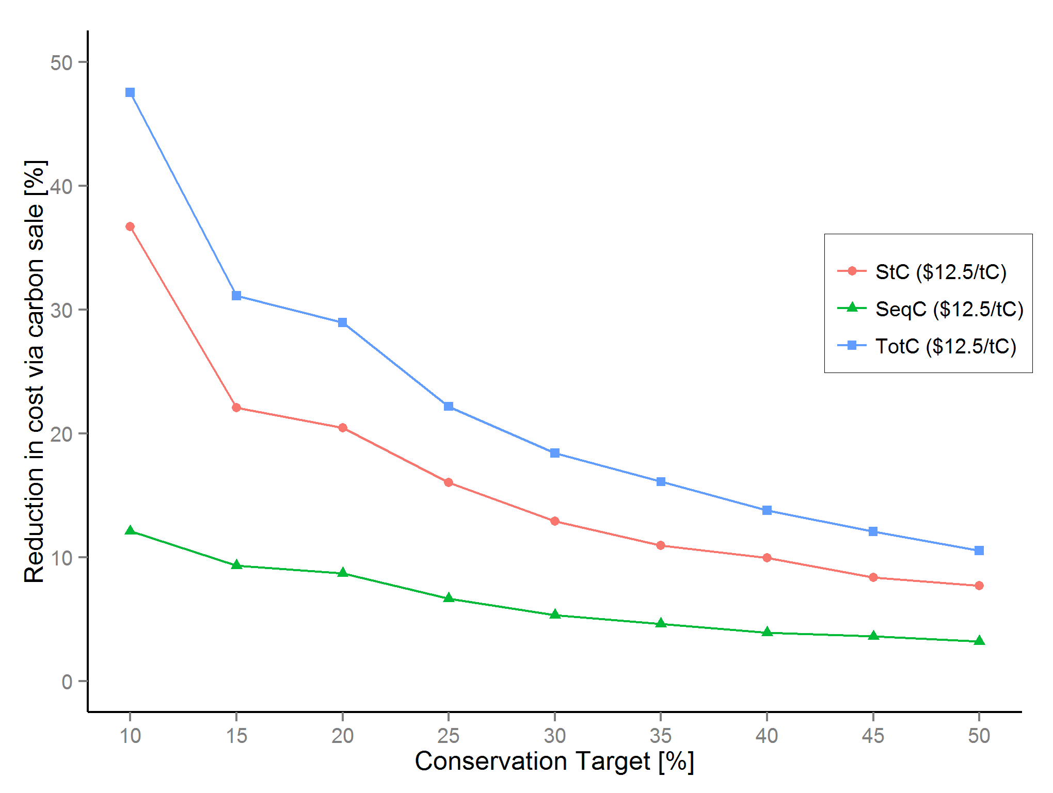
Biodiversity - Carbon
Huge Initial Reductions in Cost Possible
Schuster, Martin & Arcese 2014 PLoS One

Slide 34
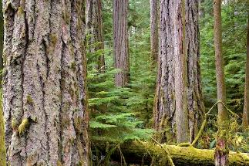
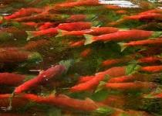
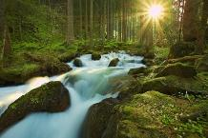
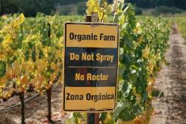
Strategic Investment for ‘Co-benefits’
Standing / Sequestered Carbon
Water Quality / Supply
Beneficial Farm Practices
Notes:
Think of a reverse auction as similar to when a homeowner solicits multiple bids for work from contractors. The homeowner puts together a scope of work, solicit bids, and chooses a contractor based on some combination of factors including price and quality.
Finally, based on estimates of the amount of habitat needed and the pricing of bids, BirdReturns accepted up to 80 percent of the bids. Each farmer received the price they bid. Just as with the contracting example, the lowest price didn’t always win, but it was a key criteria.
Farmer’s bids varied based on factors such as water cost, soil conditions, labor costs associated with creating the temporary habitat, and economic risks the program might create like not being able to plant on time in the spring.
BirdReturns has many advantages over conservation programs that set a single, uniform price for all farmers.
If the price is too low, there will be insufficient demand and too few farmers will sign up for the program. If the price is too high, there will be an excess of demand and the government will over-pay. In a time of huge societal needs and competing demands for scarce public dollars, such over-payment means that other valuable programs are not being funded.
In a reverse auction, the farmer sets the price, a price based on producing habitat. Farmers understand this intuitively. It is how they work, how they get paid for producing crops.
As one farmer put it at one of the Conservancy’s initial meetings: “You want us to grow birds, like we grow rice. We know how to do that.”
Farmer’s bids varied based on factors such as water cost, soil conditions, labor costs associated with creating the temporary habitat, and economic risks the program might create like not being able to plant on time in the spring.

Slide 35
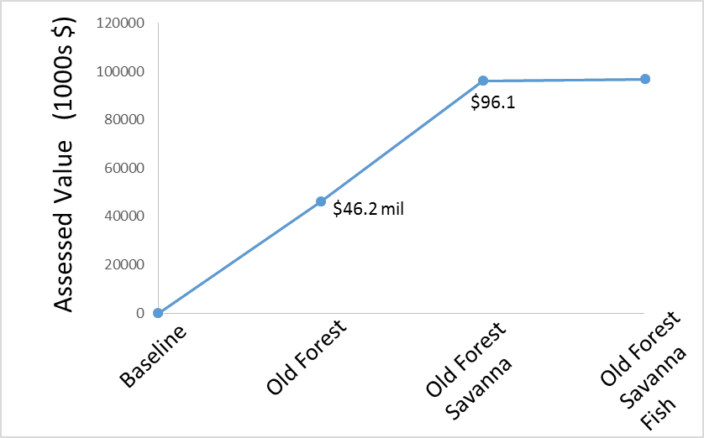




Coastal Douglas-fir Carbon Co-Benefit
$96.7
Vancouver

Slide 36
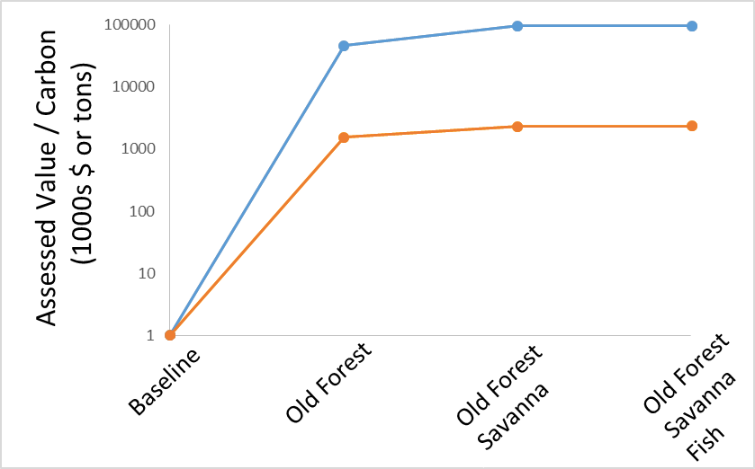
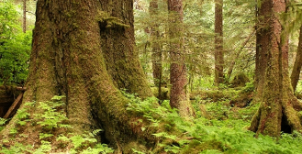
Coastal Douglas-fir Carbon Co-Benefit
$96.1
96.7
$46.2
Cost of Solution
St + Seq Carbon
$9.7
$46.4
$46.8
$31.2
Canadian Carbon Policy
$20/t by 2020

Slide 37






Climate Adaptive Planning for
British Columbia
Recently started 3 year project
Leads: Oscar Venter and Peter Arcese
Partners:

Slide 38
What’s next?

Slide 39
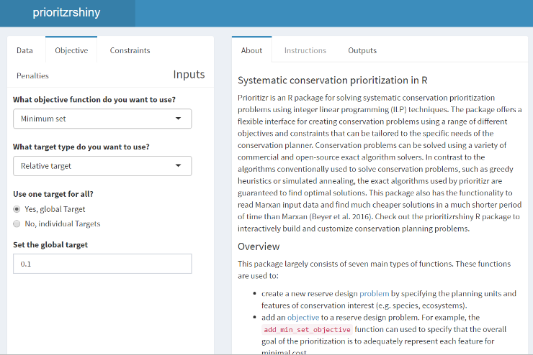
prioritizrshiny (in development)
Code
User interface
p <- problem(areas, feats) %>%
add_min_set_objective() %>%
add_relative_targets(0.1) %>%
add_boundary_penalties(5) %>%
add_binary_decisions() %>%
add_rsymphony_solver()
solution <- solve(p)

Slide 40


NCC – Carleton partnership
Tools for prioritization of conservation investments
Phase 1: Modernize NCC’s conservation prioritization methods
  Systematic Reserve Acquisition Prioritization tools
  Tools aimed at optimizing stewardship decisions
Phase 2: democratize conservation decisions beyond NCC

Slide 41



Take home message
Flexible + powerful framework
+
User friendly browser interface
=
A novice stakeholder can
devise a high-quality,
data-driven spatial plan in just
one hour.
prioritizr.net
jeffrey.hanson@uqconnect.edu.au
richard.schuster@glel.carleton.ca

