Slide 1
General and Chemical Laboratory Safety Training
For Laboratory Teaching Assistants and Research Students
Presented by Heath de la Giroday,
Dispensing Chemist, Chemical Safety Officer, Radiation Safety Officer

Slide 2
Why Safety Training?
Career development
To prevent injury and maintain your lifestyle
The University has a legal and ethical obligation to protect each student, assistant, faculty, and staff member

Slide 3
Who is in Charge of Safety
Everyone on campus is part of our safety apparatus
  You
    Participate in training, comprehend information, report safety issues, ask questions, follow procedures
  Supervisor/manager/SLI
    Providing specific/specialized training, provide PPE, monitor activities, develop and maintain safe work plans
  Dispensing Chemist (Chemical and Radiation Safety Officer)
    Assist in achieving regulatory compliance, develop proactive strategies, provide training, monitor safety of laboratories

Slide 4
Who is in Charge of Safety
Risk & Safety Coordinator
  Assist in achieving regulatory compliance, develop proactive strategies, provide training, monitor safety of laboratories
Laboratory Safety Committee
  Develop policy and procedures, provide guidance for development of lab safety structure, make recommendation to JOHS Committee
Joint Occupational Health & Safety Committee

Slide 5
Introduction to the Laboratory

Slide 6
Let’s Get Started!
Safety resources and locations
Hazards
Laboratory Hygiene and Habits
MSDS
Personal Protective Equipment
Fumehoods and BSCs
Signs and Labeling
Spills and Accidents
Waste/Disposal
Gases

Slide 7
Information Resources
Chemical Safety and Methodology Manual
  Provides laboratory and chemical safety procedures
  Provides waste disposal information
Biosafety Manual
Chemstores Website
Coming in the new year—Laboratory Safety Website

Slide 8
Safety Resources and Locations
  Know your exit doors
  Know where the fire alarm is in proximity to your laboratory
  Be aware of the fire extinguishers, fire blankets in location near your laboratory
  Know where the eye wash/safety shower is located
    Is it unobstructed?
  Know location of spill kit
    Go through contents of spill kit each semester if you are a supervisor/TA

Slide 9
Know Your Surroundings
Each laboratory has a telephone in a designated area for use
The emergency contact numbers are posted near the phone in every laboratory on the UNBC campus
Test this phone to ensure it is working

Slide 10
Know What Hazards are Present

Slide 11
Hazards
Many laboratories contain hazardous substances.
  A hazardous substance is defined as a material/substance that poses a physical or health hazard. This includes both chemical and biological agents
There are differences between a health hazard and a physical hazard

Slide 12
Health Hazards
A health hazard has the following characteristics:
  Carcinogen
  Toxic or highly toxic
  Reproductive Toxins
  Irritants
  Corrosives
  Sensitizers
  Hepatotoxins
  Nephrotoxins
  Neurotoxins

Slide 13
Physical Hazards
A physical hazard has one or more of the following characteristics:
  Explosive
  Corrosive
  Flammable
  Oxidizer
  Pyrophoric
  Organic peroxide
  Compressed gas
  Unstable (Reactive)
  Water-reactive

Slide 14

Laboratory Hygiene

Slide 15
Chemical Hygiene Plan
When a chemical is in the laboratory, the hazards of that chemical must be communicated to you
A Chemical Hygiene Plan (CHP) relays information regarding procedures, equipment, PPE, and work practices that are capable of protecting students/employees from health hazards

Slide 16
Chemical Hygiene Plan
The CHP also prevents contamination and exposure
  Placing lab coats on hooks in lab
  Sending lab coats for cleaning on a regular basis
  Labeling computers for glove or no glove use
  Dedicating a bench for toxic or mutagenic substances
Supervisors (TAs, PIs, SLIs) are responsible for communicating this information

Slide 17
Lab Attire
You should remember the following:
  Shoes must completely cover feet
  No shorts—legs must be covered
    Consider keeping a change of clothes available
  Restrain hair when working with hazardous materials
  Remove protective clothing and gloves in public to avoid contamination of public spaces
  Apparel should match what is happening in the lab, not what you are doing

Slide 18

Personal Habits
Personal habits play a large role in minimizing hazards. The following measures must be taken:
  Do not eat, drink, smoke, chew gum or apply cosmetics, or remove/insert contact lenses while in the laboratory
  Do not store food or beverages in the lab or in chemical refrigerator
  Do not mouth pipette
  Wash hands before leaving laboratory or after handling contaminated material

Slide 19
Safe Practices
Safe practices to ensure safe working conditions:
  Do not use chipped or cracked glassware
  When working with hazardous materials, have a second person nearby
  Know emergency procedures
  Keep the laboratory neat and clean
  Use hazardous chemicals under a fume hood and biohazardous materials under a biological safety cabinet (BSC)
  Decontaminate as needed
  All procedures should be performed to minimize aerosol generation

Slide 20
Laboratory Emergency Plan

Slide 21
Laboratory Information
Each lab contains an Emergency Action Plan which is required for emergency situations
This is used to inform faculty/staff/students of the procedures to follow in the event of an emergency

Slide 22
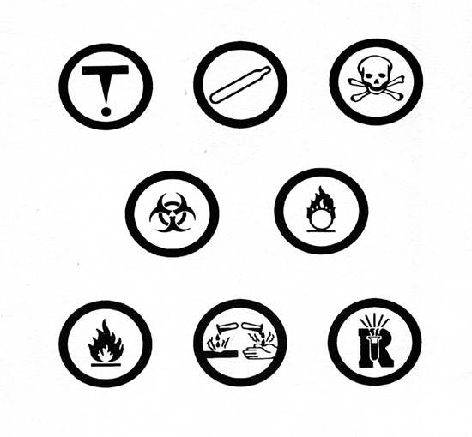
WHMIS

Slide 23
WHMIS
Workplace Hazardous Material Information System
Classifications
  A. Compressed gas
  B. Flammable and combustible
  C. Oxidizer
  D. Poisonous/infectious
    D1 Immediate toxic effects
    D2 Other toxic effects
    D3 Infectious
  E. Corrosive
  F. Dangerously reactive material

Slide 24
Labeling
It is important to know as much about a chemical as possible.
The most dangerous substance is the one that has no label.

Slide 25
Labelling
One must remember that if any chemical is transferred to a secondary container, this container must be labeled with the chemical name and concentration
If the chemical will be used by the end of the work shift, then labeling is not necessary
  If it is not consumed by the end of the shift, you have an obligation and responsibility to label it
  Max of 3 hours
  Cannot be out of personal presence
Good science practices would encourage you to label all containers

Slide 26
WHMIS in the Lab
Laboratory exemption for less than 10kg container
Laboratory Labels
  A. Laboratory Supply House Container
    Product identifier
    Reference to MSDS
    Risk phrases
    Precautionary measures
    First aid measures
  B. Laboratory Container
    Product identifier (name)
    Cannot leave laboratory (the room)—if it will be moved between rooms, it needs full labeling (available from Chemstores for free)
  C. Samples for Analysis
    Product identifier (name)
    Cannot leave laboratory or will require further labeling

Slide 27
Labeling Tips
Make it legible
Make it universal
  e.g., “Iron Reagent” does not provide sufficient information for clean up or disposal
Re-write labels that are fading as soon as you notice it
Water containers must be labeled
  Clear liquids are not water by default

Slide 28
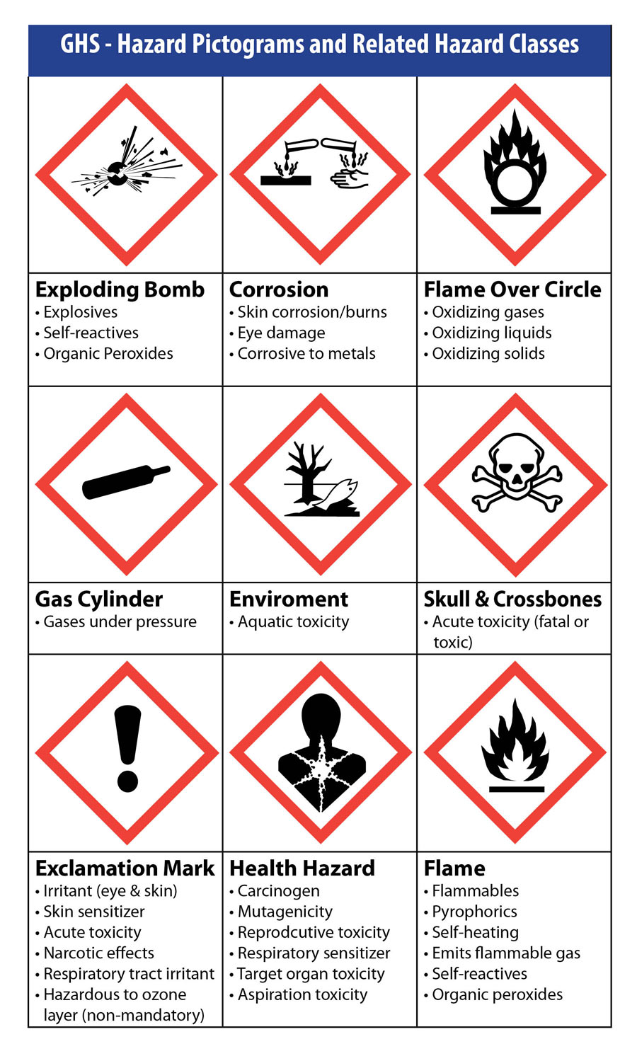
GHS
Over the next three years WHMIS is receiving an overhaul through GHS
  Additional symbols
  New classes of hazards
  Global harmonization
Additional training will be provided

Slide 29
WHMIS
Employee “right-to-know” legislation
  Education regarding WHMIS system
  Education regarding hazards of specific chemicals that are used under normal conditions
  Chemicals must be labelled
  MSDS must be readily available
Three parts
  System education
  Implementation
  Role-specific training

Slide 30
MSDS

Slide 31
Material Safety Data Sheets (MSDS)
In addition to labeling in a laboratory, the next most important type of communication regarding hazards is the MSDS.
This will communicate the information necessary regarding various hazards associated with chemicals and biological agents.

Slide 32
Reading the MSDS
Comparison of MSDS headings in WHMIS legislation and other standards (ANSI, GHS)
WHMIS (Canadian) |  | ANSI / GHS
Item | Heading suggested in CPR schedule | Section | Heading
1 | Hazardous Ingredients | 1 | Product and Company Identification
2 | Preparation Information | 2 | Hazards Identification
3 | Product Information | 3 | Composition/Information on Ingredients
4 | Physical Data | 4 | First Aid Measures
5 | Fire or Explosion Hazard | 5 | Fire Fighting Measures
6 | Reactivity Data | 6 | Accidental Release Measures
7 | Toxicological Properties | 7 | Handling and Storage
8 | Preventive Measures | 8 | Exposure Controls/Personal Protection
9 | First Aid Measures | 9 | Physical and Chemical Properties
 |  | 10 | Stability and Reactivity
 |  | 11 | Toxicological Information
 |  | 12 | Ecological Information
 |  | 13 | Disposal Considerations
 |  | 14 | Transport Information
 |  | 15 | Regulatory Information
 |  | 16 | Other Information
MSDS are broken down into sections
Canadian WHIMS dictates 9 sections
International standard is 16

Slide 33
Laboratory Information
Why is an MSDS important? When you know characteristics about a substance it can aid in precautionary measure to take when using it
Also, if there is a spill either on a surface or on your skin, the MSDS can supply you with the response measures

Slide 34
MSDS
The MSDS to every chemical in your lab must be available to you
It may be in a notebook or available over the internet
Make sure you find the location of the MSDSs in your room

Slide 35
MSDS Recommendation
Read the relevant portions of the MSDS for every chemical you use at least once
  e.g., PPE, handling precautions, physical properties (flash point)
  This is a small investment that can protect you
There may be protection, storage, or first aid requirements that you or your supervisor are unaware of
  Methanol-can absorb through skin
  Can cause liver and kidney disorders

Slide 36
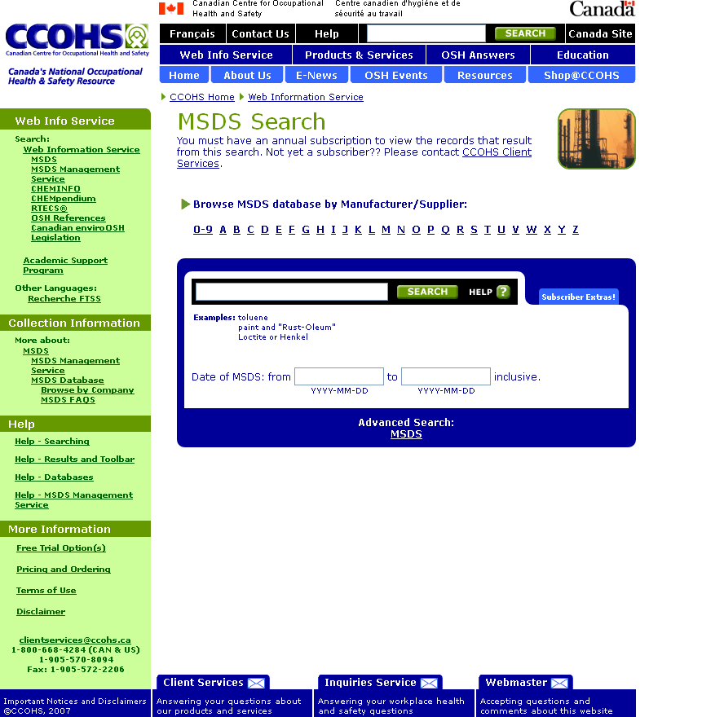
MSDS at UNBC
There is a link from the Chemstores website to searchable MSDS database maintained by the Canadian Centre for Occupational Health and Safety

Slide 37
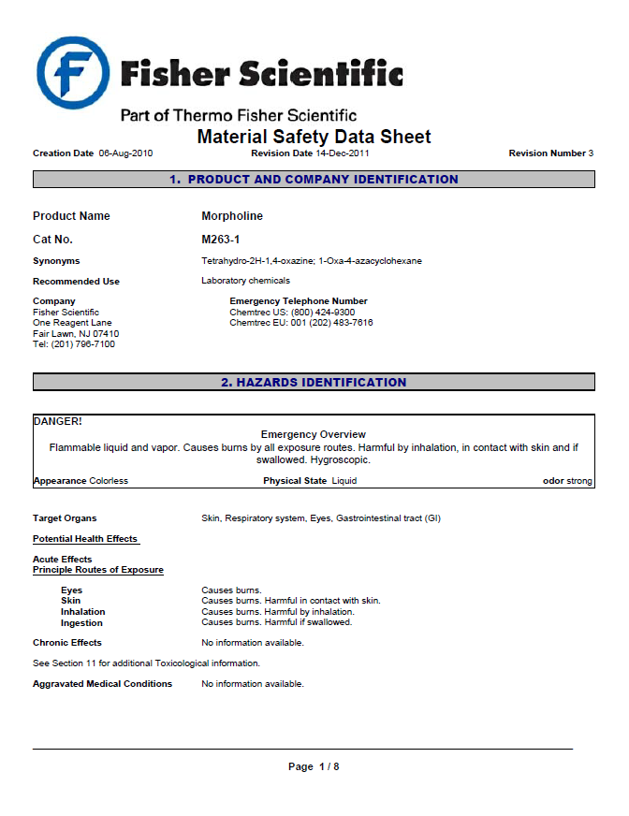
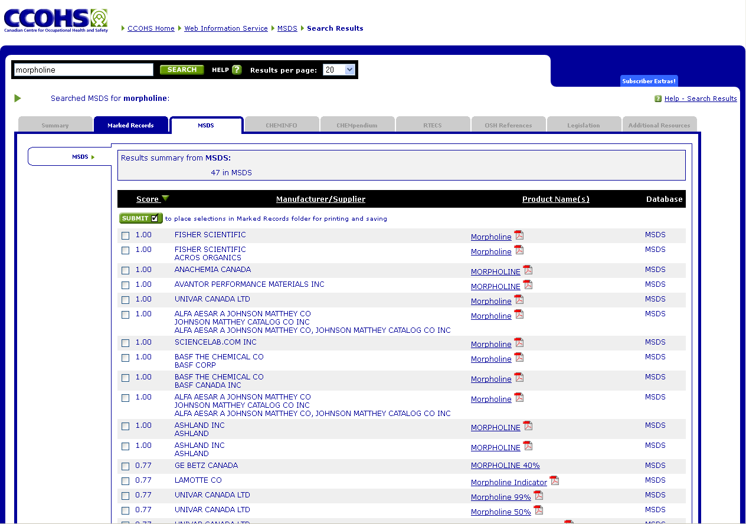
Sample MSDS

Slide 38

Chemical Inventory

Slide 39
Inventory
Fire response plan
  Used by fire department during pre-incident planning and during incident response
WorkSafeBC requirement
  Inventory and MSDS must available
Fire Code
  Maximum volumes allowed in a room (1500L)
Encourages use of materials already on campus

Slide 40
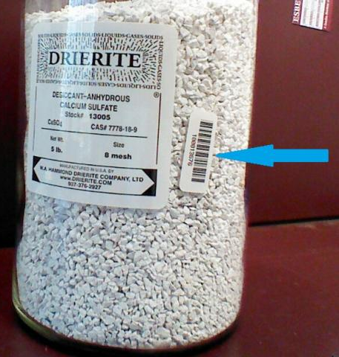
UNBC Chemical Inventory
Barcodes are placed on chemicals when they arrive
The chemical is entered into the Vertere chemical inventory
Vertere is used to generate all
documents

Slide 41
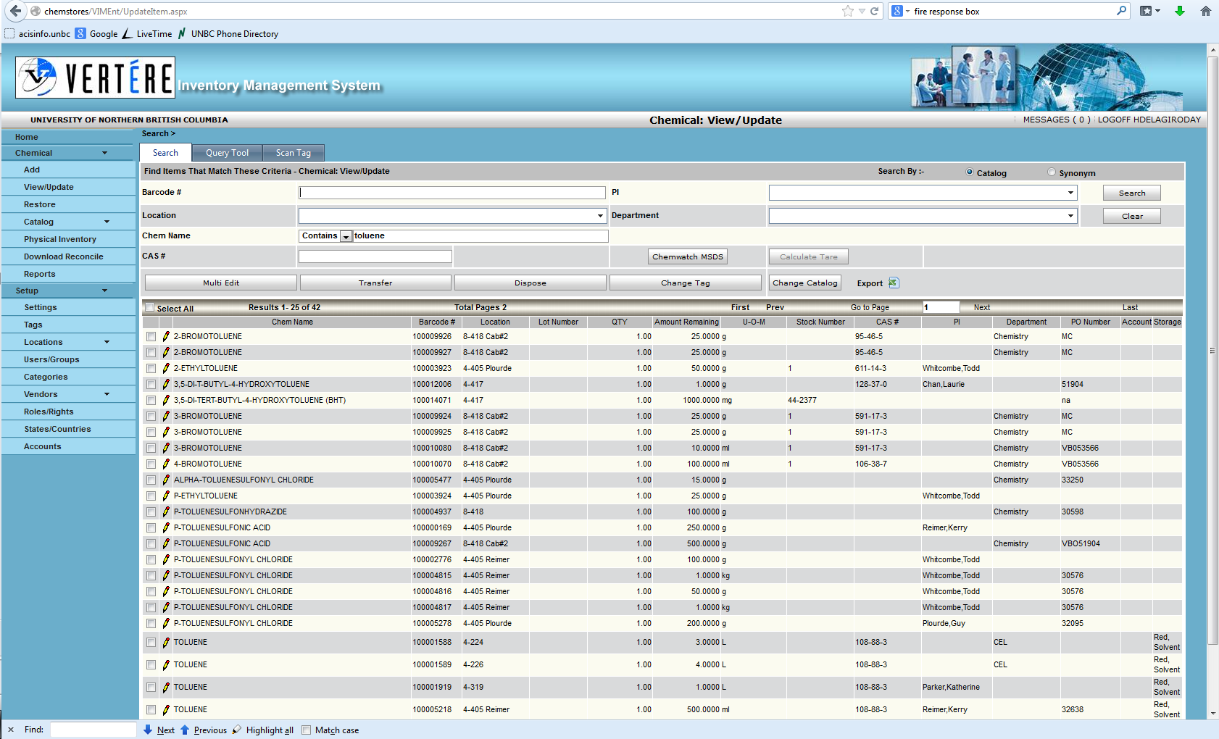

Slide 42
Vertere Inventory
Consumed chemicals
  Email the number to the Dispensing Chemist
  Deface the barcode
Physical inventory is performed
every year

Slide 43
Personal Protective Equipment

Slide 44
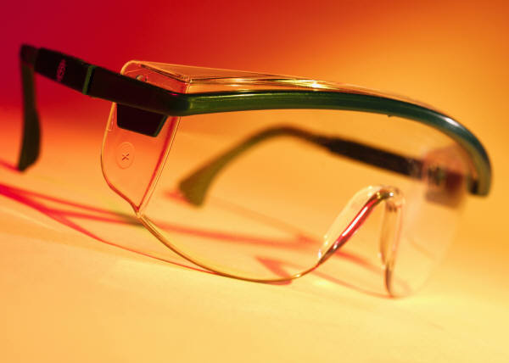
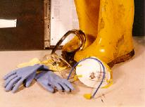
PPE
Acronym for personal protective equipment
This is the equipment that is necessary to protect yourself from hazardous materials

Slide 45
Chemicals & PPE
When chemicals are being used there is always the possibility of a spill
The proper PPE to use when chemicals are involved would include:
  Eye/face protection: safety glasses, goggles, face shield
  Hand protection (Gloves): nitrile, rubber, latex, PVC
  Body: lab jacket, apron
  Lungs: respirator, fume hood

Slide 46
Protection Is Variable
Gloves are variably permeable to chemicals
  Duration of contact, chemical, concentration, pH, carrier solvents, potential for cuts, abrasiveness, and quantity
Safety glasses, goggles, faceshield
  Chemical, quantity, height, pressurized system, and environment
Respirator
  Chemical, particulate/aerosol size, exposure duration, and environment

Slide 47
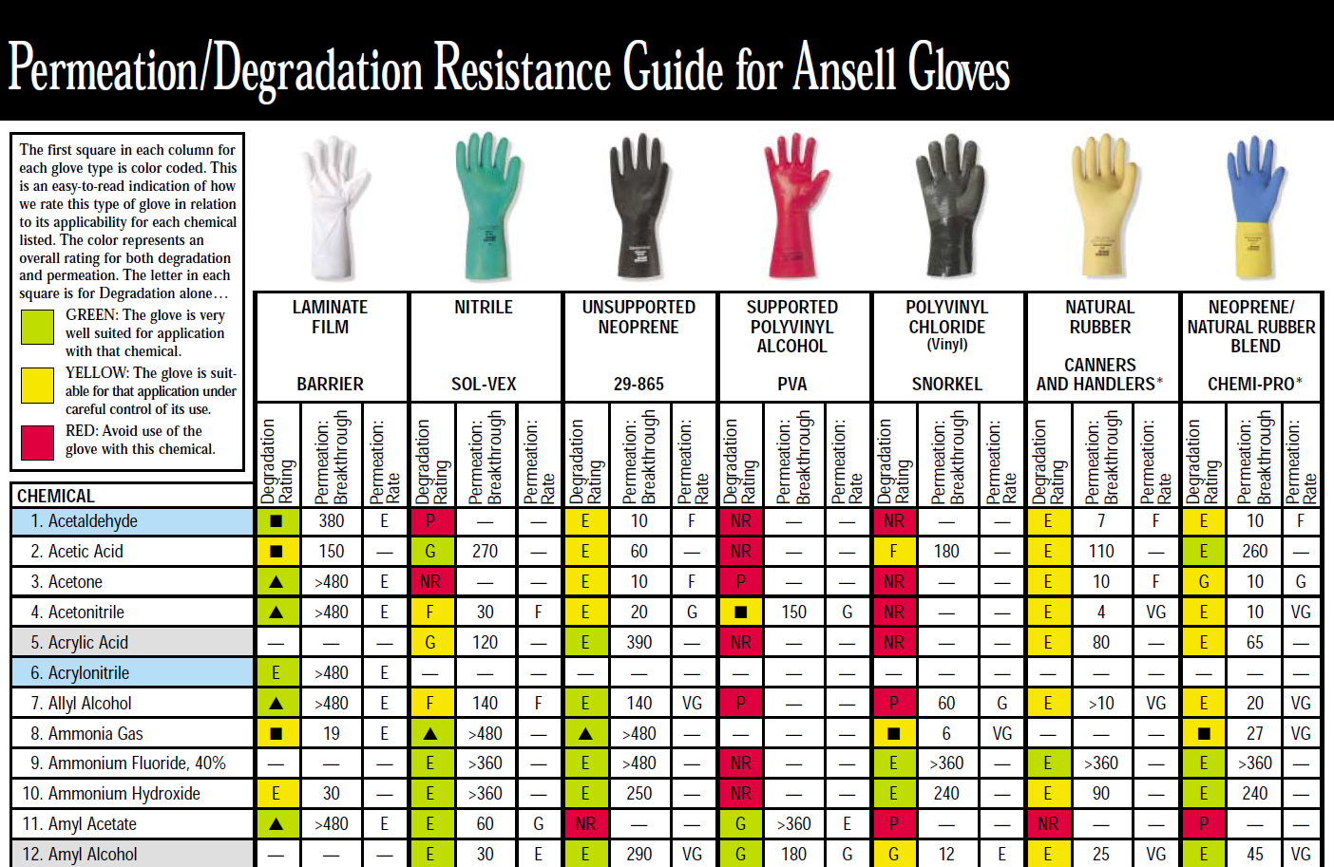
Protection Is Variable
More information is often needed to select PPE
  Glove selection table, TWA

Slide 48
Use of PPE
Knowing how to properly use PPE can be the key to adequate protection.
Not only do you want to make sure it is the proper size for you, but also make sure you are wearing it properly.
  e.g., fit tests are required for respirators
Let your supervisor know if you need a different size.
  PPE is relatively cheap compared to other items in a lab or the cost of an injury
  Poorly sized PPE does not get used as often

Slide 49
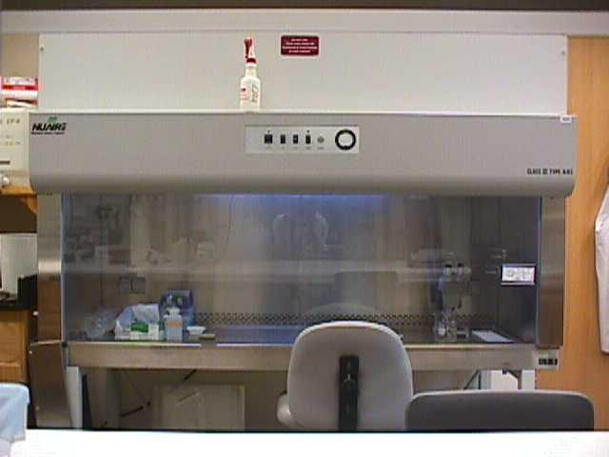
Fume Hoods and BSCs

Slide 50
Engineering Controls
Let’s look at the following barriers:
Fume hood
Biological Safety Cabinet (BSC)

Slide 51
Fume Hood
The fume hood is used with chemicals
The main function is to exhaust the vapors, aerosols, and gases to the atmosphere
The hood is designed to minimize your exposure to airborne contaminants
  This is not to be used with biohazardous materials due to insufficient filtration/treatment

Slide 52
Fume Hood Use
Ensure the exhaust blower is operating and air is entering the hood
Remember, do not put your face inside the hood!
Minimize storage of chemicals or other items in the hood
Clean spills immediately
Work with the sash at the proper operating level as indicated by the arrows
  Check it everyday

Slide 53
Things to Think About
Avoid obstructing airflow
Avoid placing lightweight items in the hood that can be drawn into the exhaust system
  Paper towels
  Pieces of styrofoam
Fumehoods do not function during power outages
  Work cannot continue

Slide 54
Fume Hoods
When not in use, containers should be capped
Fume hoods should be turned off when not in use, unless this poses a clear hazard
  Fume hoods are massive energy consumers
    They vent heated/filtered/cooled air directly to the environment
  Close hood, flick switch, and hit alarm silence button
  If additional hazard is created (e.g., heavy winds move air through ducts) leave it on

Slide 55
Biological Safety Cabinet
The biological safety cabinet (BSC) is used as a containment for infectious agents
  Uses HEPA filter to filter exhausted air
high efficiency particulate air filter is able to remove particles at a size of 0.3 um with a minimum efficiency of 99.97%
There are several designs of BSC
  Filter and recirculate air
  Filter and exhaust air

Slide 56
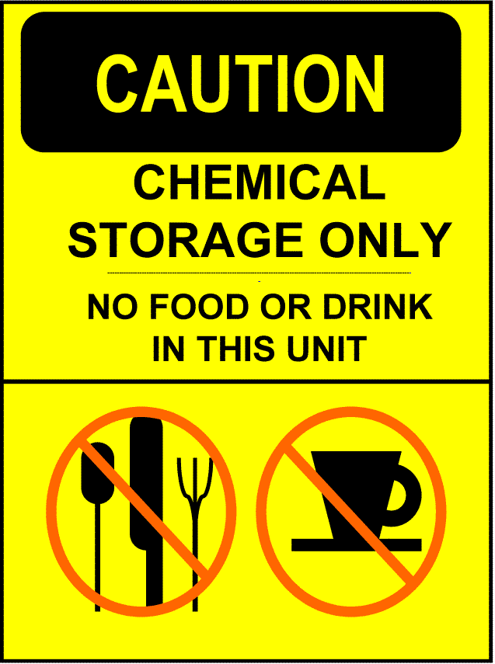


Signs

Slide 57
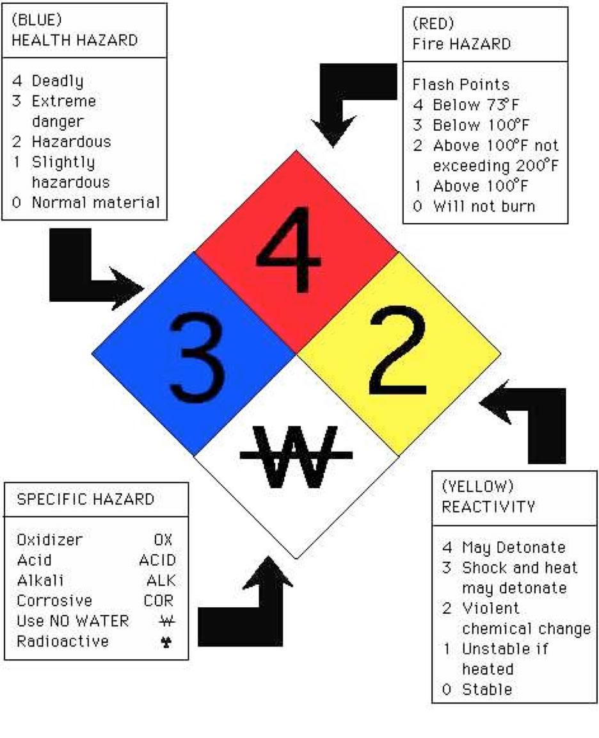
NFPA Hazard Signs
NFPA hazard signs are located on every lab door
Guides first responders
Highly recommended that a protective equipment worn at all times for rating 2 and up

Slide 58

Spills and Accidents

Slide 59
Most Major Accidents Are Preceded by Close Calls
Remember that most major accidents are highly predictable
  Close calls
  Smaller incidents

Slide 60
Spill Classification
No-hazard
  Does not represent a substantial hazard if cleaned immediately
  Can be cleaned with common cleaning materials
Low-hazard (Low-hazard Spill Form must be submitted)
  Requires contents of spill kit
  Requires support from janitorial to clean
Hazardous (Must be reported to Safety Officer)
  Represents serious hazard to personnel, environment, or facility due to location, chemical properties, quantity, or situation
  Requires additional personnel or equipment for clean up
  Eye wash or safety shower used or contaminated

Slide 61
SOP
Spills and accidents can pose a serious health and safety threat
Standard Operating Procedures should be available for spills
General Example
  Identify all hazards
  Inform others
  Refer to the MSDS
  Collect PPE
  Clean spill
  Decontaminate area

Slide 62
Aerosols
When a spill occurs, an aerosol can be created which can make the material several times more potent as a inhalation hazard
Allow sufficient time for the aerosol to settle before entering the room

Slide 63
Spill Kits
There is a spill kit in your lab, find its location
Basic Spill Kit
  Absorbants/neutralizers
  Bag
  Marker
  Gloves
  Scraper or broom
  Eye protection

Slide 64
Clean Up Tips
Always clean work from the outside inwards to avoid spreading contamination
    Add neutralizing absorbents slowly—neutralization reactions can be extremely exothermic
Move contaminated items onto a disposable bench cover, clean the surface, then clean the items and place them back on the surface

Slide 65
Emergency Situation
Focus on mitigating damage:
  People are number one priority
  Environment
  Equipment
Contact Security
Refer to MSDS sheets (they should be easily accessible)
  They will inform your response

Slide 66
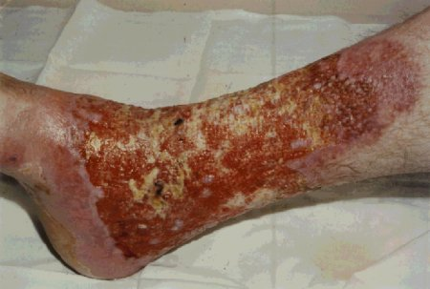
How to Report
When a hazardous spill occurs, it must be reported to your supervisor
If a spill kit is accessed, a low-hazard spill report form must be filled out
All injuries that are a result of a spill must be reported to Dispensing Chemist (250-960-6472) and Risk & Safety Coordinator (250-960-5530)

Slide 67
Waste Management

Slide 68
Waste
Hazardous and biohazardous wastes have special guidelines for proper disposal
It is important to properly dispose of waste to ensure human and environmental health
Necessary for regulatory compliance

Slide 69
Non-hazardous Waste
Normal disposal, unless it will cause undue concern
  e.g., looks dangerous or disconcerting

Slide 70
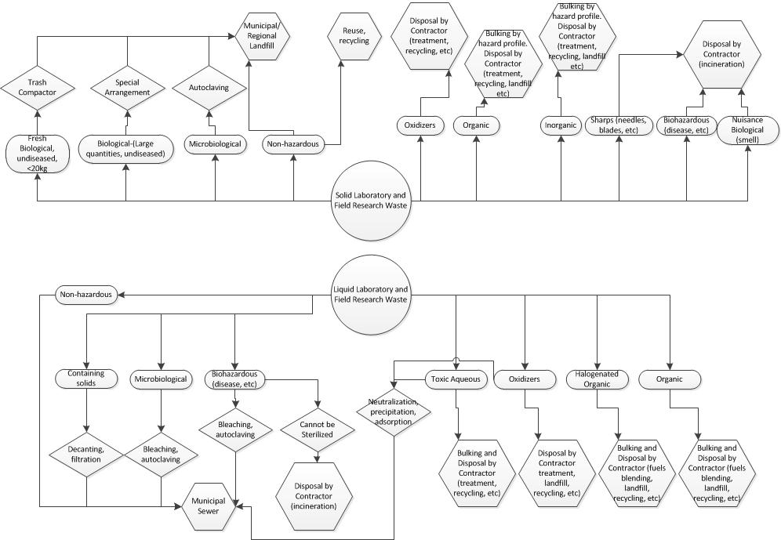
UNBC Waste Streams

Slide 71
Waste
Hazardous Waste- This is a waste which contains the characteristics of being any of the following:
  Toxic (human or environment)
  Corrosive
  Ignitable
  Flammable
  Oxidizer

Slide 72
Hazardous Waste
Neutralized to non-hazardous waste, when possible
Disposed of through Clean Harbors
  Incineration, stabilization, land fill, recycling
Stored in secure, well-ventilated areas

Slide 73
Liquid Waste
UNBC has 4 liquid hazardous chemical waste streams
  Toxic aqueous
  Organic
  Organic halogenated
  Oxidizer

Slide 74
Liquid Waste
Important to check for compatibility before adding
  Some wastes will react
  Check MSDS for incompatibilities
Extremely toxic wastes should be kept separate
It is possible to contaminate waste
  e.g., add 1 drop of methyl mercury to 4 L of acetone/hexanes extraction waste. Now it is 4 L of mercury waste

Slide 75
Liquid Waste
Guidelines
  Wastes must be compatible (should not be reacting)
  Waste bottles must be tagged
    Waste type
    Date started
    Date Finished
    All contents indicated with volume added or % by volume of the container
    Laboratory (PI, SLI, room)
  Should not be overfilled
  Waste bottles must be replaced every year

Slide 76
Waste
Note: Hazardous Waste disposal can be extremely expensive and hazardous
  Unlabeled containers
  Highly reactive substances (organic peroxides)
  Incorrectly labeled containers
  Complex solutions
  Old containers
    Some reactions occur slowly, making old containers less predictable

Slide 77
Solid Waste and Contaminated Items
Place in a sealed plastic bag, bucket, or glass container
  Label with chemical content
  Lab name/number
  Date

Slide 78
Biohazardous Waste
A biohazardous waste is any waste that is considered infectious and/or because of its biological nature it can cause physical or health hazards in humans, animals, plants or the environment.
This includes recombinant DNA and other genetically altered organisms and agents.
Biological waste is not necessarily biohazardous.

Slide 79
Biological Waste
Non-putrefying, undiseased/poisonous animal/plant tissues
  Less than 5lbs
    Drain excess liquid, place in a sealed plastic bag
    Mark name and date
    Place in a cardboard box labeled waste
    Dispose via normal garbage
  Less than 20lbs
    Same, except dispose into compactor

Slide 80
Biohazardous Waste
Waste that is considered potentially biohazardous can be disposed of in regular trash if it has been rendered non-infectious/non-hazardous
  e.g., Autoclave or bleach, if applicable
Biohazardous waste is disposed of in the biomedical waste buckets
  Red—Tissue, samples (shipped to Delta for incineration)
  Yellow—Materials contaminated with biohazardous waste (shipped to delta for commercial autoclaving)

Slide 81
Hazardous Wastes
All hazardous wastes must be brought to the Dispensing Chemist

Slide 82
What is a Sharp?

Slide 83
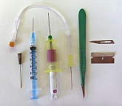
What is a “Sharp”?
A sharp is defined as any instrument, tool, or item that has rigid, acute edges, protuberances or corners capable of cutting, piercing, ripping or puncturing
  e.g., syringes, blades, jagged metal, and broken glass
Items that have the potential for becoming sharps are considered sharps
http://www.ehrs.upenn.edu/training/bloodborne/bloodborne.html

Slide 84
Safe Practices
When using a sharp there is a risk of being cut by the object and possible poisoning/infection occurring
  Sharps injuries are very serious
    Unkowns associated with injuries (contaminated wounds)
    UNBC personnel have been injured by careless disposal
    Treatments associated with “sticks” are expensive, intensive, and unpleasant
Special precautions are used for hypodermic needles to avoid a needlestick
  Do not recap, place directly in the sharps container

Slide 85
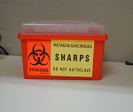
Disposal of Sharps
All sharps must be placed into a rigid, puncture and leak-resistant container that is also impervious to moisture
The sharps container must be labeled either with “Biohazard” or “Infectious Waste”
  If there is additional contamination, a separate container may be necessary
Do not put other items in or overfill sharps containers

Slide 86
Disposal of Sharps Containers
When the sharps container is full it must be taken to Chemstores
If there is a large amount, the Dispensing Chemist (250-960-6472) will come and pick it up
There must be a chain of custody with all waste

Slide 87





Gases

Slide 88
Gases
Gases are physical and health hazards
  Compressed gas containers can become powerful, dangerous projectiles if the vessel is compromised
The vented gas may be an asphyxiant, oxidizer, flammable, corrosive, or toxin
  Oxidizer and flammable may be an explosive combination

Slide 89
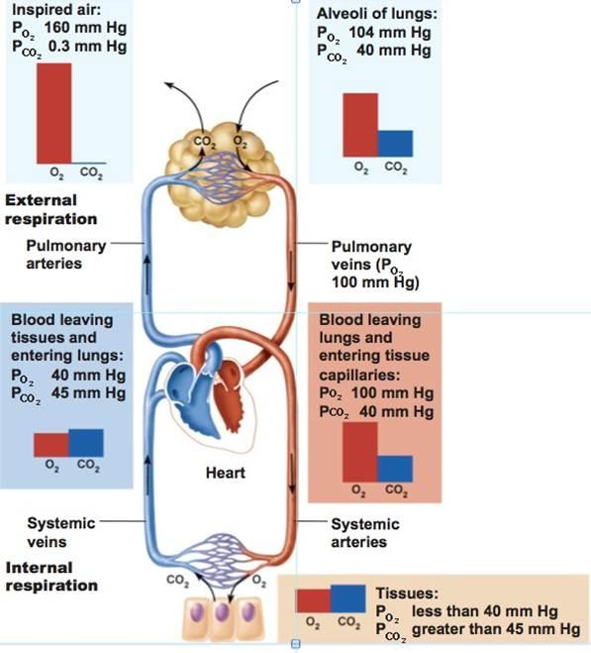
Atmospheric Displacement Asphyxiation
Venting of compressed gas or evaporation of cryogenic liquids displaces atmospheric
Oxygen deficient atmosphere can result in rapid loss of consciousness (1-2 breaths or 5-9 seconds)
Notes:
Respiration of oxygen deficient gases results in loss of internal oxygen reserves as oxygen diffuses out of the blood along the concentration gradient.

Slide 90
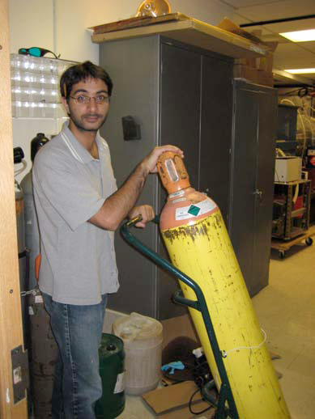
Compressed Gases
  They should be stored with a secure, approved strap or chain
  Always keep covers on compressed gas cylinders when not in use
  To move gas cylinders secure the cylinder in the tank dolly using the strap and make sure the cap is fastened

Slide 91
Regulators on Gas Cylinders
Connecting a pressurized cylinder to a closed system can overpressurize the closed system resulting in injury or equipment damage
Always make sure the regulator is completely closed before opening the tank valve and then slowly open the regulator to a safe pressure
Know the safe operating pressure of the system you are using

Slide 92
Cryogenic Liquids
Hazards
  Asphyxiation
  Freezing damage
  Overpressure bursting of vessels
  Generating liquid oxygen (oxidizer)
Liquid | Expansion Ratio (from BP to 21C) | Boiling Point
Nitrogen | 696 | -195.8ºC
Argon | 841 | -185.9ºC
Helium | 754 | -268.9ºC
Neon | 1445 | -246.1ºC
Oxygen | 860.5 | -183 ºC

Slide 93
Cryogenic Liquids
Small spaces with poor air exchange are dangerous
  Do not allow others to ride in elevator while transporting (use buddy system if possible)
  Do not transport inside vehicle passenger compartment
  Ensure that substantial air exchange occurs before going near a spill
Evacuate people away from spills
Wear appropriate PPE (pants, closed shoes, face shield, insulated gloves)

Slide 94
Accountability/Discipline
Supervisor is responsible for your conduct in the lab
The CSO, BSO, and RSC will talk to you if you are doing something unsafe
You will be asked to leave the laboratory if you are in breach of UNBC policies/procedures
  Your supervisor will be contacted
  If there are repeated offences, the issue will be brought to the Lab Safety Committee and the Dean of the College

