Slide 1
University of Northern British Columbia DC Pension Plan AGMmber
May 10, 2016
RYAN LANG

Slide 2
TABLE of
contents
Plan details
Plan Financials
Fund asset mix
Number of funds used by members
100% of assets in 1 fund
Asset allocation by age
Call centre & mysunlife.ca reporting
Call centre benchmarking
mySunlife.ca benchmarking
Sun Life Innovations and Communications
2
SUN LIFE FINANCIAL

Slide 3
Plan financials
DCPP
Transactions type | January 1, 2014 to December 31, 2014 | January 1, 2015 to December 31, 2015 | % change
Opening balance | $62,668,278.12 | $71,896,905.56
Contributions | $5,462,629.81 | $5,232,483.95 | (4.2%)
Lump sums / transfers in | $87,604.66 | $14,484.96
Withdrawals | ($282,879.08) | ($166,384.10)
Deaths / terminations / transfers / annuities | ($2,654,925.32) | ($7,062,750.30)
+ / - | $6,616,197.37 | $1,828,055.98
Closing balance | $71,896,905.56 | $71,742,796.05
Average assets per member | $102,563.35 | $101,046.19 | (1.5%)
Average contribution per member | $7,792.62 | $7,369.70 | (5.4%)
Member count | 701 | 710
3
PLAN DETAILS
Notes:
Updated

Slide 4
Fund asset miX
DCPP
Top 5 funds by total assets
Fund Name | Month-end closing balance | % of investment
CC&L GROUP INCOME&GROWTH | $9,750,986.00 | 13.6%
CC&L GROUP CDN Q GROWTH | $9,543,264.08 | 13.3%
PH&N BOND FUND | $7,110,838.90 | 9.9%
B.G. BALANCED FUND | $6,905,860.85 | 9.6%
HEXAVEST WORLD FUND | $5,940,574.60 | 8.3%
4
PLAN DETAILS
Notes:
Updated

Slide 5
Fund asset miX
DCPP
Asset Class/Fund | 62354 - DCPP December 31, 2015 closing balance | % of investment | Individual member count
Balanced | $20,733,967.79 | 28.9%
B.G. BALANCED FUND | $6,905,860.85 | 9.6% | 287
CC&L GROUP INCOME&GROWTH | $9,750,986.00 | 13.6% | 203
CI SIG INCOME & GROWTH | $3,370,965.30 | 4.7% | 132
MFS RESPONSIBLE BALANCED | $706,155.64 | 1.0% | 33
Canadian Equity | $18,194,828.72 | 25.4%
B.G. CANADIAN EQUITY | $2,539,258.29 | 3.5% | 130
B.G. SMALL CAP FUND | $4,531,803.34 | 6.3% | 168
BLK S&P/TSX COMP INDEX | $1,580,503.01 | 2.2% | 99
CC&L GROUP CDN Q GROWTH | $9,543,264.08 | 13.3% | 228
Fixed Income | $10,909,508.30 | 15.2%
BLK BOND INDEX FUND | $3,798,669.40 | 5.3% | 159
PH&N BOND FUND | $7,110,838.90 | 9.9% | 207
Foreign Equity | $13,711,850.26 | 19.1%
BG AMERICAN EQUITY | $2,194,784.38 | 3.1% | 123
BLK EAFE EQUITY INDEX | $101,023.67 | 0.1% | 16
BLK US EQUITY INDEX | $2,236,928.25 | 3.1% | 105
CI AMERICAN VALUE FUND | $2,595,570.84 | 3.6% | 114
FIERA INTERNATIONAL EQ | $336,272.60 | 0.5% | 21
HEXAVEST WORLD FUND | $5,940,574.60 | 8.3% | 224
TDAM GLOBAL EQUITY INDEX | $306,695.92 | 0.4% | 13
Guaranteed/Money Market | $8,192,640.98 | 11.4%
SLA 1YR GUARANTEED FUND | $872,659.05 | 1.2% | 21
SLA 3YR GUARANTEED FUND | $994,730.05 | 1.4% | 30
SLA 5YR GUARANTEED FUND | $1,169,145.72 | 1.6% | 36
SLF MONEY MARKET | $5,156,106.16 | 7.2% | 179
Grand Total | $71,742,796.05 | 100.0%
5
PLAN DETAILS
Notes:
Updated

Slide 6
Number of funds used by members
Dcpp – 710 members
6
PLAN DETAILS
Notes:
Updated

Slide 7
100% of assets in one fund
Dcpp – 259 members
7
PLAN DETAILS
Notes:
Updated

Slide 8
Asset allocation by age
 | <30 | 30-39 | 40-49 | 50-59 | >60 | Total
Total assets | $564,099.38 | $4,414,506.77 | $17,682,325.50 | $33,016,716.51 | $16,065,147.89 | $71,742,796.05
% of total assets | 0.8% | 6.2% | 24.6% | 46.0% | 22.4% | 100.0%
# of members | 44 | 130 | 227 | 224 | 85 | 710
Average Assets | $12,820.44 | $33,957.74 | $77,895.71 | $147,396.06 | $189,001.74 | $101,046.19
8
PLAN DETAILS
Notes:
Updated

Slide 9
Call centre
benchmarking
Customer Care Centre activity | YTD 2014 | YTD 2015
Account Information | 27 | 28
Administrative Requests | 13 | 9
Internet | 49 | 29
Plan Information | 38 | 38
Tax | 3 | 5
Transactions | 33 | 27
Unique Members: | 142 | 105
9
CALL CENTRE & WEB REPORTING
Notes:
updated

Slide 10
Mysunlife.ca
benchmarking
mysunlife.ca activity | YTD 2014 | YTD 2015
Browse | 220 | 240
Help | 6 | 3
Information | 237 | 208
My Money Tools | 180 | 106
My Plan | 60 | 56
Newsstand | 68 | 55
Requests | 171 | 121
Webcast | 5 | 8
Unique Members: | 277 | 280
10
CALL CENTRE & WEB REPORTING
Notes:
updated

Slide 11
Regulatory news
Contribution limits
Effective January 1, 2016 contribution limits are as follows:
Plan type | Dollar limit for 2016
Defined Contribution Pension Plan (DCPP) | $26,010
Deferred Profit Sharing Plan (DPSP) | $13,005
Registered Retirement Savings Plan (RRSP) | $25,370
Tax Free Savings Account (TFSA) | $5,500
Note: Yearly Maximum Pensionable Earnings (YMPE) for 2016 is $54,900
11

Slide 12
Member Website Innovation
sunlife.ca refresh
Simplified, customer-centric navigation
Campaign and brand messaging integrated into page design
Interactive content to engage visitors at different life stages
Editorial pillars: Health, Money, Planning
Action Centre to clearly identify items members need to act upon
Simplified access to detailed balance information
Improved representation and tracking of retirement goal, target retirement income
12

Slide 13
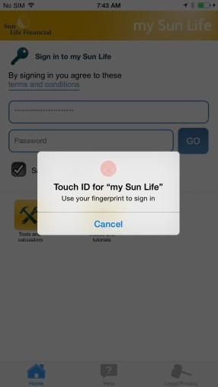
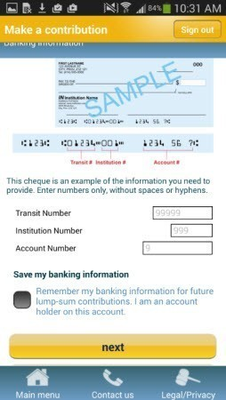
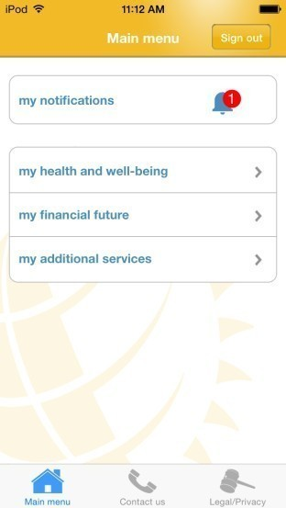
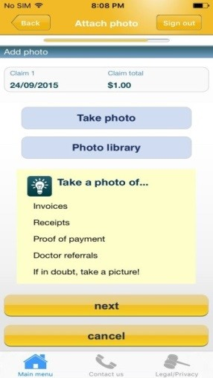
Mobile Innovations
Overview of my Sun Life Mobile
Apple Touch ID fingerprint recognition technology is being enabled for my Sun Life Mobile
Touch ID is voluntary; members have to opt in to use this feature
Some exciting features of the app for Apple and Android users include:
Save my banking information – members who make a contribution can save their banking information for future contributions
my notifications – a message centre shows targeted messages relevant to the member
13
Notes:
With 52% of traffic in mobile, on average, the mobile device can be the primary device within the household
On average 1.5M Canadians will only leverage mobile in a given month
Screen sizes on phones are getting bigger while desktops are getting smaller
Mobile screens have grown from 2.49” to 4.86” (2007 to 2014)
88% increase
Laptop screens have reduced in size by 10% (2010 – 2013)
First internet usage globally @ 37hrs / month – comscore 2014
Mobile traffic represents 52% but is tracking to surpassing desktop
Lump sum contribution statitics (as at August 31, 2015):
Highest transaction amounts: $25,000
Average contribution amount: $2,500
14% of transactions were $10,000 or greater
Primary mobile users: 18-40 years

Slide 14
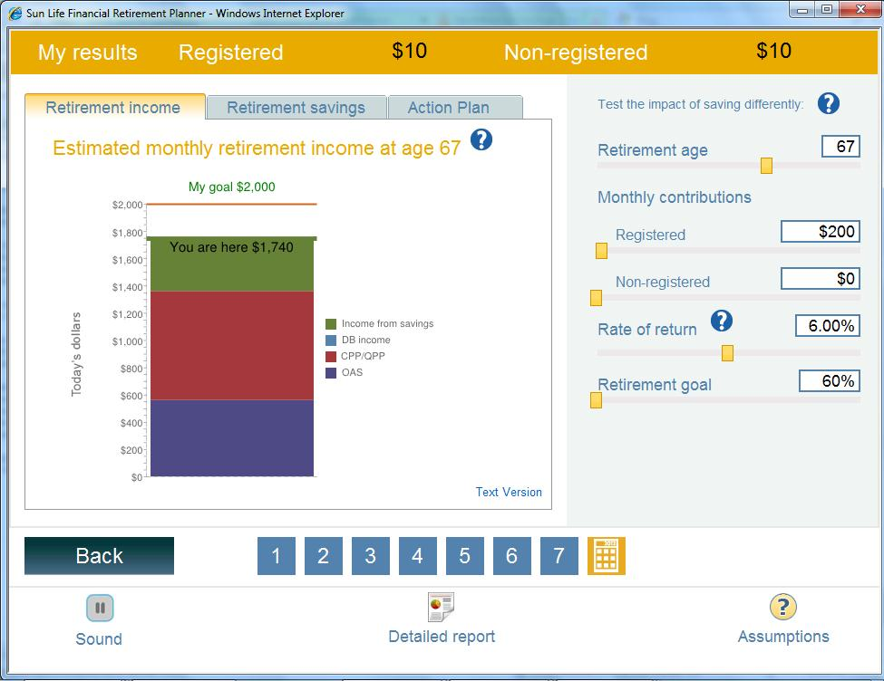
Process Innovation
Retirement planner enhancements
Monthly retirement income estimates now available on the Retirement planner:
Retirement income tab provides clearer picture of what members will have to live on at retirement, based on:
The member’s savings and contribution levels
Additional information entered by the member into the tool
Estimates of CPP/QPP and OAS payments
As members change the information in the tool, the results will change on the Retirement income tab
14

Slide 15
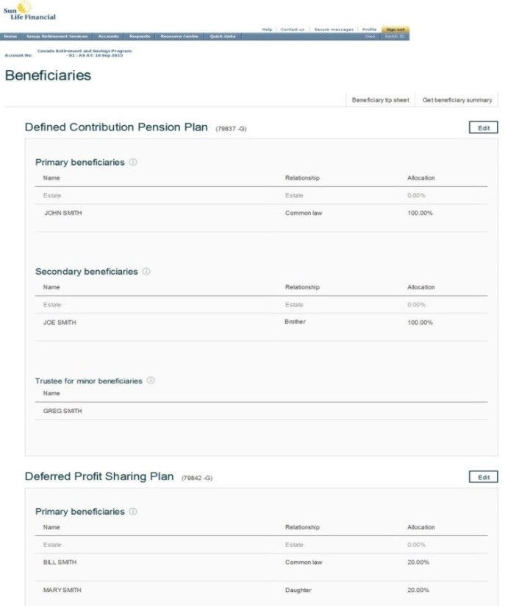
Process Innovation
E-beneficiary designations on mysunlife.ca
In November 2015, we made the following change to sunlife.ca:
Members can designate their beneficiary for each product they are enrolled in on sunlife.ca
Beneficiary designation updated immediately
Paper forms still accepted – available through Customer Care Centre.
How to access:
My Financial Centre > Quick Links > Beneficiary Info
15

Slide 16
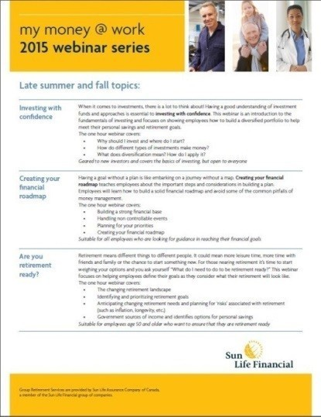
my money @ work
my money @ work webinar series
Topic / Description | Month
Connect with your money Members can learn how easy it is to manage their workplace retirement savings plan with the tools and services available online through mysunlife.ca. Target audience: Suitable for all members looking to get the most out of their workplace retirement savings plan. | March – December 2016
Creating your financial roadmap Members can learn how to build a solid financial plan and avoid some of the common pitfalls of money management. Target audience: Suitable for all members. | March/ June/ December 2016
It’s my time to retire Members will be encouraged to define and prioritize retirement goals to see what their retirement may look like. Target audience: Perfect for those who are three to five years away from retirement. | April/ October 2016
Investing with confidence – the basics An introduction to the fundamentals of investing to show members how to build a diversified portfolio to help meet their retirement and savings goals. Target audience: Perfect for the novice investor, but open to everyone.. | May 2016
Investing with confidence - advanced Understanding key concepts in investing including details around understanding value, growth, GARP and more. Target audience: Perfect for the more sophisticated investor, but open to everyone.. | July/ September 2016
16

Slide 17
THANK YOU

