Slide 1


Interprofessional Team
Education & Service Deep Dive

Slide 2
Principle Investigators
Shannon Zwiers, RN
Christine Platsko
Cyndi Noseworthy
No conflict of interest disclosures; all employees of Northern Health

Slide 3
Presentation Overview
Problem & Aim Statement
Alignment with Organizational and Provincial Strategic Priorities & Initiatives
Background & Context
Quesnel Prototype
Outcomes/Measurements
Results and Learnings from the Pilot
Next Steps
Conclusion

Slide 4
Problem & Aim Statement
Problem Statement
Known gaps related to focused IPT training, education, and shared understanding of how to implement the IPT Standardized Orientation Curriculum are negatively impacting the quality and provision of IPT services and staff wellbeing, with potential further impact to long-term staff retention.
Aim/Scope
The primary objective of this work is to reduce staff and leadership anxiety and confusion, allowing a greater focus on prioritizing the training and education needs of the IPT, relevant to the current gaps, strengths and, importantly, the demands for their services.
Notes:
At the tail end of COVID, Quesnel Leadership brought a problem to our attention and requested assistance to create a visual representation of the education held by their team.

Slide 5
Alignment with Strategic Priorities & Initiatives
Provincial Human Health Resource Strategy:
  Retain: Foster healthy, safe and inspired workplaces, supporting workforce health and wellness
  Redesign: Balance workloads and staffing levels to optimize quality of care by optimizing scope of practice, expanding and enhancing team-based care
  Recruit: Attract and onboard workers
  Train: Strengthening employer supported training models; support staff to advance the skills and qualifications
Northern Health’s 2023-2024 Strategic Initiatives
  Create and support strong, sustainable teams tailored to the services required
Notes:
PCN Refresh information In previous years and service plans, there have been a lot of initiatives handed down from leadership to frontline staff with direction on what they need to do to help the organization achieve the goals and objectives of those initiatives. Often, the “what’s in it for me” is not clearly visible to the people who do the heavy lifting to help realize those goals and objectives for the organization.
The messaging we are delivering to frontline staff with this project, in alignment with fresh, new organizational and provincial priorities around workforce retention, is that, as a frontline staff member, “You are the initiative. The work you do on this initiative comes directly back to you and your team, increasing your own and your team’s growth, wellness and feelings of safety in your roles and in your work environment.”
Susan: Language around focus and beneficiary

Slide 6
Background & Context
Primary Care services have transitioned greatly over the last decade
Required changes in practice for staff providing client care
IPT Standardized Orientation Curriculum developed
Notes:
Quesnel brought this issue to light, but not just a Quesnel issue, is an issue felt in all IPTs across the NI and NH.
To give some Background & Context around how this problem has manifested, we need to first look at how primary care services have changed over the last decade:
Where we once had very siloed professional teams providing very focussed areas of care within their designations, we now have Interprofessional teams with many designations learning to work together to provide collaborative and much more generalized care using a Team Based care approach
With that transition to IPTs, we have also seen other changes, such as consistent growth in volume of clients and clients with increasingly complex care needs
Has required staff to expand and broaden their knowledge bases and skillsets to work much closer to the top of their scopes
In turn, has created a need for increased education and training
To meet this need, the Education & Training team developed a wonderful tool for all IPT staff – the IPT SOC, a Learning Hub based curriculum containing all courses needed to provide any kind of IPT service.
However, the IPT SOC contains a vast amount of education - ~2-3 years of solid training. Without a proper introduction to the curriculum, it can be very overwhelming for staff who have to balance time for education with the need to continue service provision to heavy client panels. We have often heard “I don’t know where to start” “What do I prioritize?”
The roll out of this education started with a virtual presentation to IPT Leadership, and then soon after that, COVID struck, and the messaging and education for frontline staff around use of this tool did not reach its intended audience – the frontline staff.
The result, as you can imagine, has been a confused and frustrated staff who continue to feel overwhelmed with the unfamiliar tool, and stressed while continuing to rely on the less than ideal “Just in Time” learning to provide services they feel less confident and competent with. Consequently, we continue to see gaps in education among the IPTs.

Slide 7
Quesnel Prototype
Project scoping (stakeholders, scope, schedules, deliverables)
Administer Survey
Deliver orientation session
Administer Survey
Data Analysis & Report Development
Handover & Sustainment

Slide 8
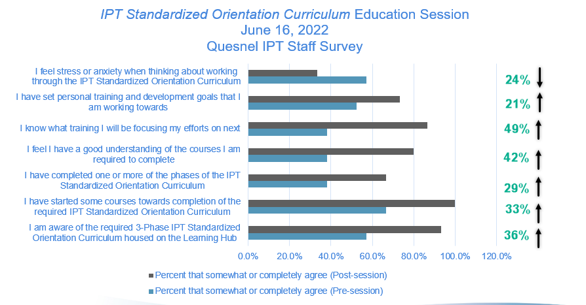
Outcomes & Measurements
Intervention: 1-Hour IPT SOC Information Session for each designation grouping
Goal: Increase IPT SOC Registration Goal: Increase awareness & understanding, reduce stress & anxiety
Notes:
One of the goals of the project was to increase IPT staff registration in the IPT SOC. Leadership had a target of 90% enrolment, and as you can see, by 1-week post info session, they had 95% team enrolment.
Additionally, with the application of the 7-question survey, we hoped to learn whether the content delivered in the session was beneficial to staff, specifically in areas of increasing awareness and understanding of the curriculum and reducing stress and anxiety around working with the curriculum. The results of that survey were significant, and proved the session to be highly beneficial to the staff, as we’ll show you in the next slides

Slide 9
Outcomes & Measurements
36%
Notes:
1. Improved overall awareness of the IPT SOC by 36%

Slide 10
Outcomes & Measurements
33%
Notes:
2. Improved staff’s awareness that they had actually already started completing curriculum courses by 33%

Slide 11
Outcomes & Measurements
29%
Notes:
3. Saw an increase in staff’s feeling that they had completed one or more entire phases by 29%

Slide 12
Outcomes & Measurements
42%
Notes:
4. Improved staff’s understanding of the required courses for their IPT role by 42%

Slide 13
Outcomes & Measurements
49%
Notes:
5. Improved staff’s knowledge of education they will focus on next by 49%

Slide 14
Outcomes & Measurements**
21%
Notes:
6. Improved staff’s setting of personal learning goals by 21%

Slide 15
Outcomes & Measurements
24%
Notes:
7. Reduced staff’s feelings of stress or anxiety around working in the IPT SOC by 24%

Slide 16
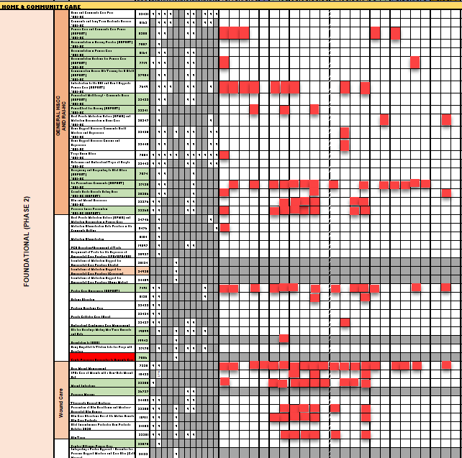
Results & Learnings
Notes:
The very robust analysis and comparison we did of Quesnel’s Education & the trending demand for their Services offered lots of opportunities for learning.
It provided opportunity to:
To identify gaps and strengths in education related to the demand for services. For example, as you can see by the first bar graph, frequency of services provided was by far the highest in the service category of Home & Community Care. In the second image, we see a snippet of the education and training report, with H&CC specific foundational courses listed downward in rows, and individual staff course completion listed across in columns. Completed courses are shown by the red squares.
When we look at the education held across the team in that service area, we can see:
Some solid course completion in particular foundational courses and decent foundational course completion as a team,
Lots of opportunity still to increase knowledge in this area, individually and as a team. Lots of courses that no one on team has completed.
Even more opportunity to broaden skillsets when we look at the intermediate and advanced course options, which have a much lower completion rate.
To reduce staff confusion further by collaborating with Ed. & Trng team to align all course resources
To see the need for changes in data collection that would allow for a more robust picture of the training & experience held by the team. While the IPT Training Dashboard showed us the formal training taken by staff through learning hub, it missed the experience gained through other forms, such as at-the-elbow training and mentorship opportunities –something that many of our more experienced long-term staff relied on long before Learning Hub came to be. Early CAPE tool completion, as self-assessment by staff of their competence and confidence in the curriculum learning objectives, would help provide that better picture in future.

Slide 17
Outcomes & Measurements
Skills/Service Category | Then | Now | Difference
Basic Onboarding (Required) | 769 | 857 | +88
General Skills | 236 | 251 | +15
Population & Public Health Specific | 138 | 143 | +5
Mental Health Specific | 89 | 108 | +19
Home & Community Care/ Care Coordination Specific | 223 | 273 | +50
Chronic Disease Specific | 13 | 28 | +15*
Allied Health Clinical Skills | 0 | 0 | N/A
COURSE TOTALS | 1468 | 1660 | +192
Notes:
In addition to increasing registration in the IPT SOC and knowledge and understanding of the available education resources,
We also hoped to increase overall education within the IPT staff and identify and close education gaps.
As you can see by the numbers on this slide, there is an evident increase in education over the last year within Quesnel’s IPTs.
Additionally, the reports that were developed for this project helped Quesnel’s leadership to identify specific education gaps within their teams:
Focus on Basic Onboarding and Accreditation/Required course completion (88)
Focus on course completion in the highest service demand areas (H&CC, most demand by far, with 50)
Focus on service area where not one fully trained IPT staff member for that area (*Chronic Disease Service Area – a relatively small but comprehensive education package in the curriculum compared to other areas, very focussed learning – last year, had a few courses completed here and there across all staff, increased by 15, not only have they doubled their course completion in that area, but also by one fully trained staff member in this service area as all courses were taken by one person, a big deal to the team because previously had a dedicated CDM team that was being dissolved and absorbed by IPT, creating an immediate need for knowledge in that service area for IPT).

Slide 18
Next steps:
IPT Standardized Orientation Curriculum Info Sessions
  Provided virtually or in-person across the NI in May, 2023 (22 Sessions, 96 participants)
Readiness Assessments
Schedule building
Modifications & Streamlining
Notes:
Not including session held in Quesnel last year with large attendance.

Slide 19


Conclusion
“We’re now using the dashboard and training tools to help identify areas our team is lacking. One of our new nurses, with the help of the Clinical Mentor and the new tools, identified a course she was interested in that no one on the team had taken yet. We approved that request, as it would benefit both the individual and the team.”
“We’ve already started using the CAPE tool and curriculum to train new staff and to make sure all staff are not missing important pieces of training.”
“Our staff are now more aware of courses they need to take. Just the other day, some of our nurses were working together as a team to complete a difficult required course that we were able to let them know they were missing.”
Notes:
Shift in federal and provincial governments to the need for factual data to show demand and service provision/team capacity
Loop back to original purpose –
Increasing workforce retention
Reducing turnover of staff through:
Increased staff understanding of their IPT role and scope
Guided educational opportunities that match client panel demand
Utilization of team strengths & planned actions to close team gaps in education
TBC approach for increased staff competence, comfort and safety in their IPT role

Slide 20
Questions?
Shannon Zwiers – Shannon.Zwiers@northernhealth.ca
Susan Schienbein Susan.Schienbein@northernhealth.ca

