Slide 1
Reducing Early Childhood Caries Through Preventative Dental Hygiene Care in Rural First Nations Communities
By Amanda Wagman, Dip. DH, BDSc, DHP (C)
Dental Hygiene Practitioner

Slide 2
Acknowledgement of Traditional Territories
I respectfully acknowledge the traditional, ancestral, and unceded territory of the Tsmimshian people and the traditional keepers of their land. I want to say thank you allowing me to live, work, and play on your land, also known as Prince Rupert.
We are gathered here today on the UNBC Prince George campus, which is situated on the traditional, ancestral, and unceded territory of the Lheidli T’enneh First Nation, part of the Dakelh (Carrier) people’s territory.

Slide 3
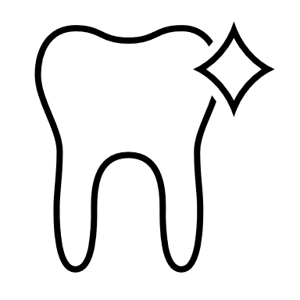
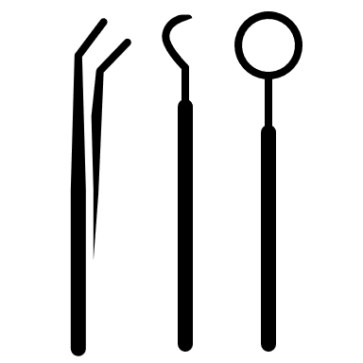
Do You Speak Dentales?

Slide 4
Tooth Decay
Cavity
Caries
Decay
Carious Lesion(s)
Notes:
Quick mention that all these terms are interchangeable with one another, and dental professionals use them synonymously.

Slide 5
Early Childhood Caries (ECC)
“The presence of one or more decayed, missing (due to caries), or filled tooth surface in any primary tooth in a pre-school-age child, i.e., between birth and 71 months of age.”
*Birth to 6 years old.
Source: The Canadian Dental Association (CDA)
Notes:
Canadian Dental Association definition of Early Childhood Caries.
Canadian Dental Association (cda-adc.ca)

Slide 6
Early Childhood Caries (ECC)
“Nursing Caries”
“Baby Bottle Syndrome”
“Bottle Mouth Syndrome”
“Rampant Caries”
Notes:
The term and case definition of “Early Childhood Caries” was adopted in 1998. Previously, it was known as “Nursing Caries, Rampant Caries, Baby Bottle Syndrome, Bottle Mouth Caries.”
The Burden of Early Childhood Caries in Canadian Children and Associated Risk Factors - PMC (nih.gov)
Nursing Bottle Caries | Boston Children's Hospital (childrenshospital.org)

Slide 7
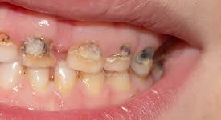
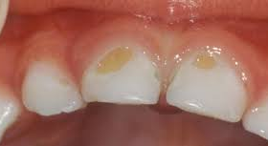
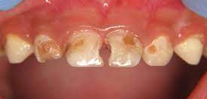
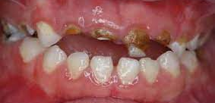
Notes:
Photos of ECC.

Slide 8
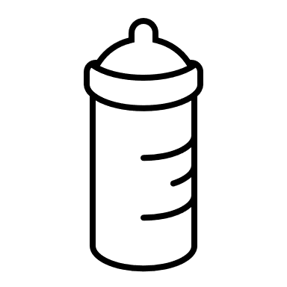
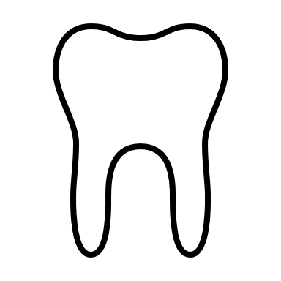
Bottle To Fall Asleep
Acquired Streptococcus mutans
Carbohydrates
ECC
Integrity of Enamel
Not brushing 2x/day
No Fluoride Toothpaste
Notes:
ECC is the most common chronic disease in children in the world. It is also preventable.

Slide 9
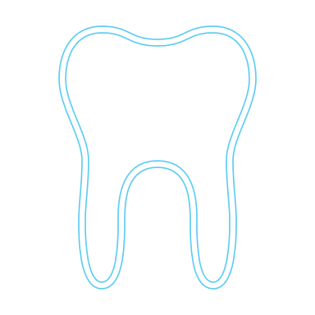
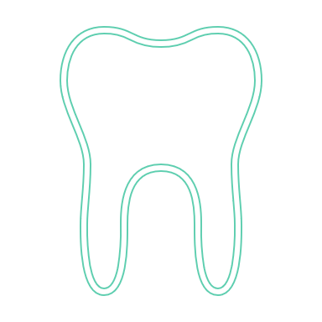
Dental Therapist
(5)
Dentist
Dental Hygienist
Certified Dental Assistant
*FNHA
Notes:
Dental therapists are trained to take X-rays, provide hygiene services, give local anesthetics, provide simple direct restorations, place stainless-steel crowns and extract teeth. They provide more extensive services than dental hygienists and perform some of the services traditionally provided by dentists.
There are five dental therapists working for the First Nations Health Authority (FNHA). The number of positions may increase to a maximum of 25 if the FNHA, the Ministry of Health and BCCOHP agree that an increase is appropriate.
Most dental therapists in Canada completed a formal education program at the National School of Dental Therapy in Prince Albert, Saskatchewan. This program lost its federal funding in 2011 and has since been discontinued.

Slide 10
Caries Rates in Northern Health
2018/2019 Provincial Dental Health Survey Report
NH: -highest rate of screened kids at 96.1% -lowest rate of cavity-free kids at 59.8% -highest rate of restorations at 21.9% -highest rate of visible decay at 18.4%
NW HSDA: -lowest rate of cavity-free kids at 55.0% (consistently lowest ranked since 2006/2007survey) -highest rate of restorations at 24.8% -tied for highest rate of visible decay at 20.2%

Slide 11
ECC remains a globally prevalent chronic disease despite general improvements in access to dental care and improvements to dental treatment. (2)
The pervasiveness of ECC among Indigenous communities can be attributed to both socio-economic and systemic inequalities. (1)
Holve et al. suggested interventions such as fluoride treatment, oral health education, application of sealants, and other community-based strategies to reduce the prevalence of ECC and improve the overall oral health of Indigenous communities. (3)
Geographically isolated areas exhibit significant levels of dental disease and lack the means to access oral health care; means such as financial capacity, transportation, oral health knowledge, and availability of services. (2,4,5)
In 2011, the only dental therapist school in Canada was closed, and an estimated 25% of the three hundred licensed dental therapists in the country are eligible to retire by 2020. (1,6, 7)
Notes:
1. Report 4 - oral health programs for First Nations and Inuit - Health Canada [Internet]. Ottawa: Office of the Auditor General of Canada; 2017 [cited 2021 Mar 17]. Available from: https://tinyurl.com/2uejn2dk
Holve S, Braun P, Irvine JD, Nadeau K. Early childhood caries in Indigenous communities. Pediatrics [Internet]. 2021 Jun [cited 2023 Jun 17];147(6). Available from: https://tinyurl.com/2p8hf3mp
3. Kyoon-Achan G, Schroth RJ, DeMare D, Sturym M, Edwards JM, Sanguins J, et al. First Nations and Metis peoples’ access and equity challenges with early childhood oral health: a qualitative study. Int J Equity Health [Internet]. 2021 Jun [cited 2023 Jun 17];20(134). Available from: https://tinyurl.com/475vz3cr
4. Mathu-Muju K, Kong X, Brancato C, McLeod J, Bush HM. Utilization of community health workers in Canada’s children’s oral health initiative for Indigenous communities. Community Dent Oral Epidemiol [Internet]. 2018 Apr [cited 2023 Jun 17];46(2):185-193. Available from: https://tinyurl.com/yckjcnfv\
5. Vashishtha V, Kote S, Basavaraj P, Singla A, Pandita, Malhi RK. Reach the unreached - a systematic review on mobile dental units. J Clin Diagn Res [Internet]. 2014 Aug [cited 2023 Jun 17];8(8): ZE05-08. Available from: https://tinyurl.com/3t6267bd
6. Oral health care teams in Canada [Internet]. Ottawa: Canadian Dental Association; [date unknown] [cited 2022 Mar 17]. Available from: https://tinyurl.com/35spm4yd
7.Leck V, Randall GE. The rise and fall of dental therapy in Canada: a policy analysis and assessment of equity of access to oral health care for Inuit and First Nations communities. Int J Equity Health [Internet]. 2017 Jul [cited 2022 Mar 17];16(131). Available from: https://tinyurl.com/f3fwa9rb

Slide 12
Rural Indigenous communities present with higher rates of Early Childhood Caries (ECC) and oral diseases compared to the general population. (1,2,3)
Some of the barriers to accessing oral health care are due to a lack of health care providers in the area, geographical distances, difficulty scheduling appointments, cost of care, decreased oral health knowledge, and food insecurity.(3,4,5)
Additionally, Indigenous Peoples have suffered immense discrimination and stigmatization throughout history, and this ongoing issue has resulted in this population straying away from oral health providers. (1)
Mistrust of oral health care providers. (3,4)
This has resulted in poor oral health, which negatively impacts the overall health and development of the community. (4)
Notes:
1. Sheikh H. CAEP dental care statement. CJEM [Internet]. 2020 [cited 2023 Jun 17];22(1):36-39. Available from: https://tinyurl.com/yyravhbr
2. Kyoon-Achan G, Schroth RJ, DeMare D, Sturym M, Edwards JM, Sanguins J, et al. First Nations and Metis peoples’ access and equity challenges with early childhood oral health: a qualitative study. Int J Equity Health [Internet]. 2021 Jun [cited 2023 Jun 17];20(134). Available from: https://tinyurl.com/475vz3cr
3. Holve S, Braun P, Irvine JD, Nadeau K. Early childhood caries in Indigenous communities. Pediatrics [Internet]. 2021 Jun [cited 2023 Jun 17];147(6). Available from: https://tinyurl.com/2p8hf3mp
4. Mathu-Muju K, Kong X, Brancato C, McLeod J, Bush HM. Utilization of community health workers in Canada’s children’s oral health initiative for Indigenous communities. Community Dent Oral Epidemiol [Internet]. 2018 Apr [cited 2023 Jun 17];46(2):185-193. Available from: https://tinyurl.com/yckjcnfv\
5. Vashishtha V, Kote S, Basavaraj P, Singla A, Pandita, Malhi RK. Reach the unreached - a systematic review on mobile dental units. J Clin Diagn Res [Internet]. 2014 Aug [cited 2023 Jun 17];8(8): ZE05-08. Available from: https://tinyurl.com/3t6267bd

Slide 13
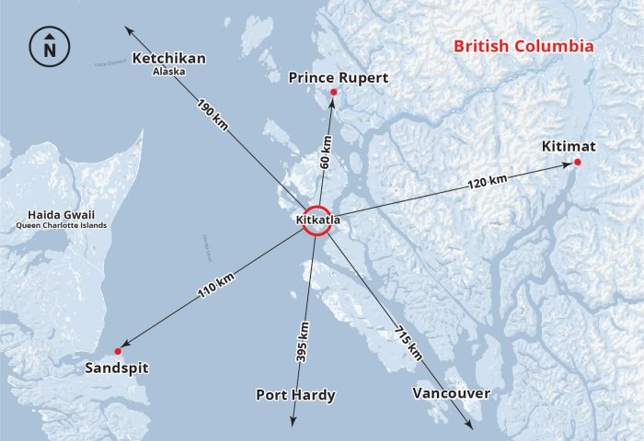
Gitxaala Nation Kitkatla
Concerns with oral health for the children:
High rates of ECC
Food served at school breakfast program
Notes:
https://gitxaalanation.com/
-Home to 450 citizens, 2094 total registered population
-High rates of ECC
-Brighter Smiles and Dr. Cam Robson travel to community to restore/extract teeth
-

Slide 14
The Working Plan: Preventative Dental Hygiene Program
Visit every 3 months for dental screenings, Fl applications
Education for parents/guardians and children
Establish a toothbrushing program at school after breakfast
Ongoing learning and evaluation of prevention program
Notes:
Collaboration through First Nations community members, Health Directors, teachers, DHP, Team Leads of Northern Health. Engagement came via an invitation from the preschool teacher in Kitkatla. Baseline oral screening data will be collected on all children 0-6 years of age and be collated with data obtained from dentists who travel to Kitkatla. A preschool and elementary school toothbrushing program will be established in addition to fluoride varnish applications four times per year.

Slide 15
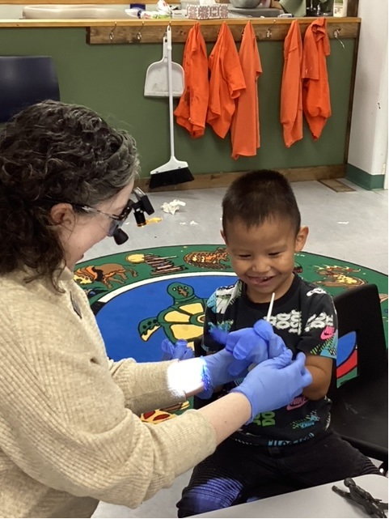
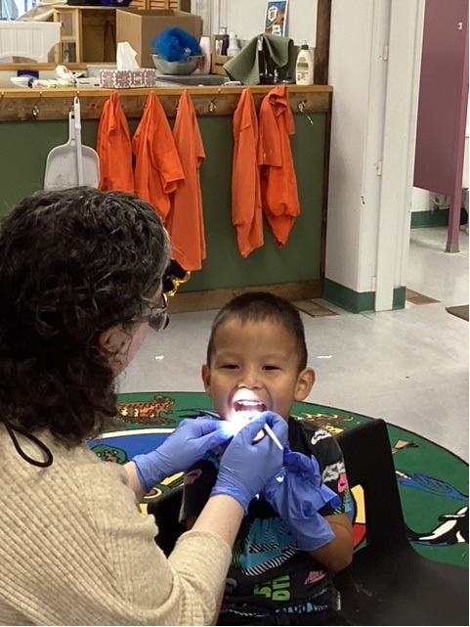
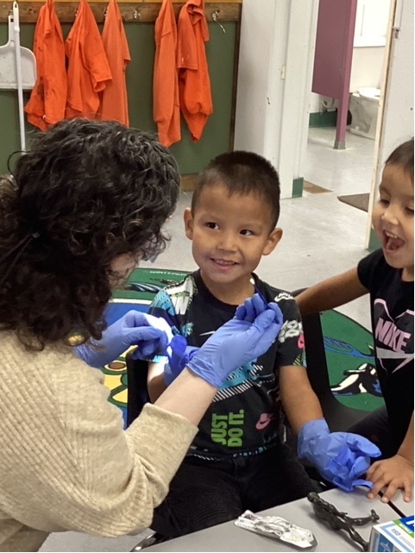
Notes:
Photo consent was obtained from children’s mom, Dease Lake October 2023.

Slide 16
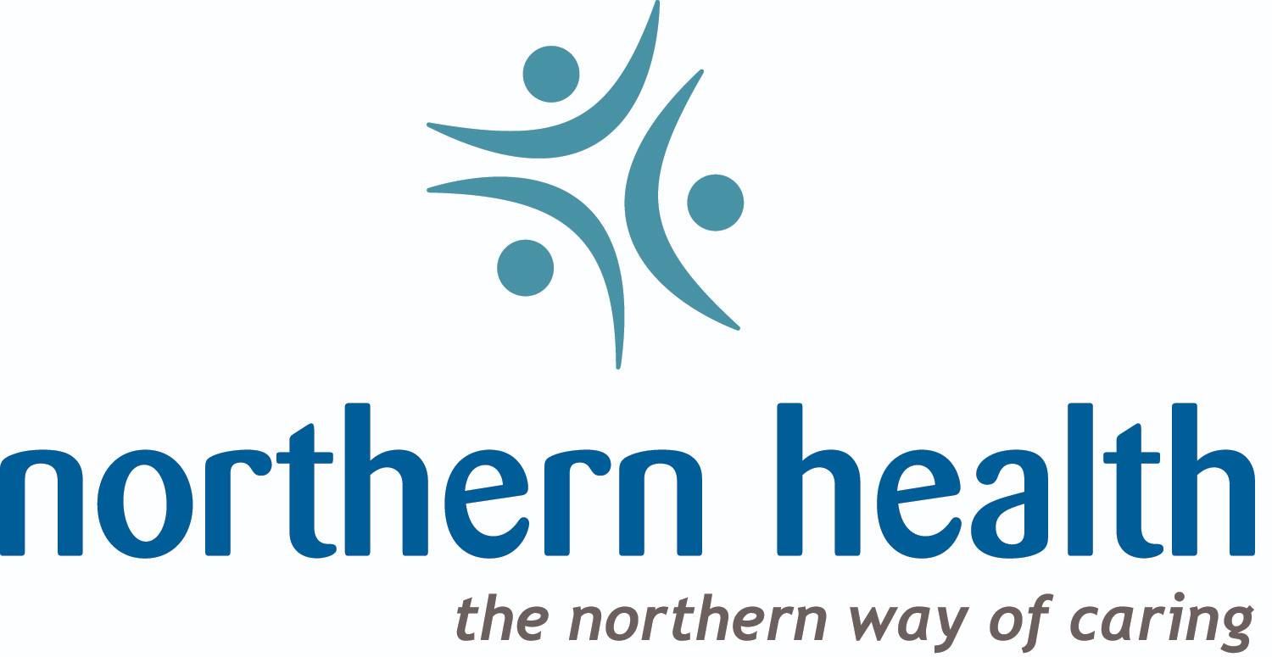
Northern Health Public Health Practice
Population and Public Health
Regional Manager:
Lara Frederick, MN, RN (C)
NW HSDA
NI HSDA
NE HSDA
Team Lead
Administrative Support
Dental Hygienists
Certified Dental Assistant
Team Lead
Administrative Support
Dental Hygienists
Team Lead
Administrative Support
Dental Hygienists
Regional Dental Lead
As a team, we offer a variety of programs, such as dental screenings, fluoride varnish applications, Seal In A Smile, Emergency Outreach Dental Clinic, and soon to be implemented Silver Diamine Fluoride!

Slide 17
Thank you!
We are a dynamic, educated, and continually evolving team of experienced clinicians who are always looking for ways to reach the people we serve in our communities

