Slide 1
BCRS Education Day Northern Health Peer Learning Rounds
Dr. Shyr Chui
Department of Medical Imaging, UHNBC
Notes:
Land acknowledgement

Slide 2
Disclosures
None

Slide 3
Case study – Patient B.A.J.
55 yo female with DM
Referred by ophthalmologist
Headaches
Unilateral right eye optic nerve edema on optometry eye exam
Outpatient CT brain and orbits requested
Received 26th May 2023

Slide 4
Case study – Patient B.A.J.
CT request received by UHNBC MI dept May 26th 2023
Protocolled by radiologist C-/+ Brain and orbits
Coded P1
Outpatient study performed May 26th 2023

Slide 5
Case study – Patient B.A.J.
CT
Single volume brain and orbits pre and post
4mm slices
Post contrast scan repeated due to eye movement
Report – “normal brain and orbits”

Slide 6
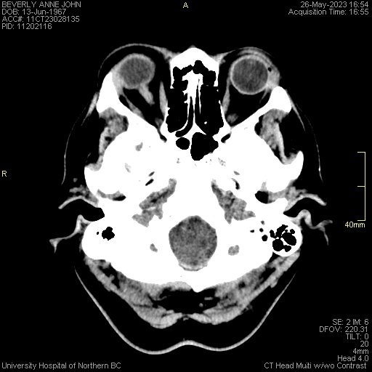
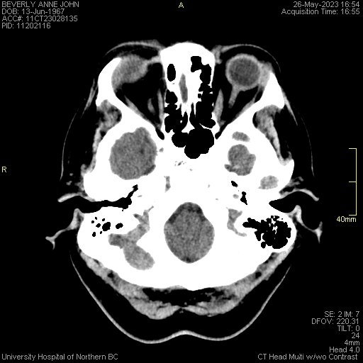
CT Brain and Orbits - patient B.A.J.
Pre-contrast

Slide 7
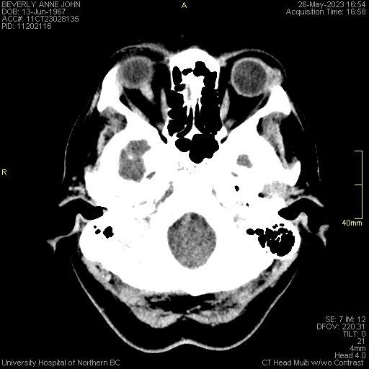
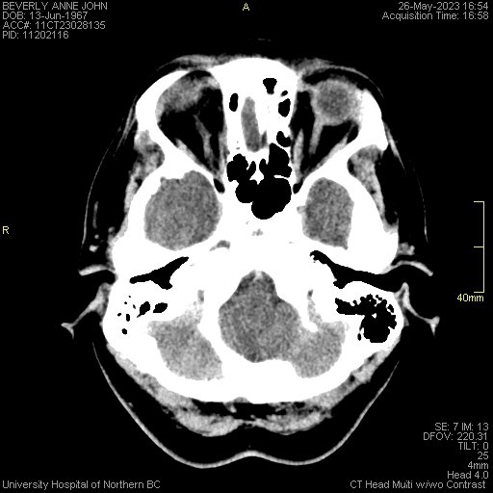
CT Brain and Orbits - patient B.A.J.
Post-contrast

Slide 8
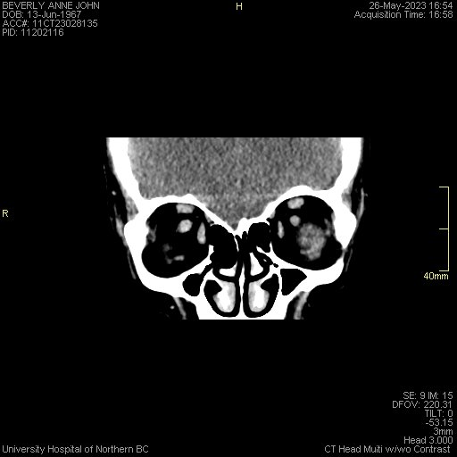
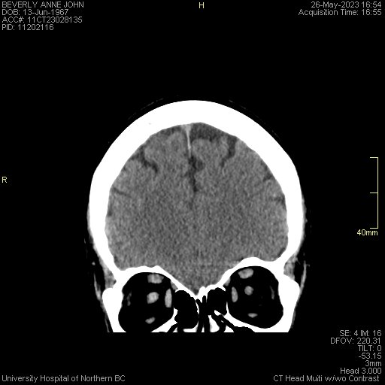
CT Brain and Orbits - patient B.A.J.
Pre-contrast

Slide 9
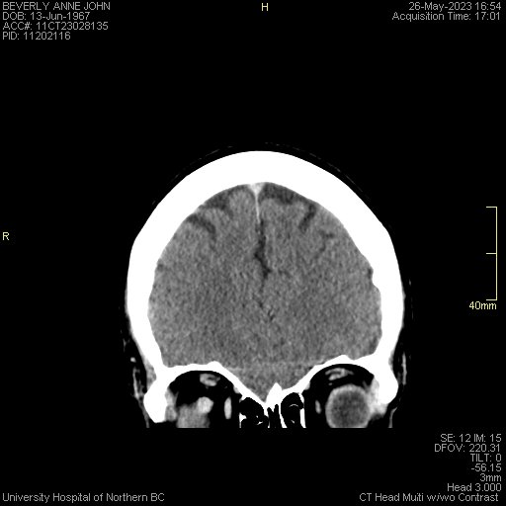
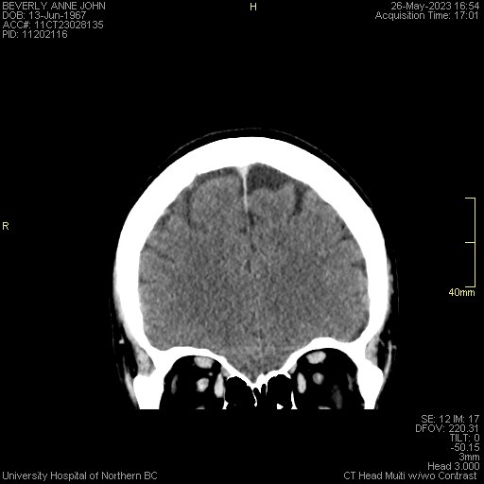
CT Brain and Orbits - patient B.A.J.
Post-contrast

Slide 10
CT Brain and Orbits - patient B.A.J.
Pre and post-contrast

Slide 11
Case study – Patient B.A.J.
Re-referred by internist in Sept. 2023 for MRI brain and orbits
Blurred vision right eye
Progressive optic nerve edema
NMOSD? Optic nerve glioma?

Slide 12
Case study – Patient B.A.J.
Request received by UHNBC MI Aug.22, 2023
Protocolled by radiologist
MR brain and orbits, C and T spine w/wo (MS protocol)
Coded P2
Study performed Sept. 11, 2023

Slide 13
Case study – Patient B.A.J.
MR
Axial T2, DWI, SWI, 3D FLAIR, 3D Pre and post Gd T1 Brain
3mm Axial T1 and FST2, Cor T1 and FST2 and post Gd Ax and Cor FST1 Orbits
Sag T1, T2, PSIR, Ax T2, Pre and post Gd Sag and Ax FST1 C and T spine
Notes:
Phase sensitive inversion recovery

Slide 14
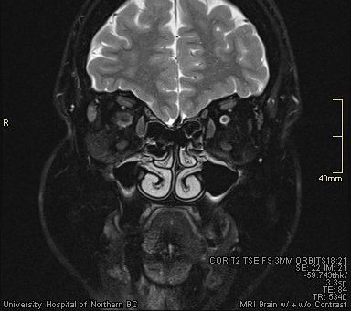
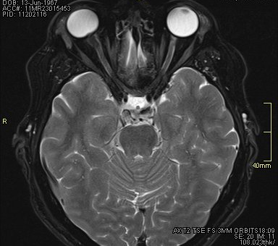
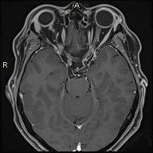
MR Brain and orbits - Patient B.A.J
FS T2 Cor
FS T2 Ax
T2 Ax
FS T1 Ax
Pre contrast

Slide 15
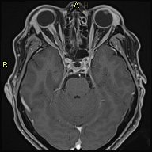
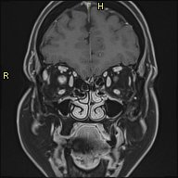
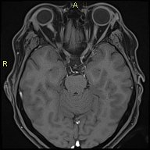
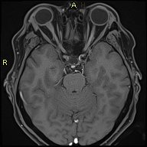
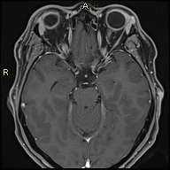
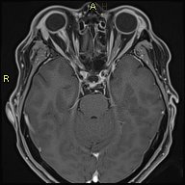
MR Brain and orbits – Patient B.A.J.
FS T1
Pre-contrast Ax
FS T1
Post-contrast Cor
FS T1
Post-contrast Ax

Slide 16
MR Brain and orbits – Patient B.A.J.
FS T1 Post contrast Ax and Cor
Notes:
Brain and cord were normal!!

Slide 17
Unilateral, enhancing optic nerve mass
Differential diagnosis?

Slide 18
Unilateral, enhancing optic nerve mass
Differential diagnosis?
Optic nerve meningioma
Optic nerve glioma
Neuromyelitis Optica Spectrum Disorder (NMOSD)
MS
Optic nerve schwannoma
Notes:
Also MS as a cause of optic neuritis and
MOG – Myelin Oligodendrocyte Glycoprotein

Slide 19
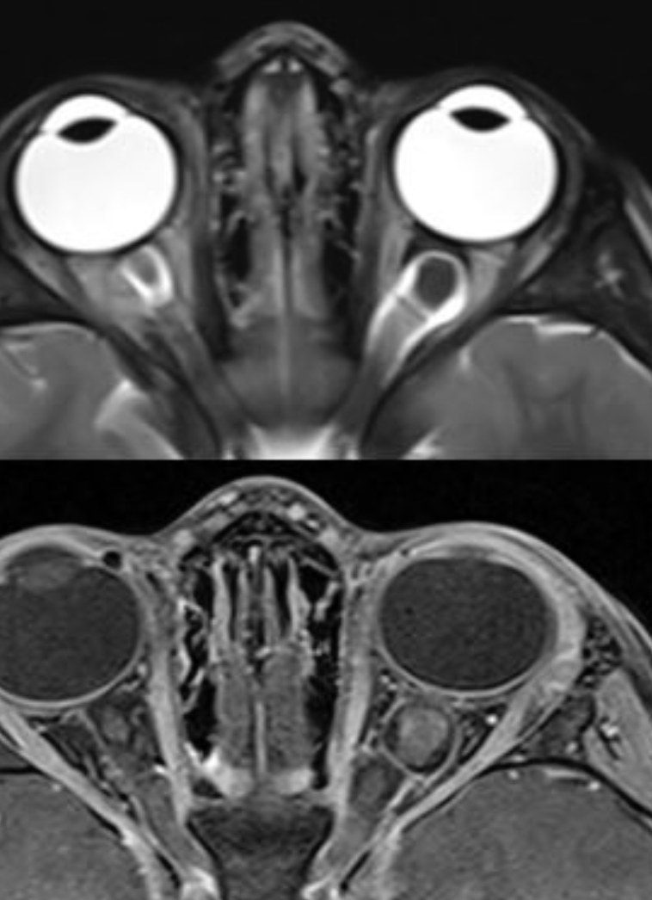
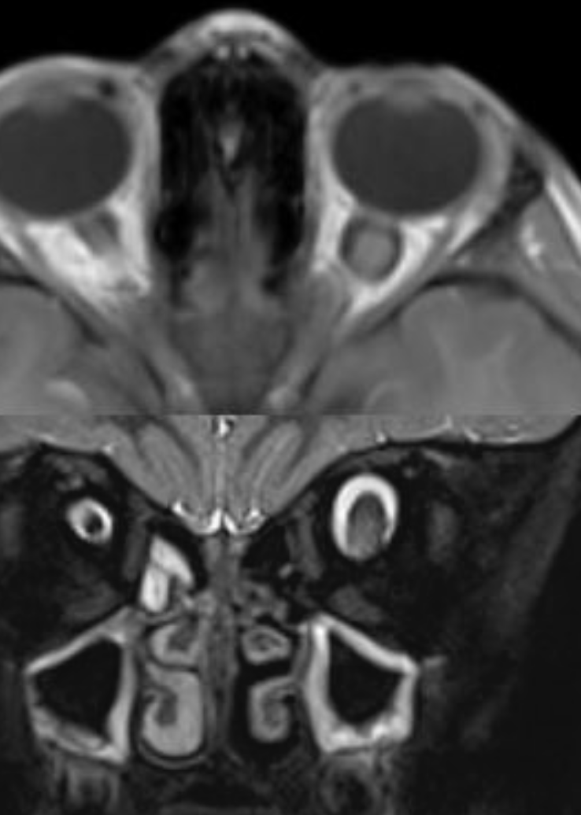
Unilateral, enhancing optic nerve mass
Optic nerve glioma
Peak incidence - first decade
Majority <20 yrs
Assoc. NF1 (often bilateral)
Can affect any part of ON
incl. chiasm
Expands nerve
Vogele et al. Diagnostics 2022, 12, 2376

Slide 20
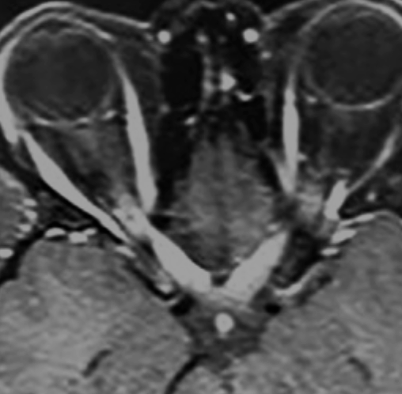
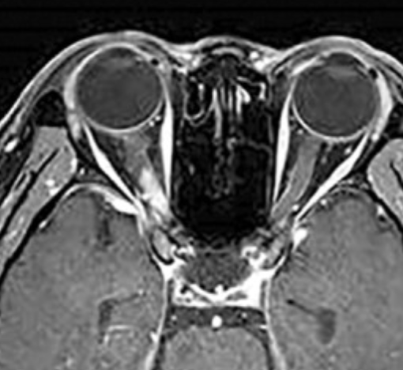
Unilateral, enhancing optic nerve mass
Neuromyelitis Optica Spectrum Disorder (NMOSD)
AQP4 AI disease
Mean age 41, F>M
Optic neuritis
and long segment transverse
myelitis +/- brain lesions
Swollen, enhancing ONs
Long segment and
posterior nerve involvement
Kim HJ et al. Neurology. 2015 Mar 17; 84(11): 1165-1173
Notes:
Aquaporin 4 antibody mediates lymphocytic infiltration and axonal loss
Less likely given normal cord and brain
Appearances overlap with MS

Slide 21
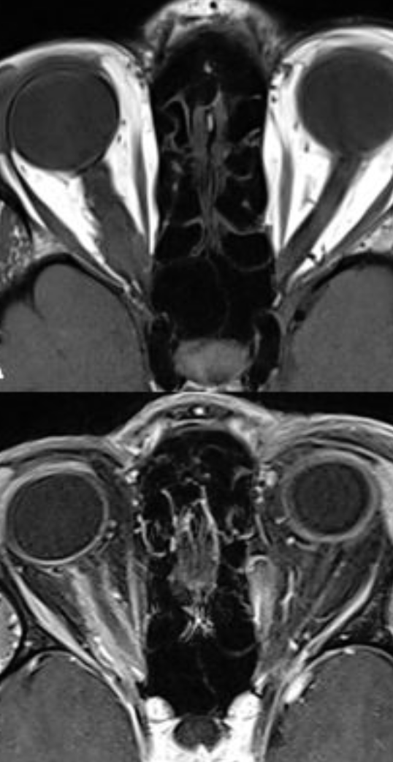
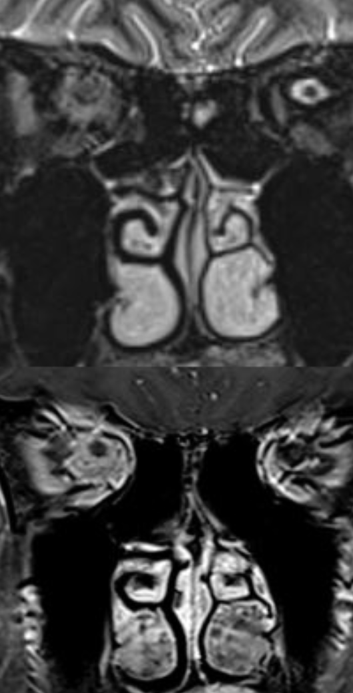
Unilateral, enhancing optic nerve mass
Optic nerve meningioma
4-5th decade
F>M
Usually unilateral
NF2 (bilateral)
“tram track sign” or ”donut sign”
Nerve not expanded
Vogele et al. Diagnostics 2022, 12, 2376

Slide 22
Learning points
Unilateral ocular symptoms and signs warrant dedicated orbital imaging
Dedicated, symmetrical, thin, orbital reformats in axial and coronal planes to both optic nerves with and without early phase contrast
Compare symmetry of intra-orbital ONs and trace back to optic chiasm

Slide 23
Thank you

