Slide 1

Rural Quality Improvement Programs
Enhancing Service Reliability and Team Resilience

Slide 2
We would like to take this opportunity to acknowledge and pay respect to the fact that we all live, work, and play as uninvited guests across the unceded traditional territories referred to as British Columbia.
Today we gather virtually and on the unceded traditional territory of the Lheidli T’enneh Nation, part of the Dakelh peoples.
I am grateful to call the territories of the Squamish, TsleilWaututh, and Musqueam home.

Slide 3
Disclosures
I do not have any conflicts to declare

Slide 4
Rural Surgical and Obstetrical Networks
The closure of rural surgical and maternity programs in the past 25 years has increased the disparity in access to care between urban and rural residents.
Funded by the Joint Standing Committee on Rural issues, the RSON initiative aims to support safe and appropriate surgery, operative delivery, and maternity care closer to home.

Slide 5



Rural Maternity Site Closures
Since 2000, 24 maternity programs have closed
  Impacting 140,000+ people across these catchments
RSON targeted 10 communities in 4 health authorities
  Direct population 73,000 / catchment 130,000 people
● Maternity Program Closed
● RSON Community
Interior Health (2017/18)
  Revelstoke
  Fernie
  Creston
  Golden
Northern Health (2019/20)
  Smithers
  Hazelton
  Vanderhoof
Island Health (2020)
  Port Alberni
Coastal Health (2021)
  Sechelt
  Powell River

Slide 6



Solution: Networked Teams in Safe, Sustainable Models of Care
Scope & Volume
Continuous Quality Improvement
Networked Teams
Consistency and sustainability
Team function and engagement
Relationships and collaborations
Local resources to support the work and foster relationships within the network

Slide 7
Outcomes from Local Quality Improvement Programs
Increased interdisciplinary collaboration
Break down silos
Streamline processes
Improved patient care
High patient satisfaction
Improved patient outcomes
Increase team engagement
Shared work and shared visions
Sense of pride across team
Stability of core services
Reduced closures
Decreased patient outflow

Slide 8
Rural ER Closures in 2022

Slide 9
Locally-driven QI programs support highly functional teams and stabilize core hospital services.
But where does it start?
Local Data
Team Education

Slide 10

Education is the trojan horse of human connection.
Dr. Ben Symon
Sim Educator
“…everybody was in the same room, learning the same thing and eating the same food.”

Slide 11

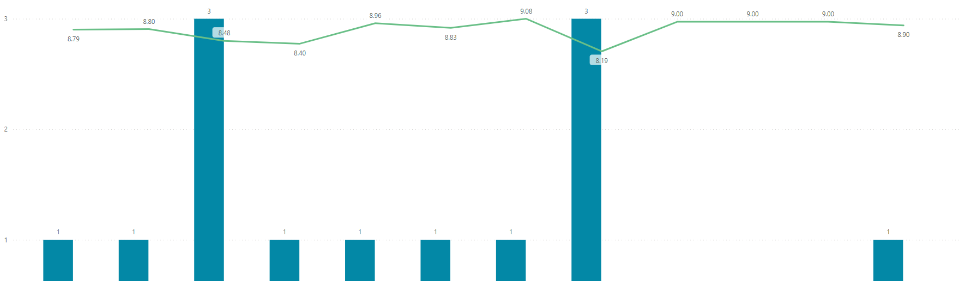
Local Data to Influence Change
Accessible
Meaningful
Timely

Slide 12
Local Data Collection & Interpretation
Patient Reported Outcomes & Experiences
2200 responses
Procedure Checklist
1500 procedures
Delivery Tracker
Maternity Patient Experience Survey
8 sites active
Perioperative Skills Confidence Tool
Co-developed by 5 sites
Maternity Skills Confidence Tool
19 communities
Team Effectiveness Questionnaire
7 communities
Phone call / SMS – 30 days
Complications tracked in realtime, iPad in recovery
QR code with patient chart
Text message 6 weeks post
300 responses
SMS Pain Survey
Text message 48hrs post
Pain scales and post-op info
1300 deliveries
Transfer reason, inductions, etc
Regional block assessments
100 specific skills
In use in 7 communities

Slide 13
Enabling Factors for a Local Quality Program
Timely, local, actionable
Time, coordination, local positions, prioritization
Data
Support
Structures for a team to come together
Culture of Quality and Safety
Team
Idea
What could be better?
Resilient Teams & Stabilized Local Programs
“I love the fact that we can work on things that really matter to us.”

Slide 14
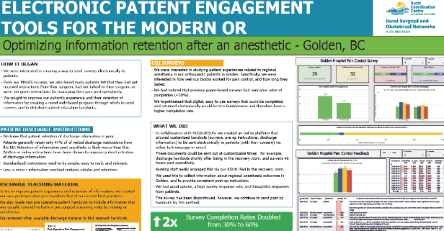
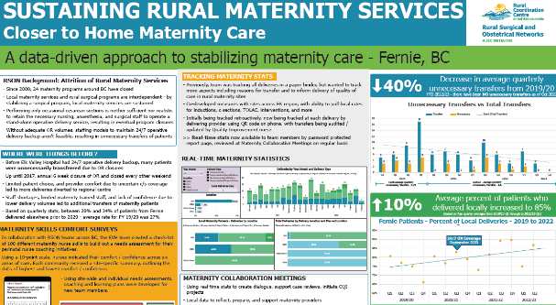
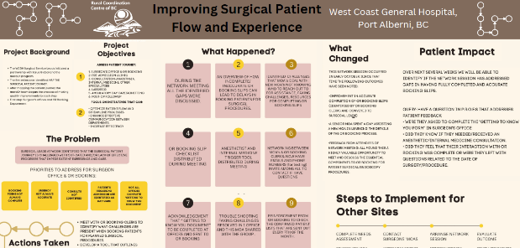
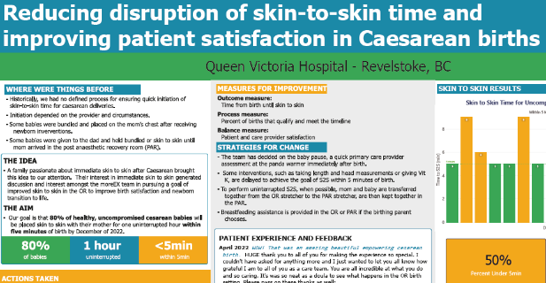

Slide 15
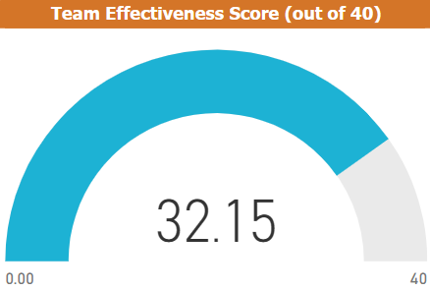
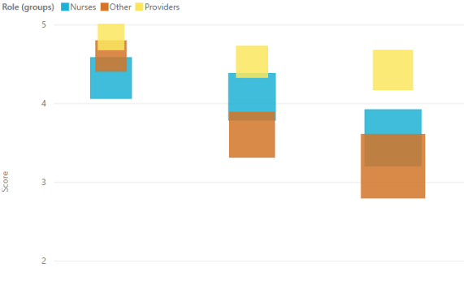
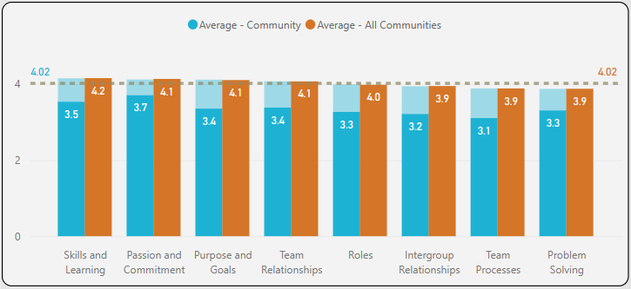
NHS Team Effectiveness Questionnaire
Purpose and Goals | Roles | Team Processes
Team Relationships | Intergroup Relationships
Problem Solving | Passion and Commitment
Skills and Learning
7 sites / 152 interdisciplinary team members
Plot local results alongside provincial averages
Identify areas of variance between provider groups

Slide 16
“I feel like the bar has gone up”
Coming together
“…everybody was in the same room, learning the same thing and eating the same food.”
Protected time
“…it’s essentially afforded us the time, especially as an OR team, to actually say right, let’s take on something that we feel we need to improve...”
“I feel like we aim for higher, and we expect higher and if things aren't higher, we try to work on what went wrong.”
Stronger together
“…all of these activities have made us feel like a stronger team and we work really well together…. it’s been fantastic.”
Reviewing data
“It has been an amazing team effort and morale booster for the OR staff 100%. They love to see it… read the comments.”

Slide 17
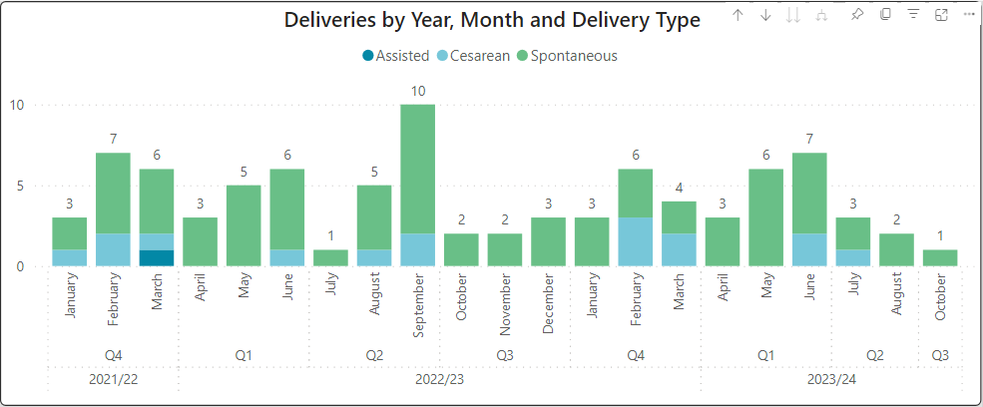
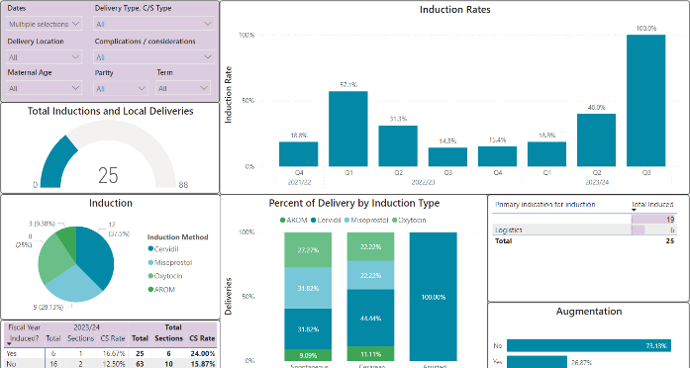
Tracking Delivery Stats
Move from paper binder to digital tool
Inform delivery of quality care as well as provide data for advocacy
Co-developed measures with rural sites across BC
Ability to pull local rates for inductions, c-sections, TOLAC, transfers, staffing levels, and more
Now being tracked at each delivery by the provider using QR code on their phone, with transfers being audited / updated monthly
Real-time stats now available to team members by password protected report page, reviewed at Maternity Collaborative Meetings on regular basis

Slide 18
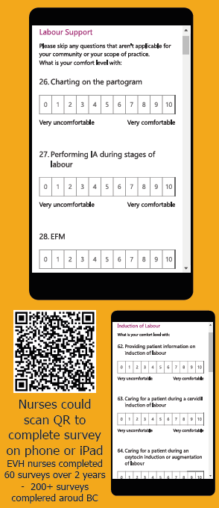
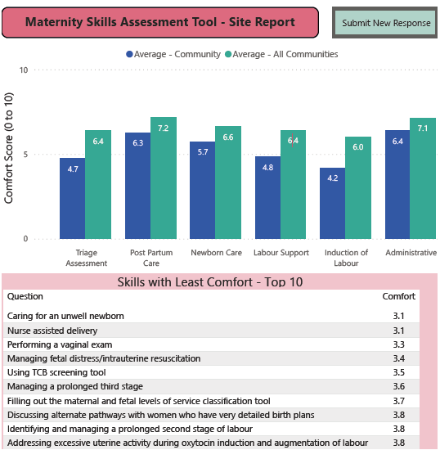
Maternity Skills Confidence Survey
In collaboration with multiple rural sites, a check-list of 100 different maternity nurse skills was built out as a needs assessment for perinatal nurse coaching initiatives.
Using a 10-point scale, nurses indicated their comfort / confidence across six areas of care. Each community received a site-specific summary, outlining the skills of highest and lowest comfort / confidence.
Using site-wide and individual needs assessments, coaching and learning plans were developed for new team members.

Slide 19
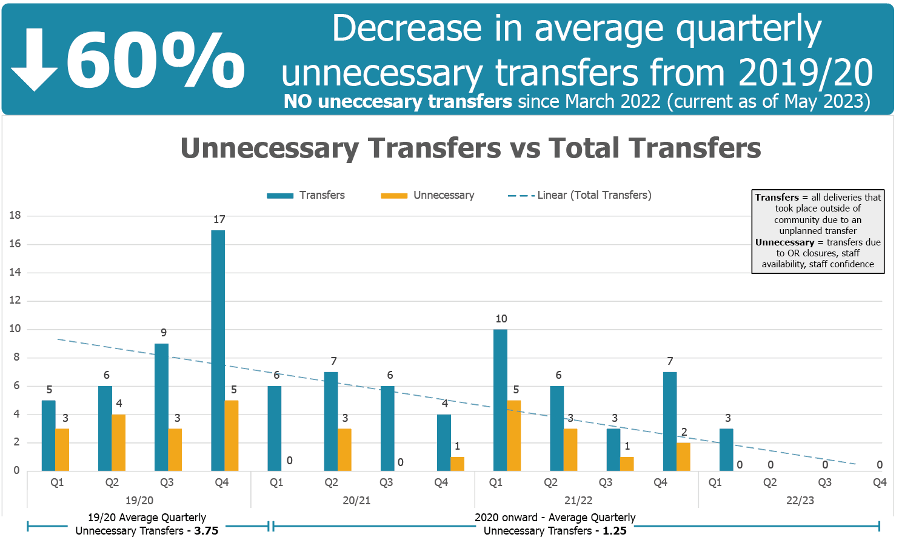
RSON COMMUNITY SUCCESS STORY

Slide 20
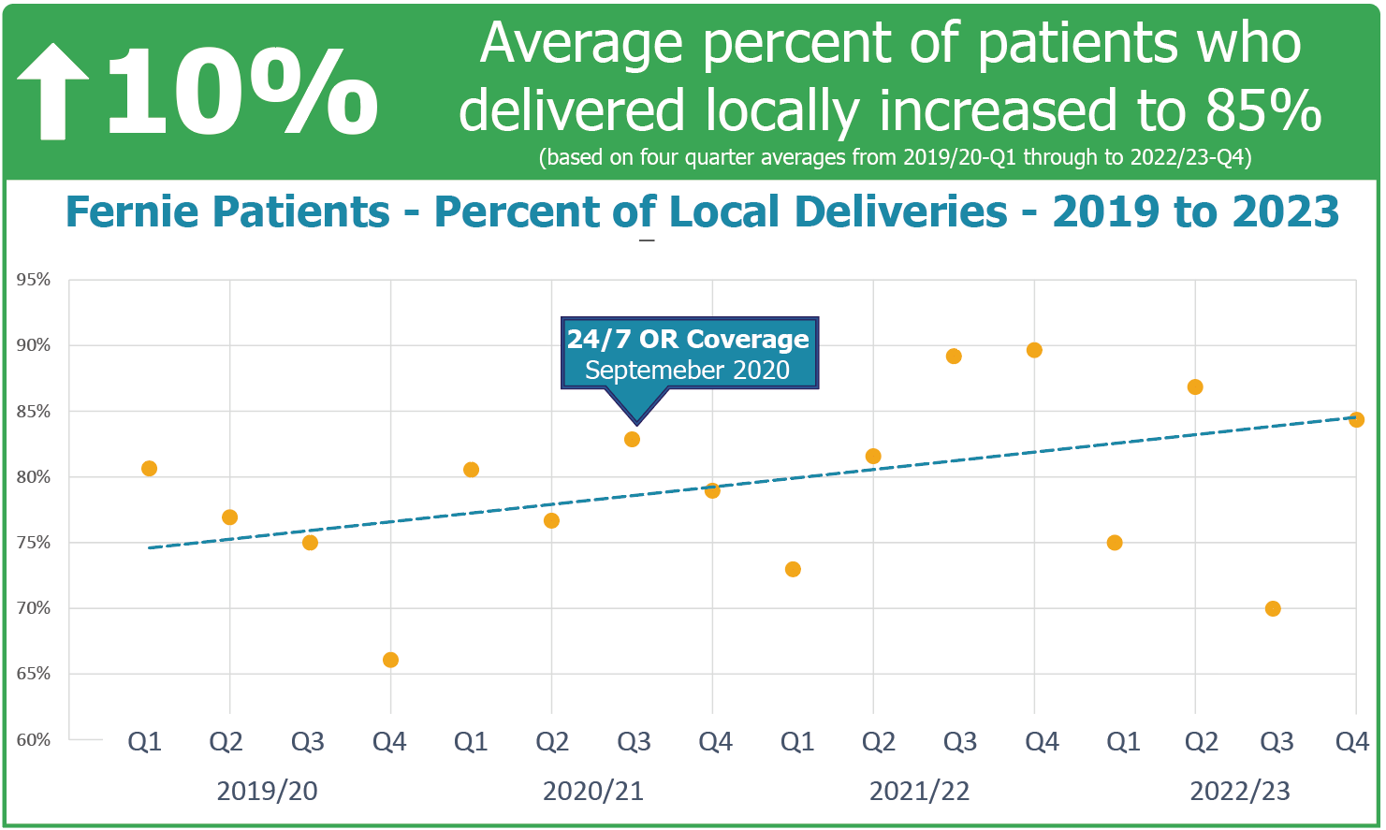
RSON COMMUNITY SUCCESS STORY

Slide 22

Enabling Factors:
Sustainable Small Surgical Hospitals
Quality Activities
Coaching
Local Quality Projects
Scope & Volume
24/7 coverage
Sustainable staffing
Regionally responsive
Data: Timely & Meaningful
Networks of Core Services
ER | Anesthesia | Surgery | Maternity
Local CQI Position
Embedded within .
the hospital team
Local Coordination
Support, coordination, and project administration

Slide 23
Rural Surgical and Obstetrical Networks
Continuous Quality Improvement (CQI)
Nancy Humber
Kim Williams
Tom Skinner
RSON Clinical Lead
Networks Director
Project Manager
tskinner@rccbc.ca
Sean Ebert
Clinical CQI Lead
@RCC_bc
RCCbc
TheRCCbc
rccbc.ca
@rcc_bc

