Slide 1
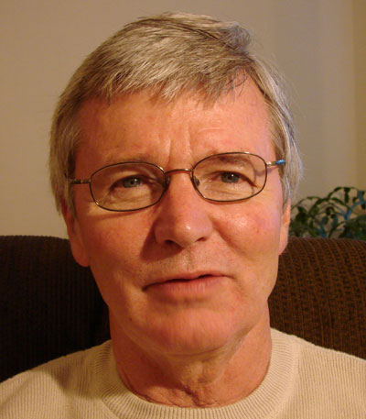
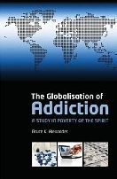
GL☑BAL FRIDAY PRESENTS
Bruce Alexander,
Professor Emeritus, Psychology at SFU
“THE GLOBALISATION OF ADDICTION”
Bruce Alexander, is professor emeritus of psychology at SFU and a pioneer in human addiction research. In 2007 he won the Nora and Ted Sterling Prize in support of controversy. In making the award, the chair of the committee wrote "Professor Alexander’s work addresses important local and global issues, and gives another perspective on addiction. The intense disapproval it has generated should make thinking people want to take a look at just what he’s saying that is perceived as so dangerous."
March 5, 2010
Senate Chambers, Room 1079
12:00 – 1:30 pm
(available by elluminate)

