Slide 1
ADVANCING FORWARD: Intro to the New Tri-Agency Guide on Financial Administration
Jacqueline Dockray
Research Project Officer, Natural Sciences and Engineering
Aneta Douglass
Accounting Analyst - Research

Slide 2
OBJECTIVES
By the end of this session, you should be able to use the new Guide by:
Understanding the key differences between the new and the old Tri-Agency Guide on Financial Administration (TAGFA), including the four principles and other important changes
Understand the impact of the new TAGFA on the administration of the Tri-Agency research funds at UNBC
Navigate available resources for more information about the new TAGFA implementation

Slide 3
CONTENT
Part 1: About the Guide
Part 2: Use of Grant Funds
Part 3: TAGFA Principles and Directives
Part 4: Administering Institution’s Policies and Directives
Part 5: Tri-Agency Resources

Slide 4
Part 1: About the Guide

Slide 5
Objectives of the Principles-Based Guide
Streamline and simplify the administration and use of grant funds
Promote and support sound judgment and due diligence
Foster a balance between control and flexibility
Lessen administrative burden
Allow for more efficient processes
Harmonization of Tri-Agency policies and guidelines
No discretion to depart from these principles and directives

Slide 6
What has changed?
Shift from prescriptive list of eligible and ineligible expenses to a principle-based approach under the new Guide.
New Guide provides framework for institutions to determine eligibility of expenses maximizing the use of existing policies, processes and controls.
In general, anything eligible under the old Guide will continue to be eligible as long as the item or service respects the four key principles and directives as outlined in the TAGFA.

Slide 7
Part 2: Use of Grant Funds

Slide 8
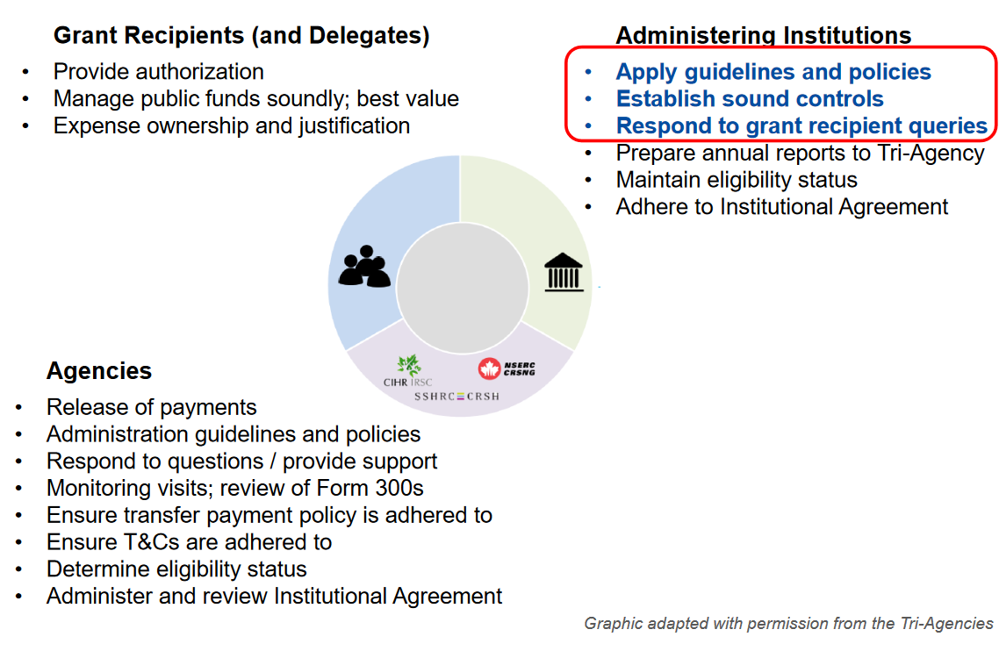
Roles & Responsibilities
Slide taken from U of Toronto presentation https://research.utoronto.ca/media/440/download

Slide 9
Order of Precedence and Interpretation
Steps, IN ORDER, for determining the eligibility of expenses:
1. The Four Principles
3. The Program/Funding Opportunity literature
2. The Relevant Directive Details
4. The Institution’s Policies and Directives
Every step from this assessment process should be executed before making eligibility determination

Slide 10
Part 3: TAGFA Principles
&
Directives

Slide 11
PRINCIPLES
Grant expenditures MUST:
1. Contribute towards the direct costs of the research/activities
2. Not be provided by the administering institution
3. Be effective and economical
4. Not result in personal gain

Slide 12
PRINCIPLES on the Use of Grant Funds
Grant expenditures MUST:
1. Contribute to the direct costs of the research/activities for which the funds were awarded, with benefits directly attributable to the grant
What are DIRECT COSTS?
Essential expenditures that would not have been incurred had the grant not been undertaken
Accordingly, they can be directly assigned to the grant activities with a high degree of accuracy

Slide 13
PRINCIPLES on the Use of Grant Funds
Grant expenditures MUST:
2. Not be provided by the administering institution to their research personnel
“Provided by the administering institution”?
If an administering unit normally provides a good or service, it cannot be charged to the grant
Tri-Agencies are mindful that what is provided by an institution can vary both across and within institutions

Slide 14
PRINCIPLES on the Use of Grant Funds
Grant expenditures MUST:
3. Be effective and economical
“Effective and economical”?
It achieves the intended outcome with due regard for minimizing cost by avoiding unnecessary expense
Optimal use of the funds; does not necessarily mean the “lowest cost”.

Slide 15
PRINCIPLES on the Use of Grant Funds
Grant expenditures MUST:
4. Not result in personal gain for members of the research team
“Personal Gain”?
A benefit or advantage to a particular person rather than to the grant-funded research/activities

Slide 16
DIRECTIVES on Certain Expense Types
DIRECTIVES: What are they?
Mandatory Requirements
Provide a framework to make decisions
Allow for sound judgment and due diligence
Employment and Compensation Expenses
Goods and Services
Travel and Travel-Related Subsistence Expenditures
Hospitality Expenses
Gifts, Honoraria, Incentives

Slide 17
DIRECTIVES: Employment & Compensation
ELIGIBLE EXPENSES
☑ Individuals employed to work on funded research/activities can be compensated from grant funds (exceptions: see Ineligible section below*)
☑ International Researchers (employer must attest, by letter, that the individual is not being compensated by the employer for the time spent on the grant)
☑ Mandated compensation benefits
☑ Only the portion of mandated severance pay for the period the individual worked on the current grant
INELIGIBLE EXPENSES
* Grant recipients or individuals who conduct research independently as part of the terms and conditions of their employment
☒ * Individuals expected to work on the funded research/activities free of charge
* Individuals employed and compensated by another organization for the time spent on the funded research/activities **
** Grant funds can be used to reimburse the organization for costs incurred in compensating the individual for time spent on grant activities

Slide 18
DIRECTIVES: Employment & Compensation
Test for Understanding
For each of the following statements, determine if the expenditures would be an appropriate use of grant funds under the Employment and Compensation directive?
Salary paid to an individual who is employed full-time with a local counseling organization to provide related services to the grant recipient’s funded research project.
Compensation from grant funds to an international researcher providing services on the grant recipient’s project.
Compensation to a PhD student for work conducted on two different funded research projects.
Compensation to an independent researcher from another research team collaborating on the grant recipient’s funded research project.
PRINCIPLES
Contribute towards direct costs of the research/activities
Not be provided by the administering institution
Be effective and economical
Not resulted in personal gain

Slide 19
DIRECTIVES: Goods & Services
ELIGIBLE EXPENSES
☑ Goods and services expenditures, in accordance with the four principles
INELIGIBLE EXPENSES
Consulting Fees to:
Grant recipients or individuals who conduct research independently as part of the terms and conditions of their employment
Individuals expected to work on the funded research/activities free of charge

Slide 20
DIRECTIVES: Goods & Services
Test for Understanding
For each of the following statements, determine if the expenditures would be an appropriate use of grant funds under the Goods and Services directive?
Office and stationery supplies not normally provided by the administering institution.
Grant recipient wants to use her own company to translate documents from the research project.
The costs associated with regulatory compliance to provincial or municipal regulations and by-laws.
Consulting fees for the services rendered by a statistician on a project.
PRINCIPLES
Contribute towards direct costs of the research/activities
Not be provided by the administering institution
Be effective and economical
Not resulted in personal gain

Slide 21
DIRECTIVES: Travel & Travel-Related Subsistence
ELIGIBLE EXPENSES
All travel and travel-related subsistence claimed in accordance with UNBC relevant policies and procedures
Such expenditures, including reasonable out-of-pocket expenses, can be claimed for the grant recipient and other individuals who contribute to the funded research/activities. For claimants other than the grant recipient, the affiliation with the funded research/activities must be specified
☑ Expenditures must be authorized by the right level of authority
INELIGIBLE EXPENSES
☒ Alcoholic beverages

Slide 22
DIRECTIVES: Travel & Travel-Related Subsistance
Test for Understanding
For each of the following statements, determine if the expenditures would be an appropriate use of grant funds under the Travel and Travel-Related Subsistence directive?
A car rental for research travel related purposes.
Purchase of a travel Visa.
Airfare for a grant recipient to discuss research findings with out-of-town members of the project team.
Grant recipient is submitting expenses for rainwear necessary for their family member to visit the research project site.
PRINCIPLES
Contribute towards direct costs of the research/activities
Not be provided by the administering institution
Be effective and economical
Not resulted in personal gain

Slide 23
DIRECTIVES: Hospitality
ELIGIBLE EXPENSES
Hospitality costs must be directly related to the funded research and be incurred for:
☑ Networking purposes provided in the context of formal courtesy or as a form of cultural respect;
Activities in the context of assemblies or gatherings that facilitate and contribute to achieving the research objectives;
☑ Where one or more of the individuals participating is not a member of the research team and not involved in the day-to-day funded research/activities
INELIGIBLE EXPENSES
Alcoholic beverages
Costs incurred for interactions between participants involved in the day-to-day funded research/activities

Slide 24
DIRECTIVES: Hospitality
Test for Understanding
For each of the following statements, determine if the expenditures would be appropriate use of grant funds under the Hospitality directive?
Cost of catering for a workshop without presentations or outcomes with collaborators from partners’ organizations.
Cost of groceries for a meal the grant recipient is hosting for visiting scholars to discuss new methodologies used for the funded research.
Cost of catering for a Christmas party the grant recipient is hosting for their laboratory team.
Grant recipient is having dinner with another faculty member not involved with their grant to discuss hiring a new lab member.
PRINCIPLES
Contribute towards direct costs of the research/activities
Not be provided by the administering institution
Be effective and economical
Not resulted in personal gain

Slide 25
DIRECTIVES: Gifts, Honoraria & Incentives
ELIGIBLE EXPENSES
Gifts, honoraria and incentives can be offered to an individual/group:
☑ when participation is voluntary
☑ as a “THANK YOU” for a service for which fees are not traditionally paid
☑ as a token of appreciation, respect and/or goodwill
☑ when prescribed by cultural heritage/established traditions
☑ as a formal courtesy
INELIGIBLE EXPENSES
Gifts, honoraria and incentives cannot be offered to:
☒ Tri-Agency grant recipients
a member of a grant team
*The provision of gifts and incentives to participants requires prior approval of the appropriate Research Ethics Board

Slide 26
DIRECTIVES: Gifts, Honoraria & Incentives
Test for Understanding
For each of the following statements, determine if the expenditures would be an appropriate use of grant funds under the Gifts, Honoraria and Incentives directive?
A gift for an Elder invited to open a research conference with an opening prayer.
An honorarium for a local artist invited to prepare a piece of artwork for display at a conference.
A cash donation made to a cultural site for the use of their facilities to conduct research activities.
The provision of a $20.00 gift card to an individual as an incentive for their participation in the funded research study.
PRINCIPLES
Contribute towards direct costs of the research/activities
Not be provided by the administering institution
Be effective and economical
Not resulted in personal gain

Slide 27
Part 4: Administering Institution’s Policies and Directives

Slide 28
EDI – Equity, Diversity and Inclusion
UNBC is responsible for recognizing the importance of equity, diversity and inclusion in its policies and practices as stated in the Agreement on the Administration of Agency Grants and Awards by Research Institutions.
All administering institutions that accept agency funding must make concerted efforts to develop and implement policies and procedures that advance the goals of EDI in the use of grant funds, to achieve equitable participation in the research system.
Grant recipients are responsible for ensuring that they carry out their grant activities in accordance with the EDI policies and practices of their administering institutions.

Slide 29
Institutional Policies
Work in Progress:
GAP Analysis to identify gaps and changes between the old Guide, the new Guide and current UNBC policies, processes and guidelines
For situations where the new guide is silent, institutional policies will apply.
When in doubt, the MOST stringent policy always applies.

Slide 30
Part 5: Tri-Agency Resources

Slide 31
Supporting Resources and Tools
Frequently Asked Questions
Roles and Responsibilities
Virtual Guidance Tool
CAUBO Best Practices

Slide 32
Contact Information
Aneta Douglass – Finance @ 26534
email: Aneta.Douglass@unbc.ca
Phone: 250-960-6534
Jacqueline Dockray – Office of Research @ 26357
email: Jacqueline.Dockray@unbc.ca
Phone: 250-960-6357

Slide 33
Questions/Comments

Slide 34
Thank YOU!

