Slide 1

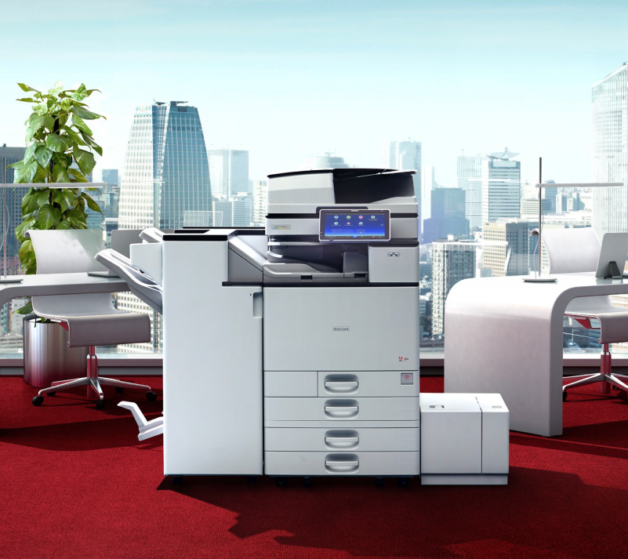

Ricoh
PaperCut &
Device
Training
Solution Training Department
Ricoh Canada Inc.
01/08/2019

Slide 2
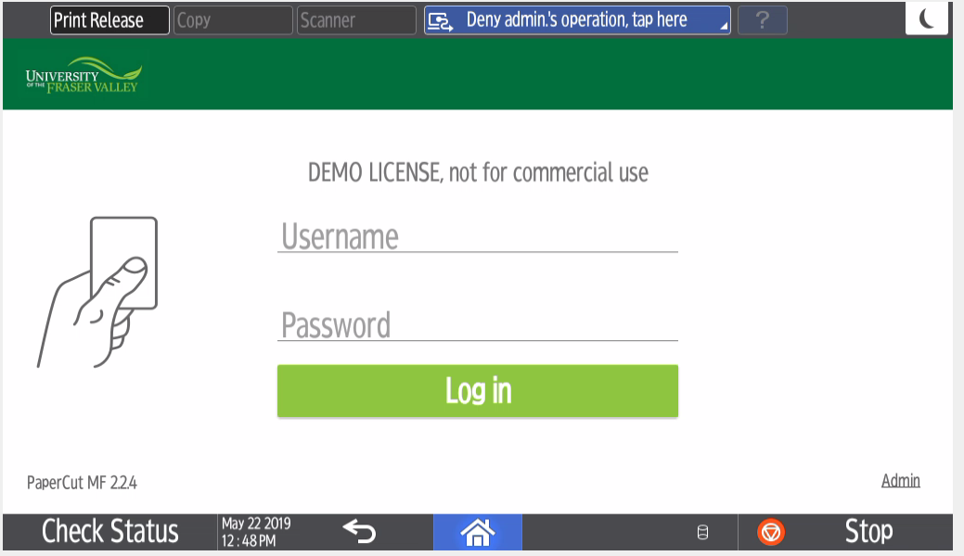

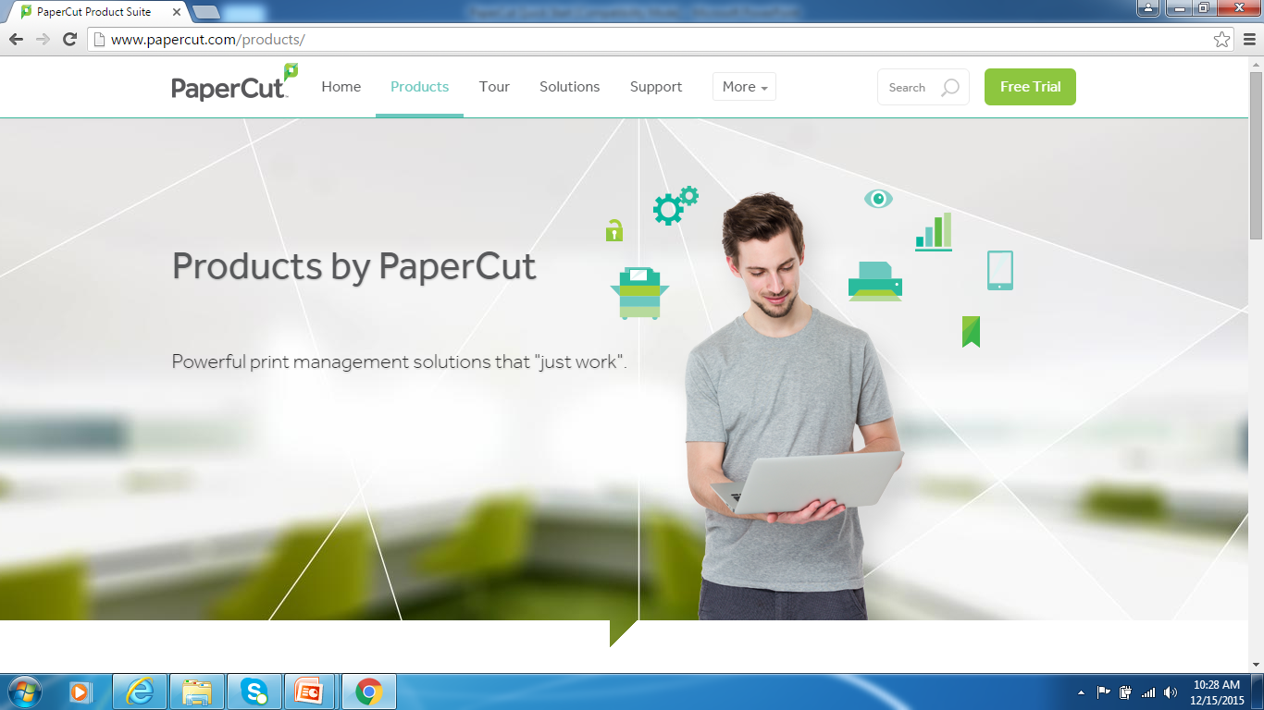
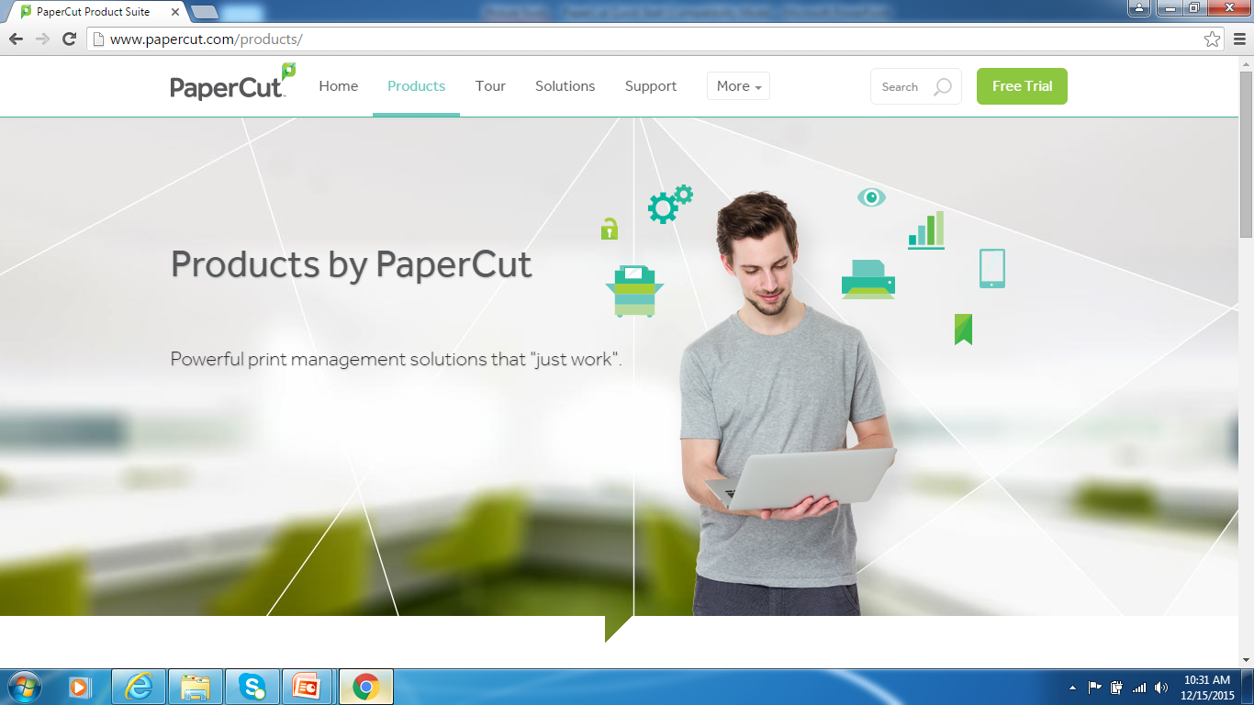
Welcome to PaperCut
... your new eco-friendly, secure print software

Slide 3

Agenda
Activating Your Card
Secure Print to Me
Scan to Me
Ricoh Scan
Copy
Help Desk Information
Status / Misfeeds / Maintenance

Slide 4
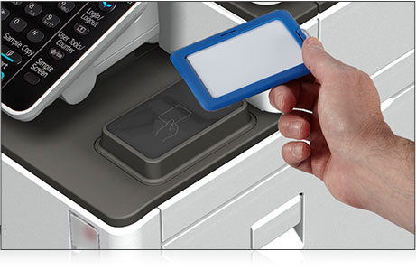
Activating Your Card

Slide 5
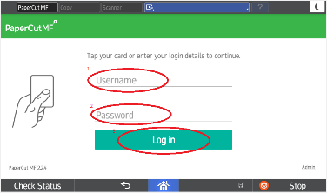
Activating your card
Step 1
Tap your Access Card over the card reader on your Ricoh device. The screen will read,
Associate your card with a user account by entering in your login details.
Press Username to associate your card with an account
This is a one time process.

Slide 6
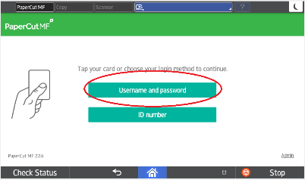
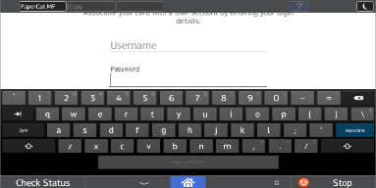
Activating your card
Step 2
Enter your Network Username and Press Next
Enter you Network Password
Step 3
Press Associate on the touch screen.
.

Slide 7
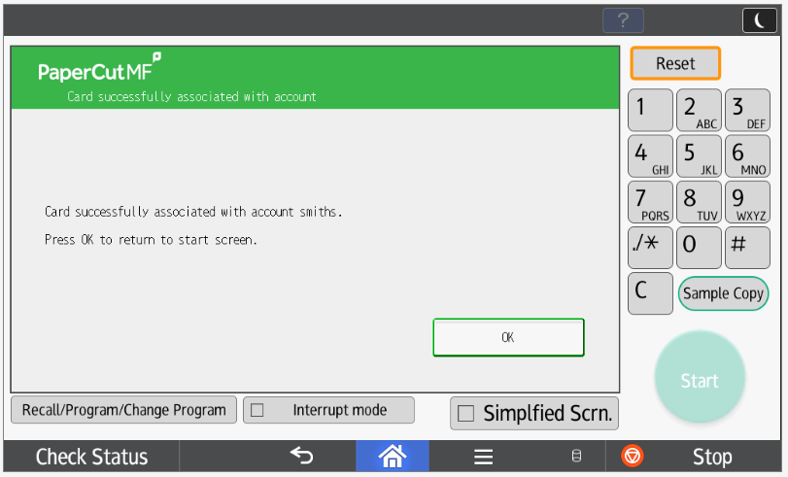
Activating your card
Step 4
If Network information is entered correctly it will say that your “Card is successfully associated with account”.
Press OK on the touch screen to proceed.
Tap card again to access Print Release, Device Functions and Scan
If your card doesn’t associate, re-tap your card and enter network username and password again.

Slide 8
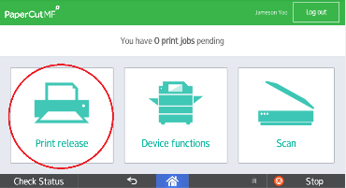
Login and Logout
Once your card is activated, you can go to any Ricoh device in your office to Log In and release your Print jobs, use Device Functions and Scan.
Don’t Forget To Log out by pressing the Logout button
at the top right of the screen or tap your card on the reader or it will log you out automatically after 60 seconds.

Slide 9
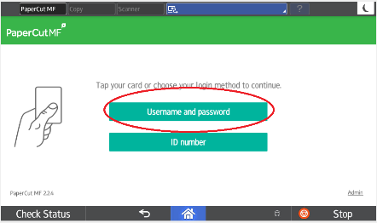
Forgot Your Card?
If you forget or lose your card, you can manually login with your network authentication.
Enter your username in the Username field, then in the Password field and press Log in.

Slide 10
Using
Print
To Me

Slide 11
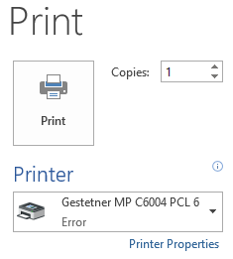
Print to Me Printing
Select your ‘Print To Me’ print queue.
Print To Me Queue

Slide 12
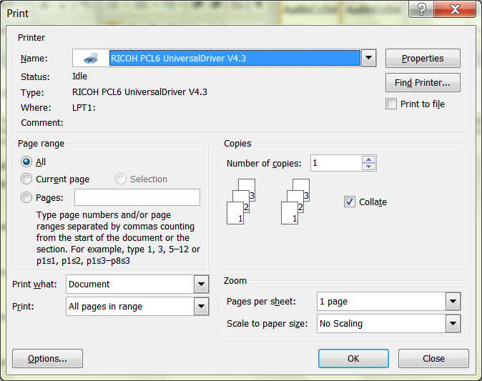
Print Driver
Open your document, click on File and Print. Select the “Secure Print” printer, if it is not your default, and click on Properties or Preferences depending on the application to get into the Ricoh driver.

Slide 13
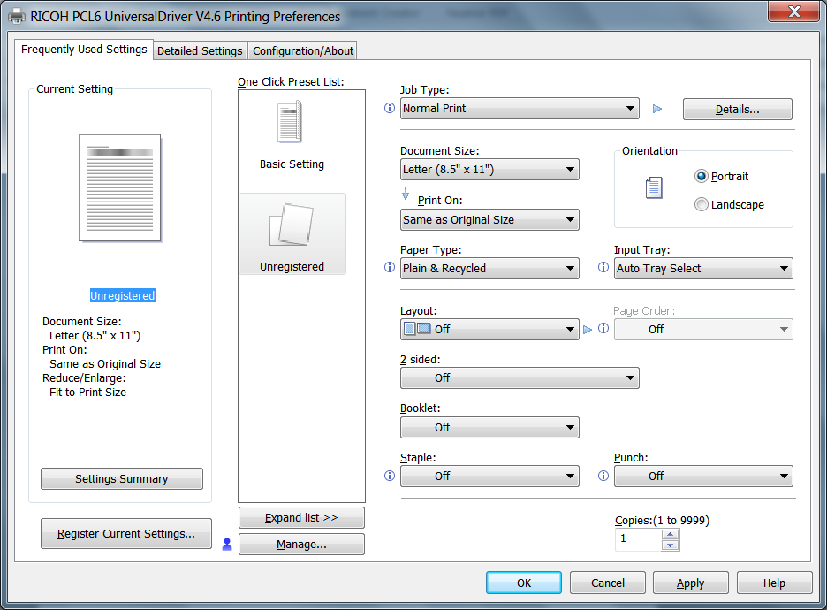
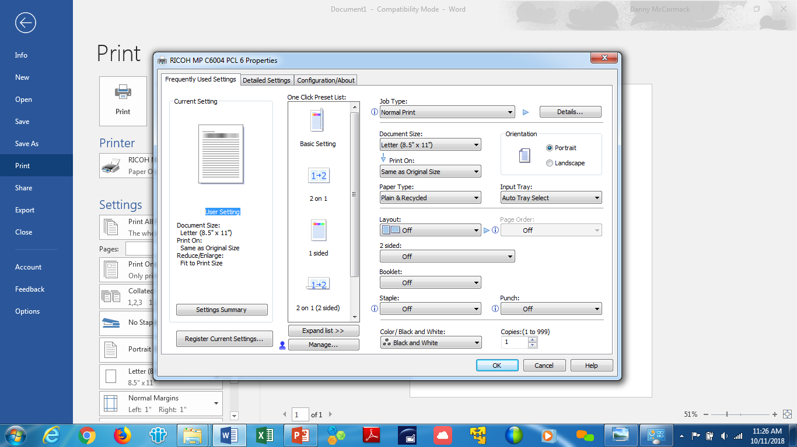
Frequent Settings
Frequent User Settings
Document Size
Portrait or Landscape
Paper Type
Input Tray
Layout
2-Sided
Booklet - Magazine
Staple
Punch
Color/Black and White
You can make One Click Presets by picking the features and Registering the Current Settings.

Slide 14
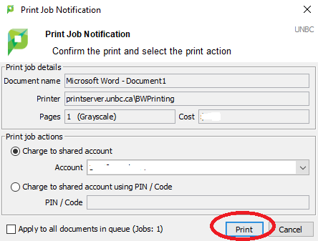
Print Driver
Confirm the print.
Click Print.

Slide 15
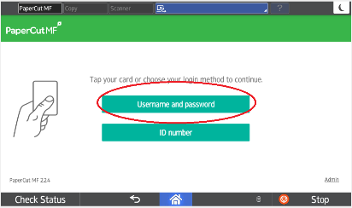
Print To Me Printing
Step 1
Tap your card on the reader at the Ricoh device.
OR
If you forgot your card you will need to authenticate manually, enter your Username and Password and press Log in.

Slide 16
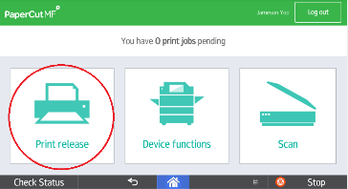
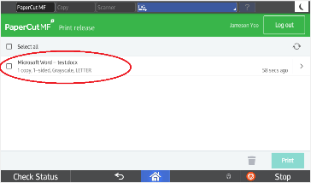
Print To Me Printing – Print Release
Step 2
You can press Print all to release all jobs or press Print release - you will notice your print jobs queued up ready for release. Select your print jobs and press Print.
To delete a print job select the print jobs press the garbage can icon.

Slide 17
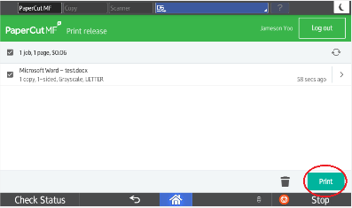
Print To Me Printing – Print Release
Step 3
You can press Print all to release all jobs or press Print release - you will notice your print jobs queued up ready for release. Select your print jobs and press Print.
To delete a print job select the print jobs press the garbage can icon.

Slide 18

Direct Print
Select your file.
Select Print.
Choose the MFD that you want to print to.
This will print directly to the MFD.
Pick up your print job at that location.

Slide 19
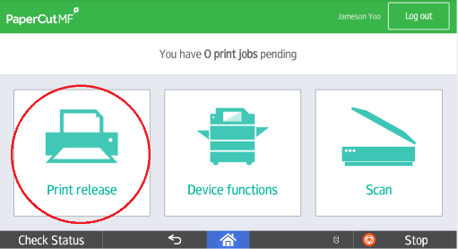
Check Status - Correcting a Print Job Error
When the red light under Check Status is highlighted, touch the icon to resolve the problem. Opposite the function, the unit indicates the reason for the error.

Slide 20
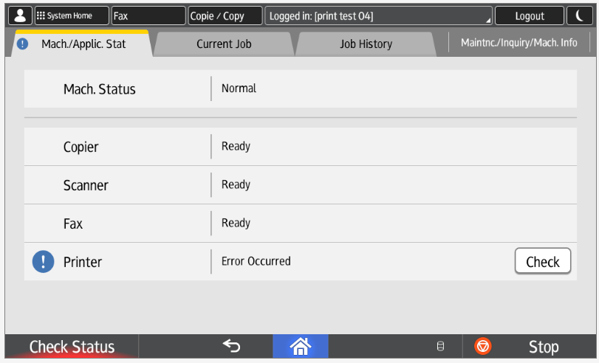
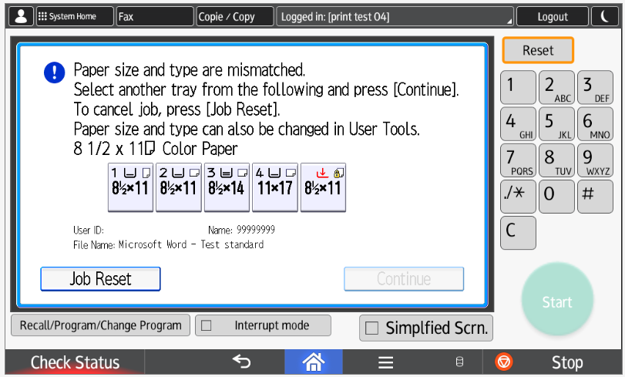
Check Status - Correcting a Print Job Error
When you are in the Check Status menu, click on the Check icon and that will bring you to the page below and allow you to resolve the issue.
If you want to stop a job press the Stop button to stop and cancel the job.

Slide 21
Using Scan to Me

Slide 22
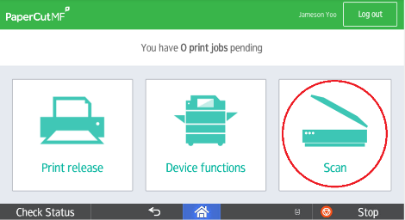
Scan to Me – Quick Scan
Tap your card on the card reader at the Ricoh device OR Log in manually with your username and password.
Step 1
Press the Scan button in the PaperCut screen.

Slide 23
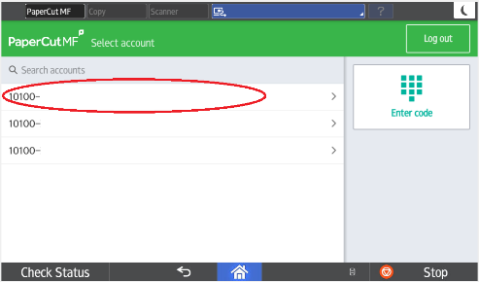
Scan to Me
Step 2
Select the Account

Slide 24
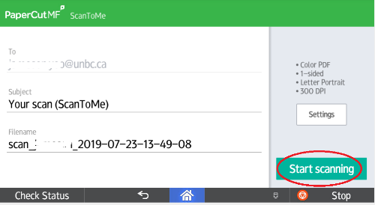
Scan to Me
Step 3
Customize Your Info
Subject – select box and enter a personal subject line or leave the default.
Filename – select box and enter a new name for your file or keep the default.
Press Scan setting to change the default settings
OR
Press Start Scanning

Slide 25
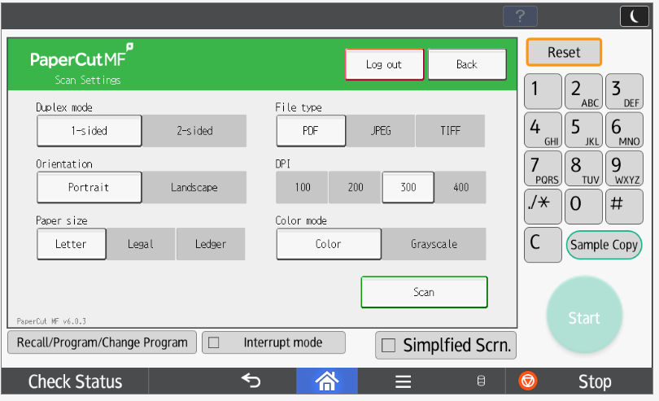
Scan to Me – Quick Scan
Step 4
Settings
Select Settings to Change for your scan
Duplex Mode (Single or 2-Sided)
Orientation – Portrait or Landscape
Paper Size – Letter, Legal Ledger
File Type – PDF, JPEG, TIFF
DPI – 100 to 600 DPI (dots per Inch)
Colour Mode – Colour, Grayscale or BW
PRESS SCAN to SEND Your Document

Slide 26
Ricoh Scanning

Slide 27
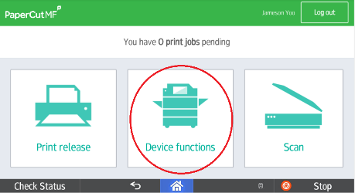
Ricoh Scan
Tap your card on the card reader at the Ricoh device OR Login manually with your username and password.
Press the Device functions button in the PaperCut screen.

Slide 28
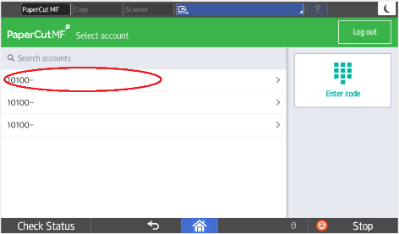
Ricoh Scan
Select the Account

Slide 29
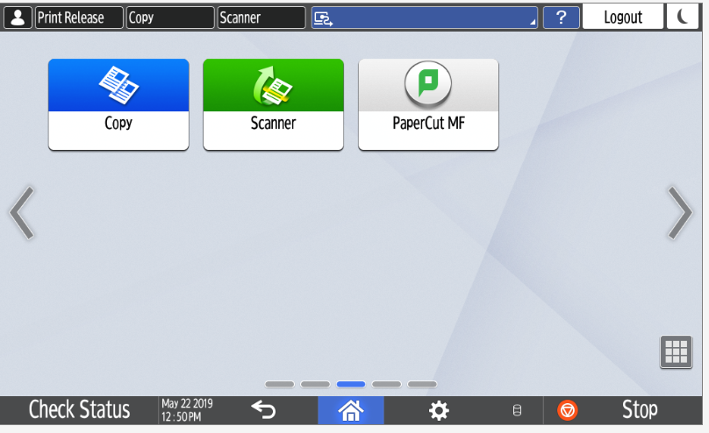
Ricoh Scan
Press Scanner

Slide 30
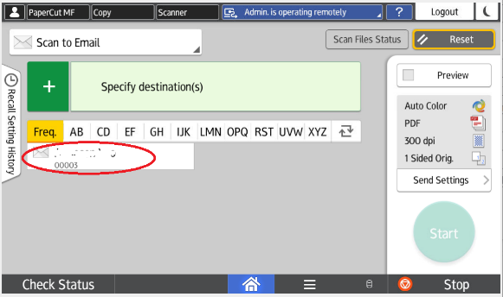
Ricoh Scan - Scan to Email
Select your name.
Press Start or see Send Settings Slide for more options

Slide 31
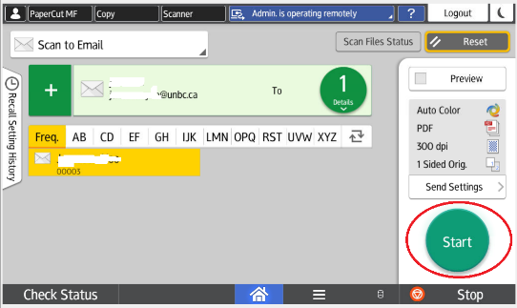
Scan to Email
Press Start

Slide 32
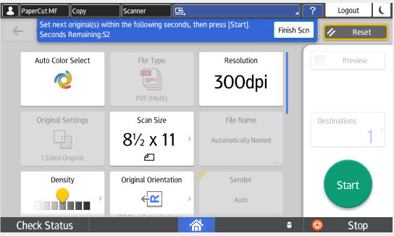
Scan to Email – Scan from the Glass
If scanning from the platen glass or using batch mode or scanning an odd size from the glass please press Finish Scn to send the document.

Slide 33
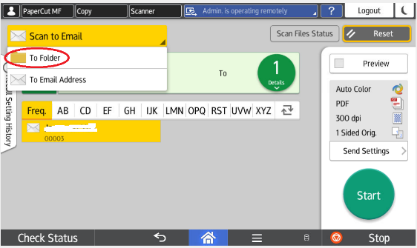
Ricoh Scan - Scan to Folder
Select To Folder from drop down menu

Slide 34
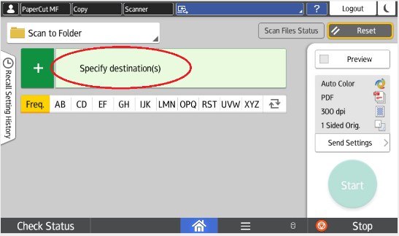
Ricoh Scan - Scan to Folder
Press Plus Sign in green box

Slide 35
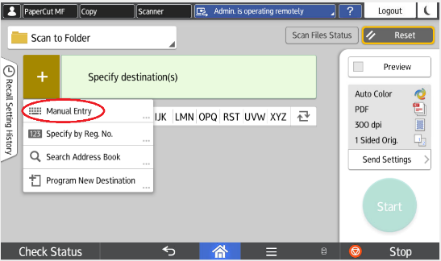
Ricoh Scan - Scan to Folder
Select Manual Entry

Slide 36
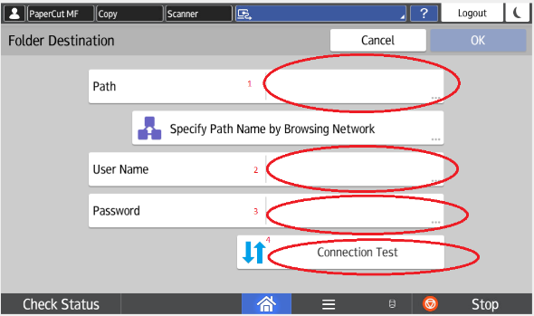
Ricoh Scan - Scan to Folder
Browse to Path.
Enter User Name and Password.
Select Connection Test to see if path and credentials were correct.

Slide 37
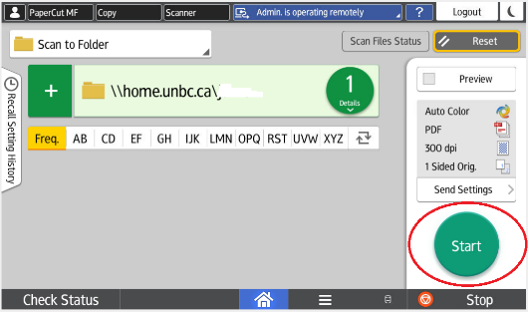
Ricoh Scan - Scan to Folder
Network path will appear.
Press Start.

Slide 38
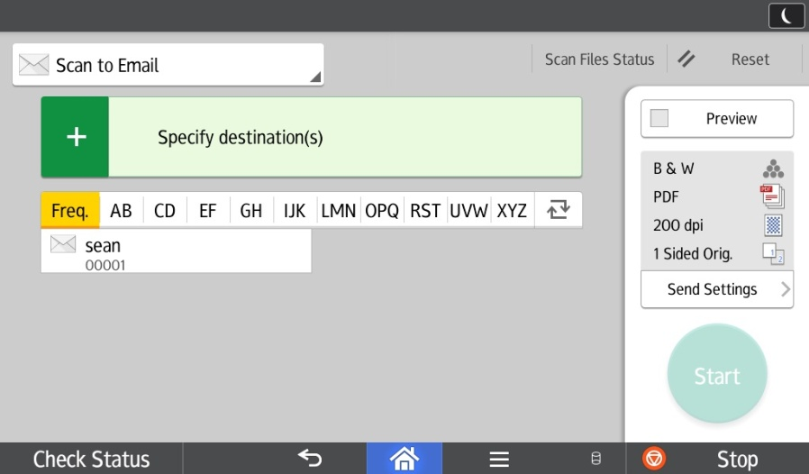
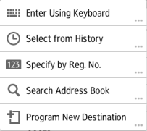
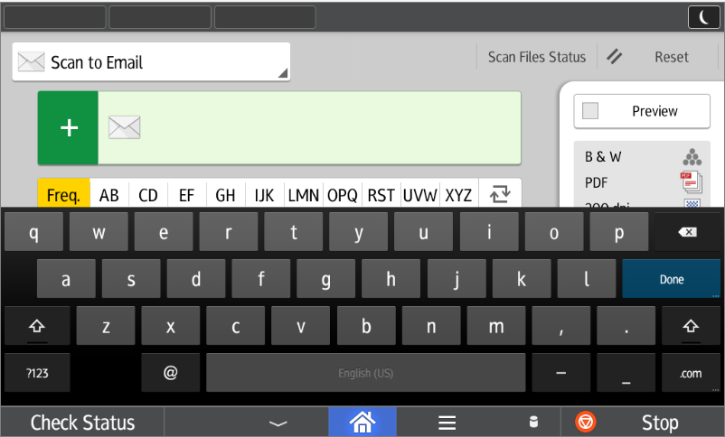
Ricoh Scan Specify Destination
Select from a pre-programmed destination
Press “+” for drop down
-Enter Using Keyboard
-Select From History
-Search LDAP Address book

Slide 39
Ricoh Scan Program New Destination
Press “+” for drop down.
Select Program New Destination,
Under Email tab press Change, enter address, then OK.
Under Name, press Change, and enter a name for the email display, then OK
Press Next and select a Title for the email to be stored under :
Frequent adds the programmed email to the main screen.
Selecting an alphabetical title (AB,CD,EF…) displays the programmed email under that title
Press OK at the top of the screen
Press Exit.

Slide 40
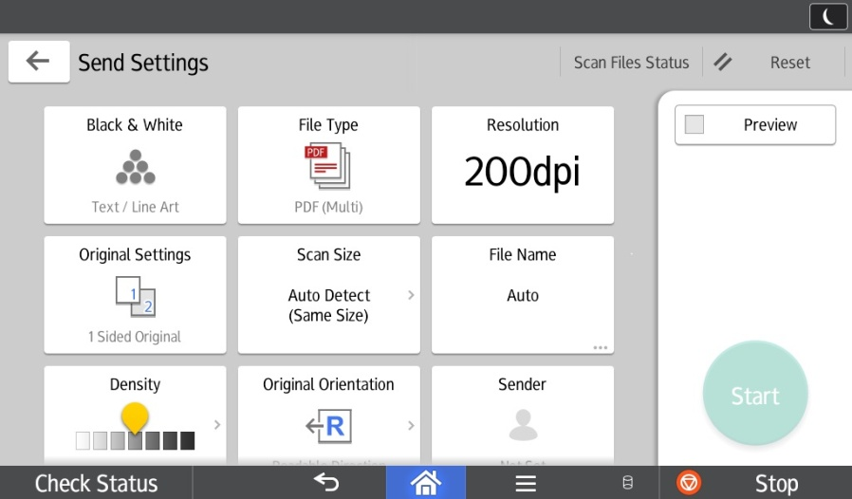
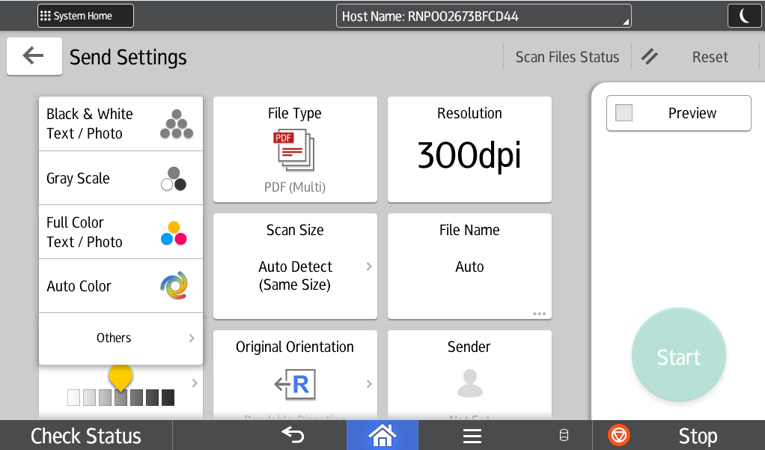
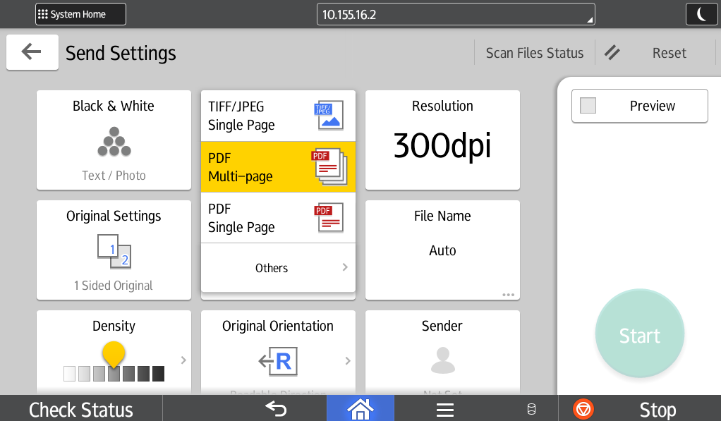
Ricoh Scan - Send Settings
Choose from color options.
File Type Options: Multi Page- sends documents as a single attachment.
Single Page: sends documents as multiple attachments.

Slide 41
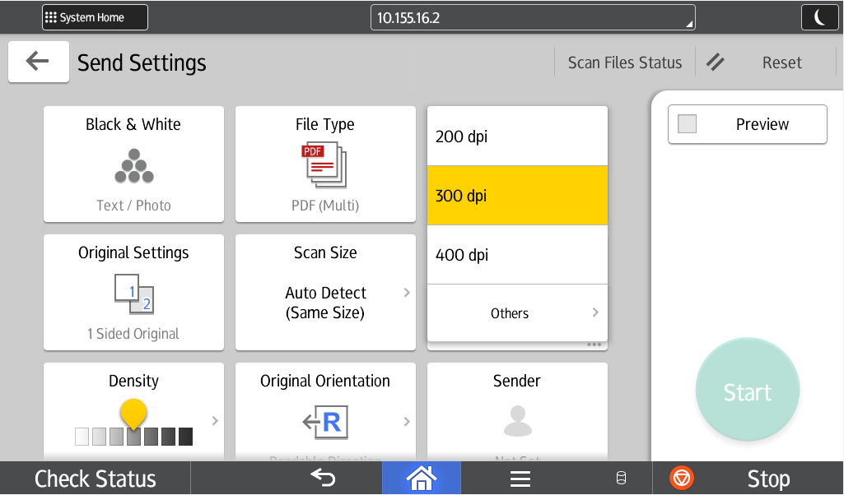
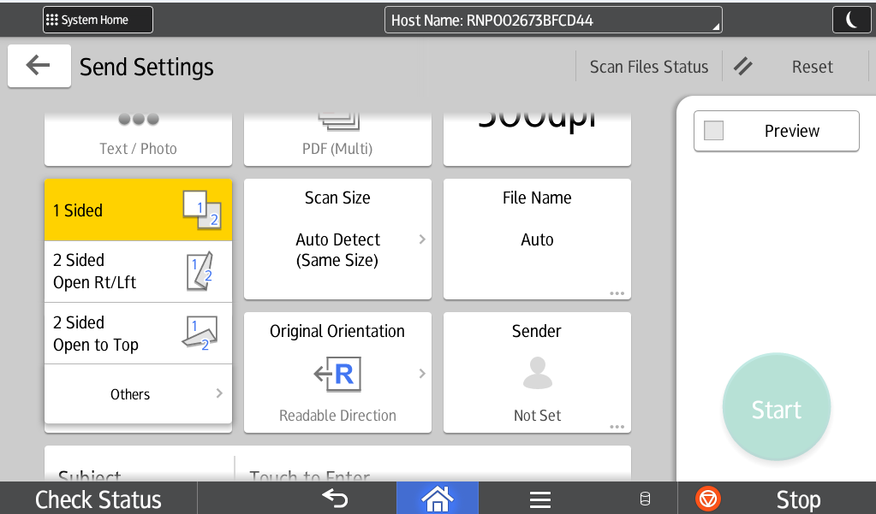
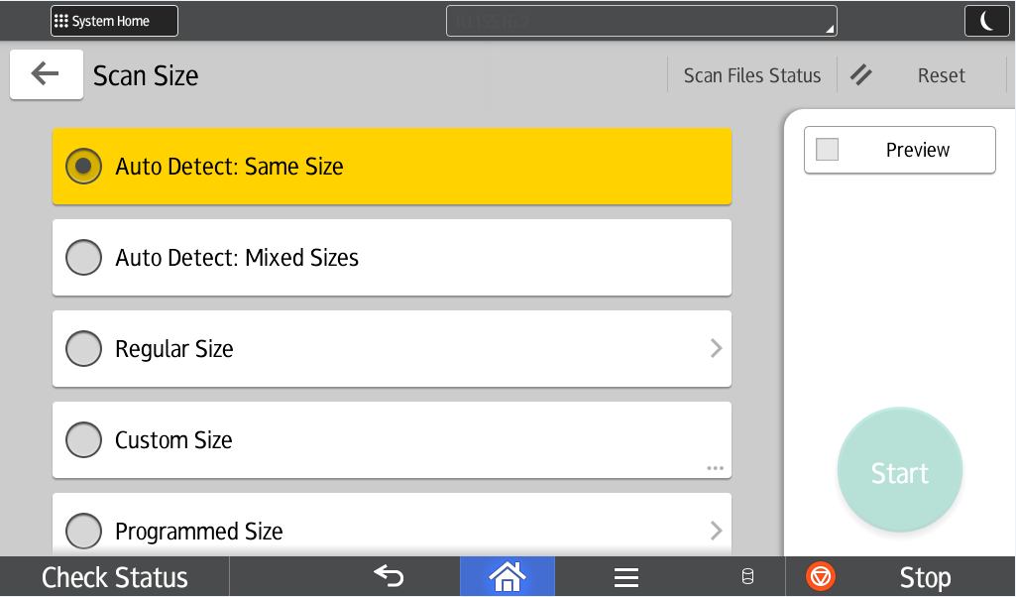
Ricoh Scan - Send Settings
Press Original settings
Choose from 1 sided, 2 sided open RT/ Lft, or 2 sided Top to Top.
Choose from Auto Detect : Same Size, Auto Detect : Mixed Sizes, Regular Size, Custom Size, and Programmed Size.
New! Blank Page Detect

Slide 42
Ricoh Scan
When done, press “Start”.

Slide 43
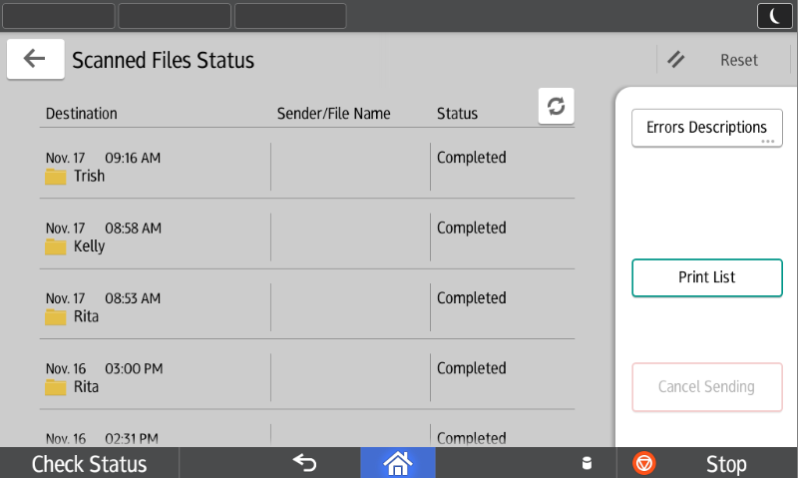
Scan File Status
Scan File Status: View status of a job or cancel a fax if status is pending.

Slide 44
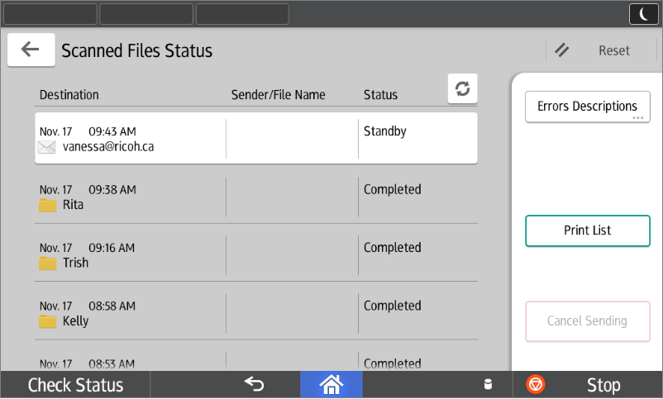
Ricoh Scan - Cancel a Scan
Select Scan File Status, Standby and then Cancel Standby.

Slide 45
Copy

Slide 46
Copy
Tap in or login with User Name and Password.
Select Account.
Press Device functions
Press Copy

Slide 47
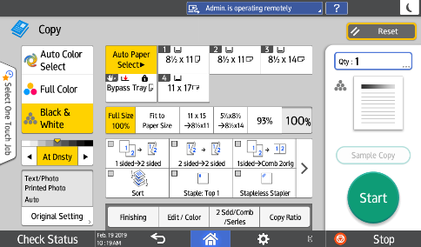
Colour or Black & White
You can choose Full Color or Auto Color Select when copying colour documents.

Slide 48


Reduce/Enlarge
Use Preset short cuts or press
Copy Ratio option to choose more presets from 25 to 400%, Zoom in 1% increments with + or -, or enter your percentage directly with Number Keys by pressing 100%...
You can also choose Scale to Paper Size to allow the device to decide how to reduce or enlarge to a particular size that you chose.

Slide 49
Quantity & Sort/Stack
Auto Paper Select: pick the paper tray
Qty: Select how many copies you would like.
Sort: You can turn on SORT to collate documents. Finishing for stack.
At Dnsty: Set density Lighter or Darker

Slide 50

2 Sided/Combine/Series
Use the Quick Buttons
or
Press
2 Sdd/Comb/Series
(2 sided/Combine/Series)
TIP: If 1 to 2 sided is the default uncheck it for 1 sided

Slide 51

Staple – Hole Punch
Press Staple Top 1 for a metal staple (50 pages) or Staple or Stapleless Stapler (5 pages) or Hole Punch.
Arrow over for more Quick Buttons
Press Finishing for more staple options

Slide 52


Original Size & Original Type
Original Size: allows you to select Mixed Sizes when your document has various page sizes in it.
Original Type: allows you to set the type of document to be copied, or choose Text, Text photo. Generation Copy, Light or Map for image repair.
Generation Copy – For originals that have been copied repeatedly. Will lighten the text and straighten out lettering.
Light – For originals containing light text. Will darken lighter text on a page only.
Map – For originals containing maps. Will darken faint lines on maps or drawings.

Slide 53


Create Margin and ID Card Copy
Select Edit / Color then
Create margin to shift wide images on document to allow for hole punching without losing important information on the document.
Or scroll to next page for features such as Create Margin and ID Card Copy

Slide 54
Device status, Misfeeds
and Maintenance
Blocages et Entretien

Slide 55


Check Status
When the LED under Check Status is lit, press Check to resolve the problem. Next to the function, the device indicates the reason for the error.

Slide 56



Check Status
Under Current Job, you can change the order of print jobs and delete a job that has not yet printed.
Under Job History, you can obtain certain details (file name, print time) of a completed job.

Slide 57



Misfeeds - Jams
Follow the indications on the screen that show you step-by-step instructions on how to remove the misfed paper.

Slide 58


Misfeeds – Right Side
Section Y
Sections B and C
Always remove the misfed paper in the same direction as the feed rollers.
Do not pull sideways as the paper will tear and the rollers will wear.

Slide 59



Misfeeds – Right Side
Section C- Entrance
Section Z - (Duplex unit), located inside the right panel

Slide 60

Misfeeds - Middle
Section C - Exit
Section D - Transfer Tray

Slide 61


Misfeeds - Finisher
Section R (1000-sheet finisher)
Misfeed areas in Finisher SR3210

Slide 62


Misfeeds - Finisher
Section R (1000-sheet finisher + Booklets)
Misfeed areas in Finisher SR3220

Slide 63

Misfeeds - Finisher
Section R (3000-sheet finisher)
Misfeed areas in Finisher SR3230

Slide 64


Misfeeds - Finisher
Section R (2000-sheet finisher + Booklets)
Misfeed areas in Finisher SR3240

Slide 65


Misfeeds – Internal Finisher
Section R (500-sheet finisher): Push the unit to the left
Turn the blue knob
to exit the paper
Misfeed areas in Finisher SR3130

Slide 66


Misfeeds – Document Feeder
Section P
Push the grey latch to access the sheet from the inside
Original misfeed

Slide 67


Document Feeder
The 3 sensors on the feed table should not be blocked by paper, etc. It will result in undesired paper size output, or the unit will beep indicating to load special paper size in the tray
Document Feeder Sensors

Slide 68

Maintenance – Document Feeder
A cloth is supplied with your device. Please clean the 2 scan glasses and the exposure glass frequently, or, when you notice lines or spots on your copies or scans.

Slide 69
Rebooting Machine
To reboot: Press the main power button, Machine will do a shut down. When shut down count to 10 and press the main power button to start up machine.

Slide 70

To Place a Service Call
To place a service call please contact Ricoh.
You need to have the machine serial number available which is on the Ricoh sticker on the front of your machine.

Slide 71
Changing Toner, Waste Toner Cartridge and
Staple Cartridges

Slide 72



Changing the Toner - BW
Open the front panel and remove the used cartridge.
Shake the new cartridge LIGHTLY vertically (see inside panel), unscrew the cap, and insert it into the toner unit with the arrow on top.
NEVER REMOVE, SHAKE AND RE-INSERT THE USED CARTRIDGE
When the Add Toner message appears under Check Status, it is time to change the toner cartridge.

Slide 73


Replacing the Toner- Colour
Open the front panel and remove the used cartridge.
Shake the new cartridge LIGHTLY vertically (see inside panel), unscrew the cap, and insert it into the toner unit with the arrow on top.
NEVER REMOVE, SHAKE AND RE-INSERT THE USED CARTRIDGE.
When the System Message box shows toner bottle empty, it is time to change the toner cartridge. You can still print up to 300 pages in this state.

Slide 74



Waste Toner Cartridge -Colour Machines Only
A message will appear in the System Message box that will let you know when the waste toner cartridge is getting full.
To change cartridge, open the door next to Tray 1, remove the full waste toner bottle, replace with new waste toner bottle.
Order an extra cartridge with supplies (free with service contract)

Slide 75
Toner - @Remote – Auto Toner Program
“
Please be aware that the Auto Toner program works on the assumption of having one toner (of each color) on the shelf.
When a toner cartridge is replaced, the toner level for that color will go to 100% and this will trigger an auto toner order from @Remote. When this happens, our @remote automation tool will simultaneously look at the toner levels for other colors. If the system detects that the remaining level of toner is 20% or less for any of the other colors, it will bundle those in with the order for the original color and ship them all together. Subsequent alerts for the bundled color will be ignored until after it has reappeared at 100%.
For example: if a Yellow toner is replaced, the toner level for that color will go to 100% and it will trigger an auto toner order from @Remote. The system will then look at the level of toner remaining in the Cyan, Black & Magenta cartridges. If, for example, the Cyan toner is at 20% or less, it will be bundled and shipped with the Yellow toner. The Cyan toner will not be eligible to be re-ordered until after it has alerted at 100%. It would then be eligible to be ordered either the next time it alerts at 100% or the next time appears at less than 20% on another color’s replenishment alert.

Slide 76



Staples – Type T Internal finisher
Following the instructions on the display or box of staples, push the stapling unit to the left, pull out the casing, remove the empty cartridge, and insert a new one
Type T
500-sheet Finisher (SR3130): when the Staple icon (Top Right of screen) flashes, it is time to change the staple cartridge

Slide 77




Staples – Type T
Following the instructions on the display or the box of staples, remove the cartridge from the casing and insert a new one
1000-sheet Finisher (SR3210): when the Staple icon (top right of screen) flashes, it is time to change the staple cartridge

Slide 78

Staples – Saddle Stitch
Following the instructions on the display or the box of staples, remove the cartridge from the casing and insert a new one
Pull out the stapling unit by its handle. The staple cartridge is located on the left side
1000-sheet Booklet Finisher (SR3220): when the Staple icon (top right of screen) flashes, it is time to change the staple cartridge

Slide 79



Staples – Type S – Type K
Staple ctg Type S
Refill ctg Type K
1000-Sheet Booklet Finisher (SR3220),

Slide 80



Staples – Type T
Following the instructions on the display or the box of staples, remove the cartridge from the casing and insert a new one
Type T
2000-sheet Booklet Finisher (SR3240): when the Staple icon (top right of the screen) flashes, it is time to change the staple cartridge

Slide 81
Thank You
Ricoh
2019 Energy Star Manufacturer of the Year

