Slide 1
Building for the Future: Foundations for Sustainable Prosperity
Greg Halseth & Don Manson
Community Development Institute
at UNBC

Slide 2
Outline
Introduction
Community Development

Slide 3
1) Introduction

Slide 4
Historically
Natural resources maintained local economies
Required many labourers
Communities were ‘centres’ to local hinterlands
Provincial government invested in these communities
  Services
  Facilities
  Amenities
Disrupted after 1980

Slide 5
A New Game Now
Pressures since:
    International trade agreements
    Trade globalization
    Low cost production regions
Resource industries are concentrating
Technology is labour-shedding
  Job losses
  Limited wage benefits remain

Slide 6
At Issue:
Challenge
  Small town and community change
  Fast pace of globalization
Opportunity
  Building resilient communities based on local assets, actions & aspirations

Slide 7
Question
  How to equip communities to exercise place-based advantages & meet development opportunities & challenges on own terms?

Slide 8
2) Community Development

Slide 9
Answer: Focus on
Community Readiness
Understanding the role / position of your region in the world
Grounding strategies in a realistic, in-depth analysis of our local & regional assets and aspirations
Focus more on long-term implementation of vision

Slide 10
Community Development Foundations
The ability of communities to identify aspirations & organize assets and resources to achieve their objectives
Increasing the skills, knowledge & abilities to access/use information & resources
Create strategies & partnerships to take advantage of changing circumstances
A long-term, sustainable vision that facilitates community well-being, quality-of-life & resilience

Slide 11
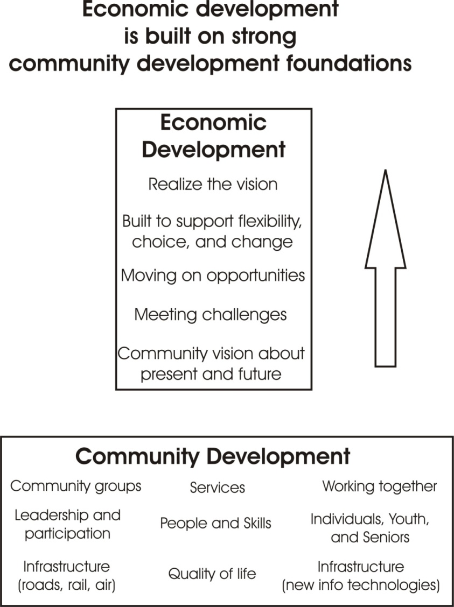
Keys to Innovation
Create a broad community development platform as a foundation for seizing opportunities

Slide 12
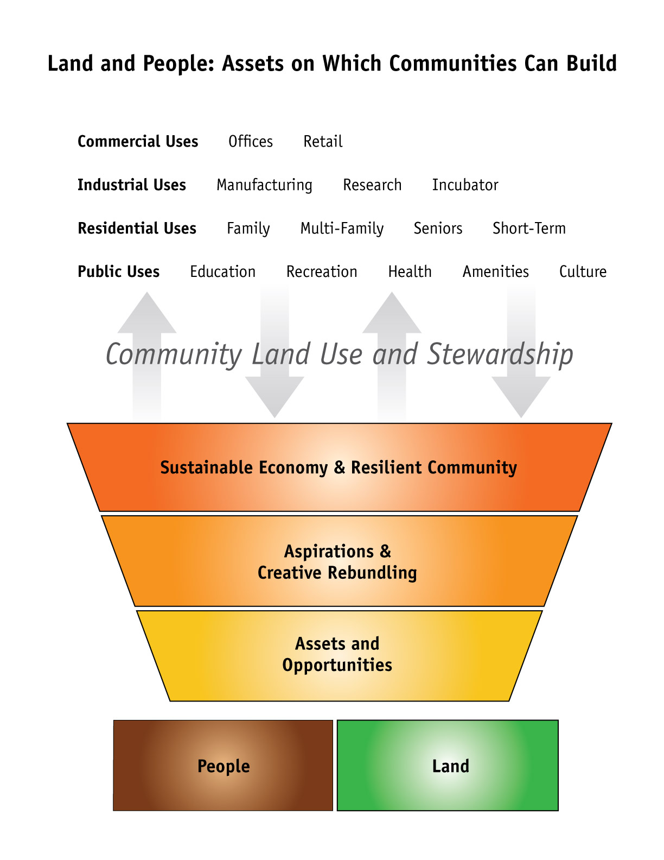
Community Assets: Land & People

Slide 13
Place-Based Development
A place-based economy demands much more of local capacity
Accommodates new relationships, partnerships, collaboration & wider inclusion
Competitive variables:
  Traditional: Infrastructure, production, location, economic structure & amenities
  Newer: Social capital, innovation & institutions

Slide 14
CD & Economic Development
Rebundle community assets
Reimagine community aspirations
Reinvestments in local social, economic & cultural infrastructure
From resource dependence to a diversified economy grounded in resources & inclusive of other options

Slide 15
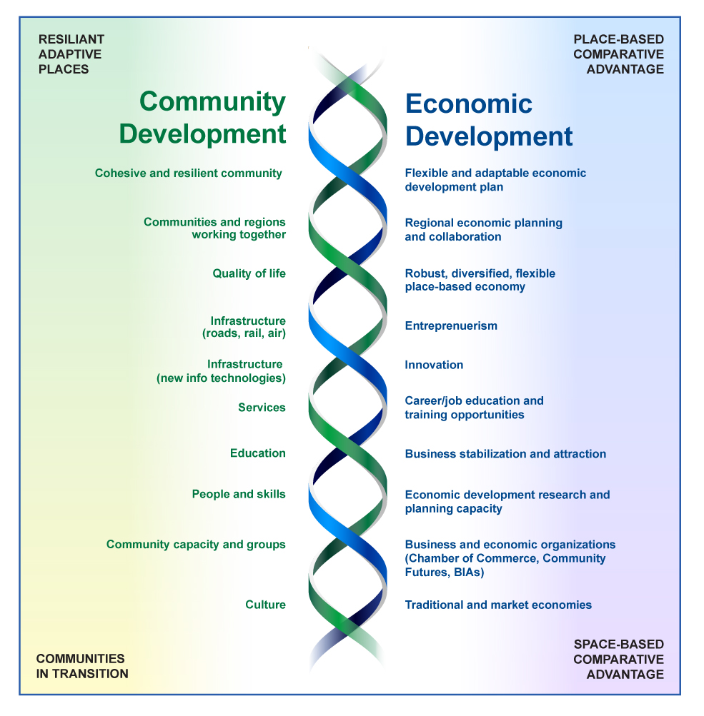
In Practice: Interdependent & Mutually Supportive

Slide 16
Lessons I
A “new base for successful rural innovation”
  Work as regions
  Scale up/strategic partnerships
  Focus on readiness
  Key infrastructures
    Physical
    Human
    Community
    Economic

Slide 17
Lessons II
Re-bundle our competitive assets in innovative ways
Attention to 4 "bottom lines"
  Community
  Economy
  Environment
  Culture

Slide 18
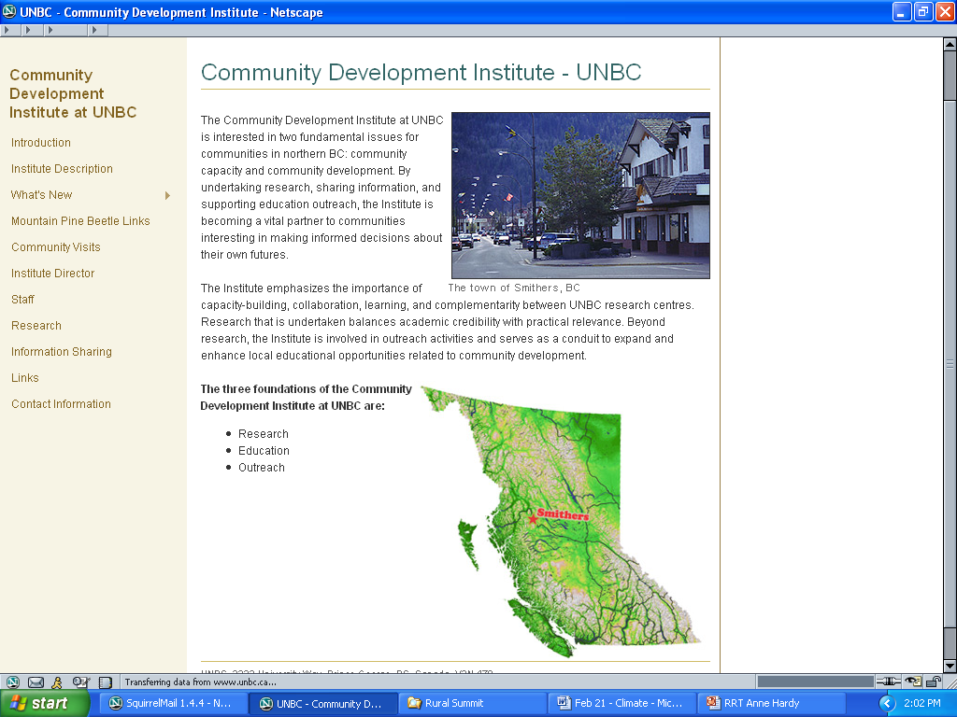
www.unbc.ca/cdi

Slide 19
Greg Halseth
Professor, Geography
University of Northern British Columbia
http://www.unbc.ca/geography/faculty/halseth/index.html
Canada Research Chair in Rural and Small Town Studies
Community Development Institute – UNBC
http://www.unbc.ca/cdi/

