Slide 1
Community Development Institute (CDI)
Community Speaker Series
The Housing Continuum
Craig Crawford, Vice President, Operations
BC Housing
April 23, 2012

Slide 2
partnership model
Private/Voluntary Sector
Health Authorities
Local Government
Community Based Housing Delivery
BC Housing
Federal Government
Notes:
Importance of Non Profit Housing Providers
Close to community – not perceived as government
Uses local knowledge to enhance project
Willing to contribute financially
Takes on development risk
Provides a greater diversity of housing
Supported by a professional association
Creates pressure for political support for affordable housing
Musters community support
Importance of Municipalities
Land available
Inclusionary zoning
Density bonusing
Pre-zoning of sites
Small lot development
Alternative development standards
Housing Agreements and limited value of resale
Mixed income communities
Development approvals – fee waivers, faster processing
Property tax waivers
Non Profit partners are responsible for the planning, delivery and operation of projects
BC Housing’s role is to manage housing program delivery
BC Housing uses a set of budgeting and cost management tools to ensure that sound fiscal management principles are brought to the process
These tools include:
Program Frameworks
Design and Construction Standards
Standard Contract Forms
Unit Rates
Value Analysis
Provisional Project Approval and Final Project Commitment Milestones

Slide 3
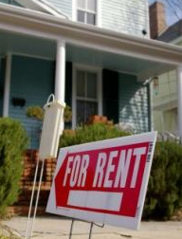

Housing Continuum
Emergency Shelter & Housing for the Homeless
Supported
Housing
Independent Social Housing
Market Rental
Home Ownership

Slide 4
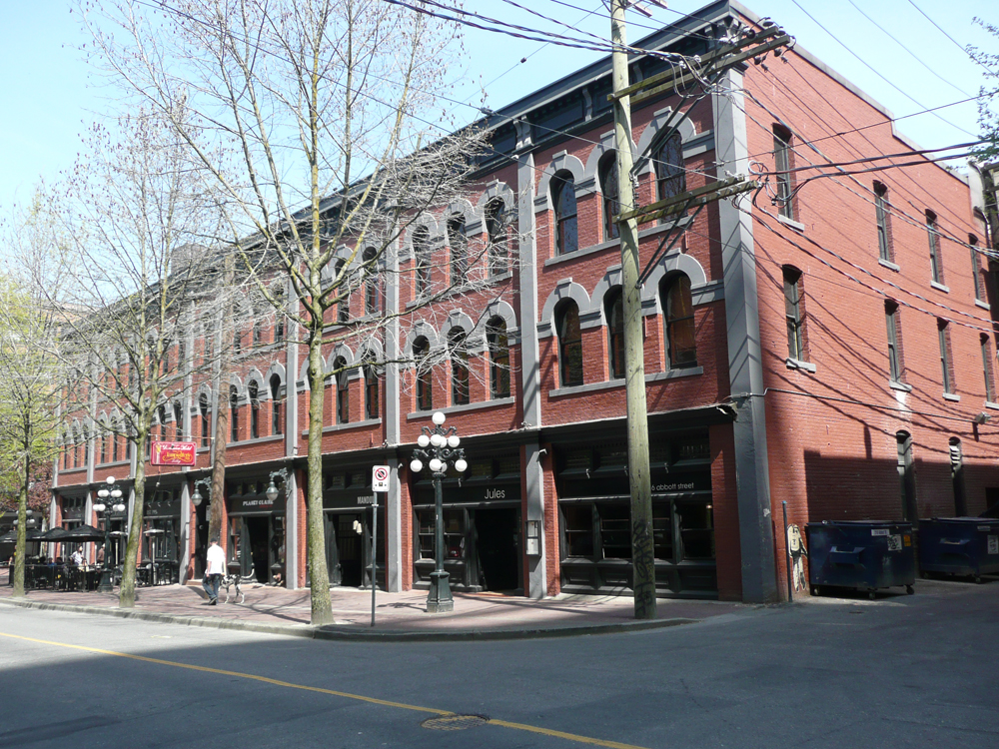
single room occupancy hotels
Notes:
purchase existing stock : preservation strategy while new stock gets built
Purchased 47 buildings across the province
27 SROs (12 in 2007 / 8 in 2008 / 7 in 2009) Vancouver, New West, Abbotsford, Quesnel, Kamloops, PG, Williams Lake, Nanaimo,Victoria, Port Alberni
1,556 units after renovations
Purchase: $91.8 million
Renovation: est. $53.7 million (renovations ongoing)
Operating: est. $7.8 million annually (avg. $500K/100 unit bldg.)
Housing Stock: primarily BC Housing owned; property management and support services provided by non-profit organizations
Experienced non-profit housing providers 24 /7 staff
The cost of purchasing and renovating the SROs is approximately $113,000 per unit.
The cost of building new supportive housing is approximately $250,000 - $300,000 per unit.
Dominion in Gastown, commercial ground floor ( $)

Slide 5
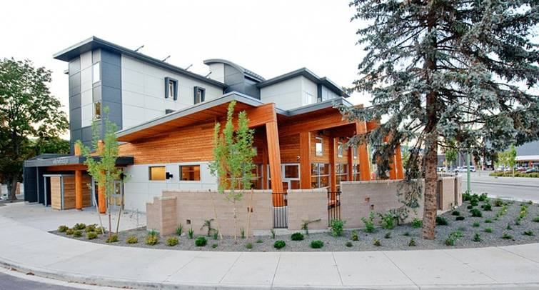
willowbridge, kelowna

Slide 6
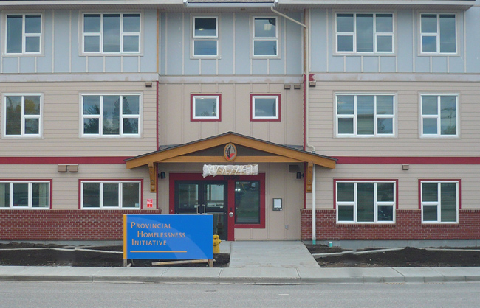
Friendship Lodge, Prince George
Notes:
Also: 36 seniors units on 6th avenue
30 units of modular seniors housing on the Hart Highway

Slide 7
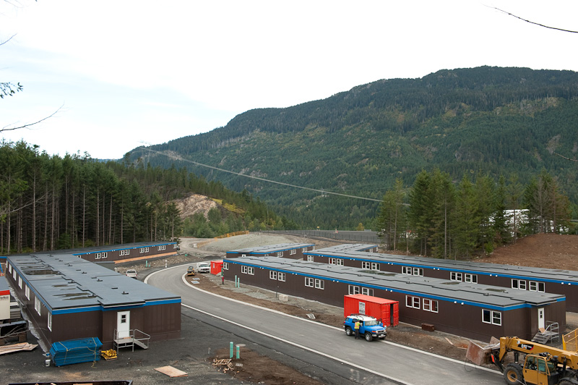
Whistler Olympics modular housing
Notes:
Whistler:
80 “boxes”
640 beds
$100,000 / box
$13.5 M
BC Housing:
6 sites
156 units
$221,000 / unit
$34.6 M

Slide 8
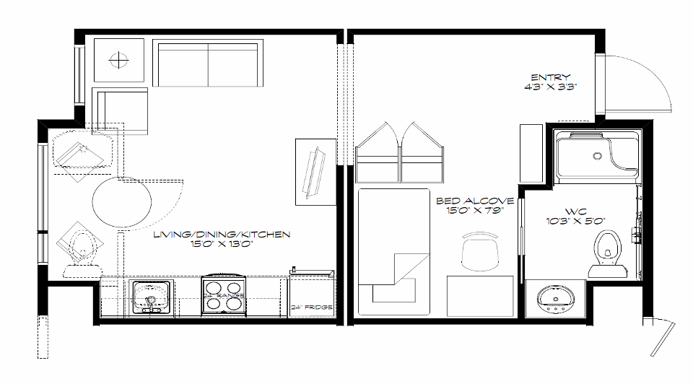
modular housing
Notes:
VANOC design based on work force housing – simple camp arrangement.
Some specifications : doors , flooring, trim, electrical and plumbing rough ins to accommodate our end use.
Units built taken apart after the Olympics.
Re-assembled back to back – Olympic mode corridor becomes exterior.
Provides interesting articulated exterior.
Stack and create corridor.
Build common area as needed for use, kitchen/dining/offices/support.

Slide 10
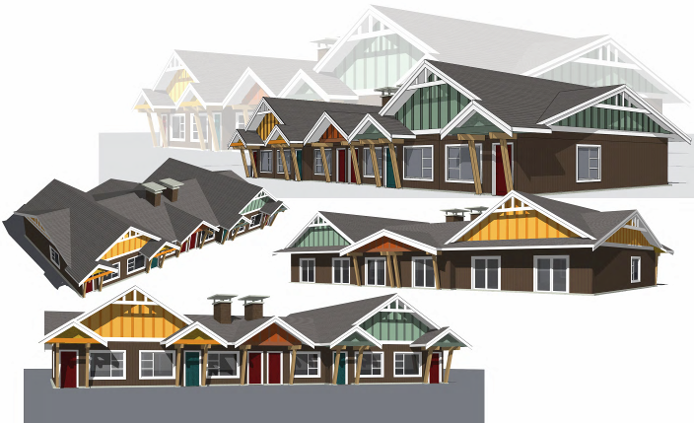
seniors rental housing
Notes:
$52,000 per modular unit
$150,000 complete
400 units
29 sites

Slide 11
seniors rental housing

Slide 12
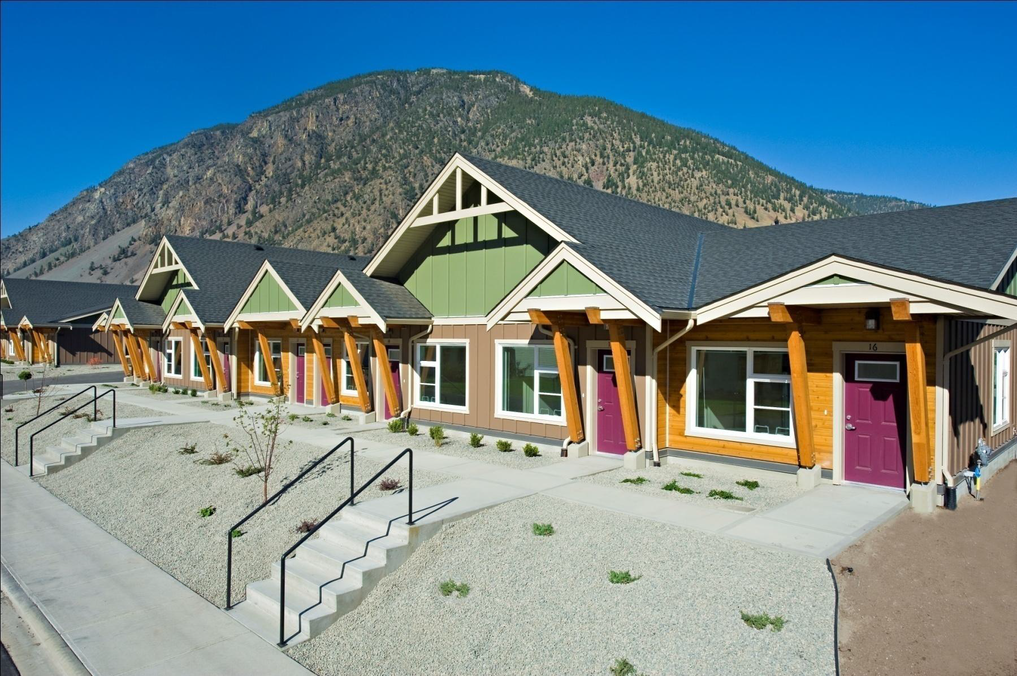
seniors rental housing

Slide 13
Community Development Institute (CDI)
Community Speaker Series
The Housing Continuum
Craig Crawford, Vice President, Operations
BC Housing
April 23, 2012

