Slide 1
Solving From The Source
Using Design and Teaching Goals to Find Assessment Solutions
Lisa Dickson Grant Potter 17 July 2020 UNBC
Notes:
Grant does intro

Slide 2
Notes:
lisa

Slide 3
Notes:
lisa

Slide 4
PROBLEM: Academic dishonesty during online exams
If the students are not watched throughout the exam, what is to stop them from conferring with each other or using their textbook or the internet to find the answers?
How can I observe students in an online exam to make sure they aren’t cheating?
Notes:
Grant will frame issue

Slide 5
PROBLEM: Promises and claims of online proctoring services
https://www.theverge.com/2020/4/29/21232777/examity-remote-test-proctoring-online-class-education
Notes:
Grant will speak to proctoring

Slide 6
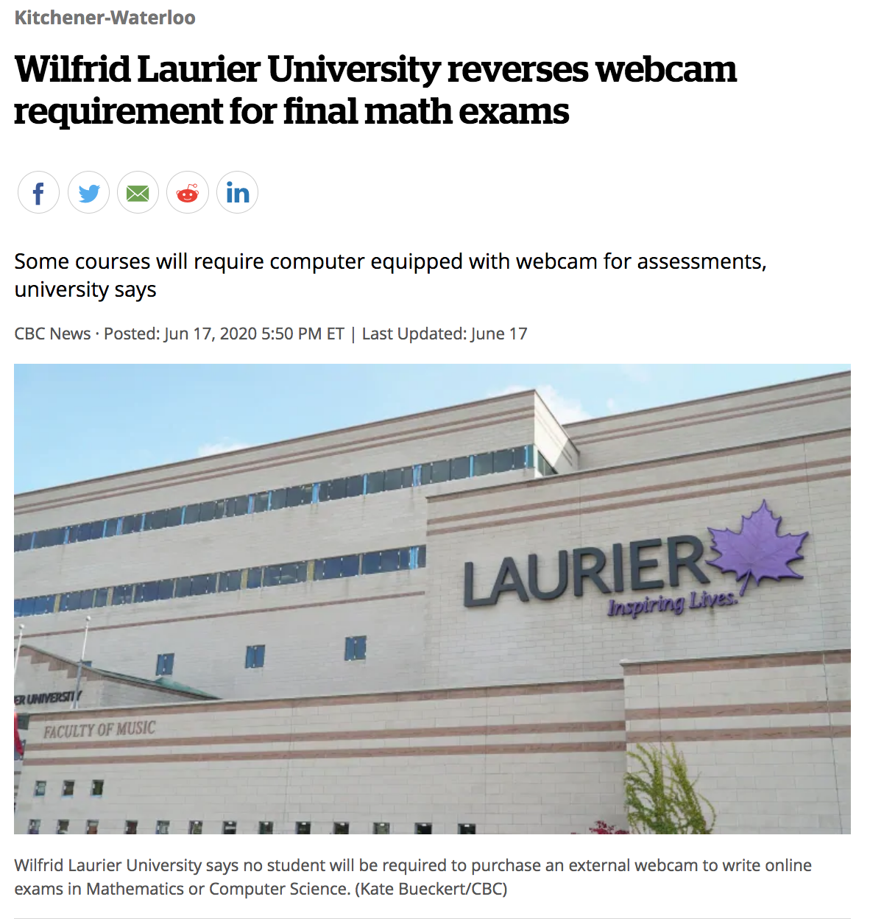
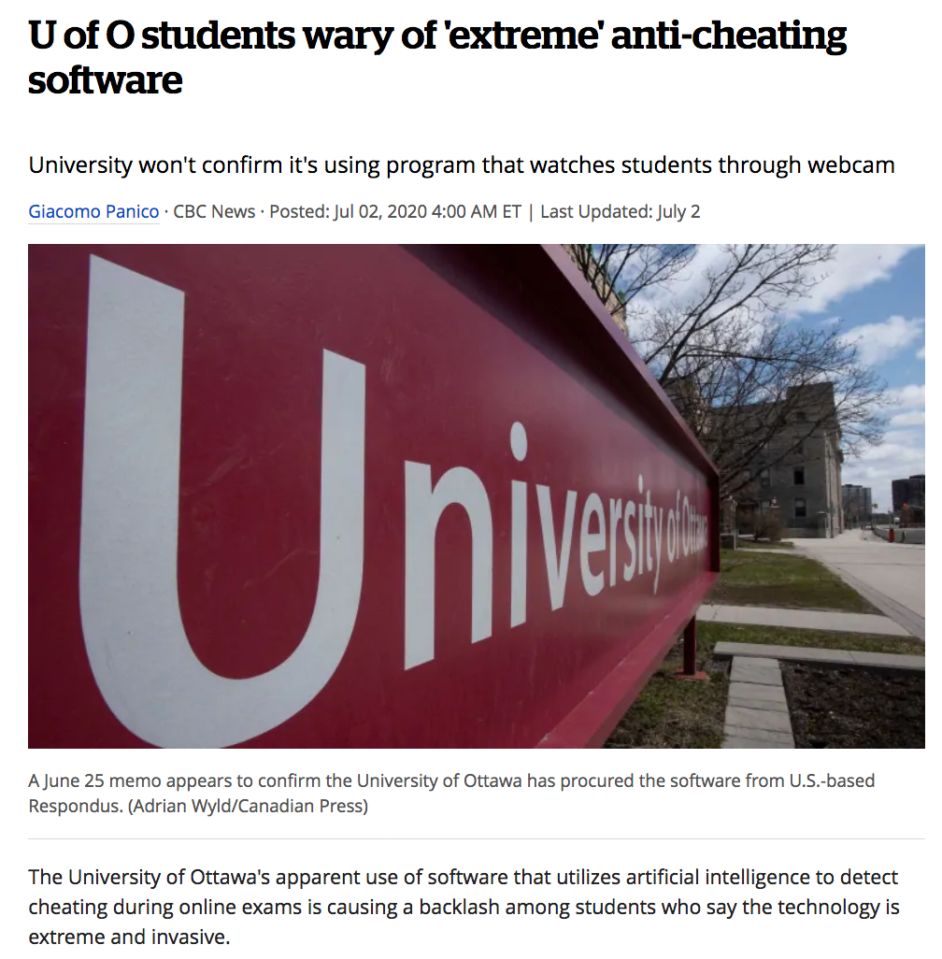
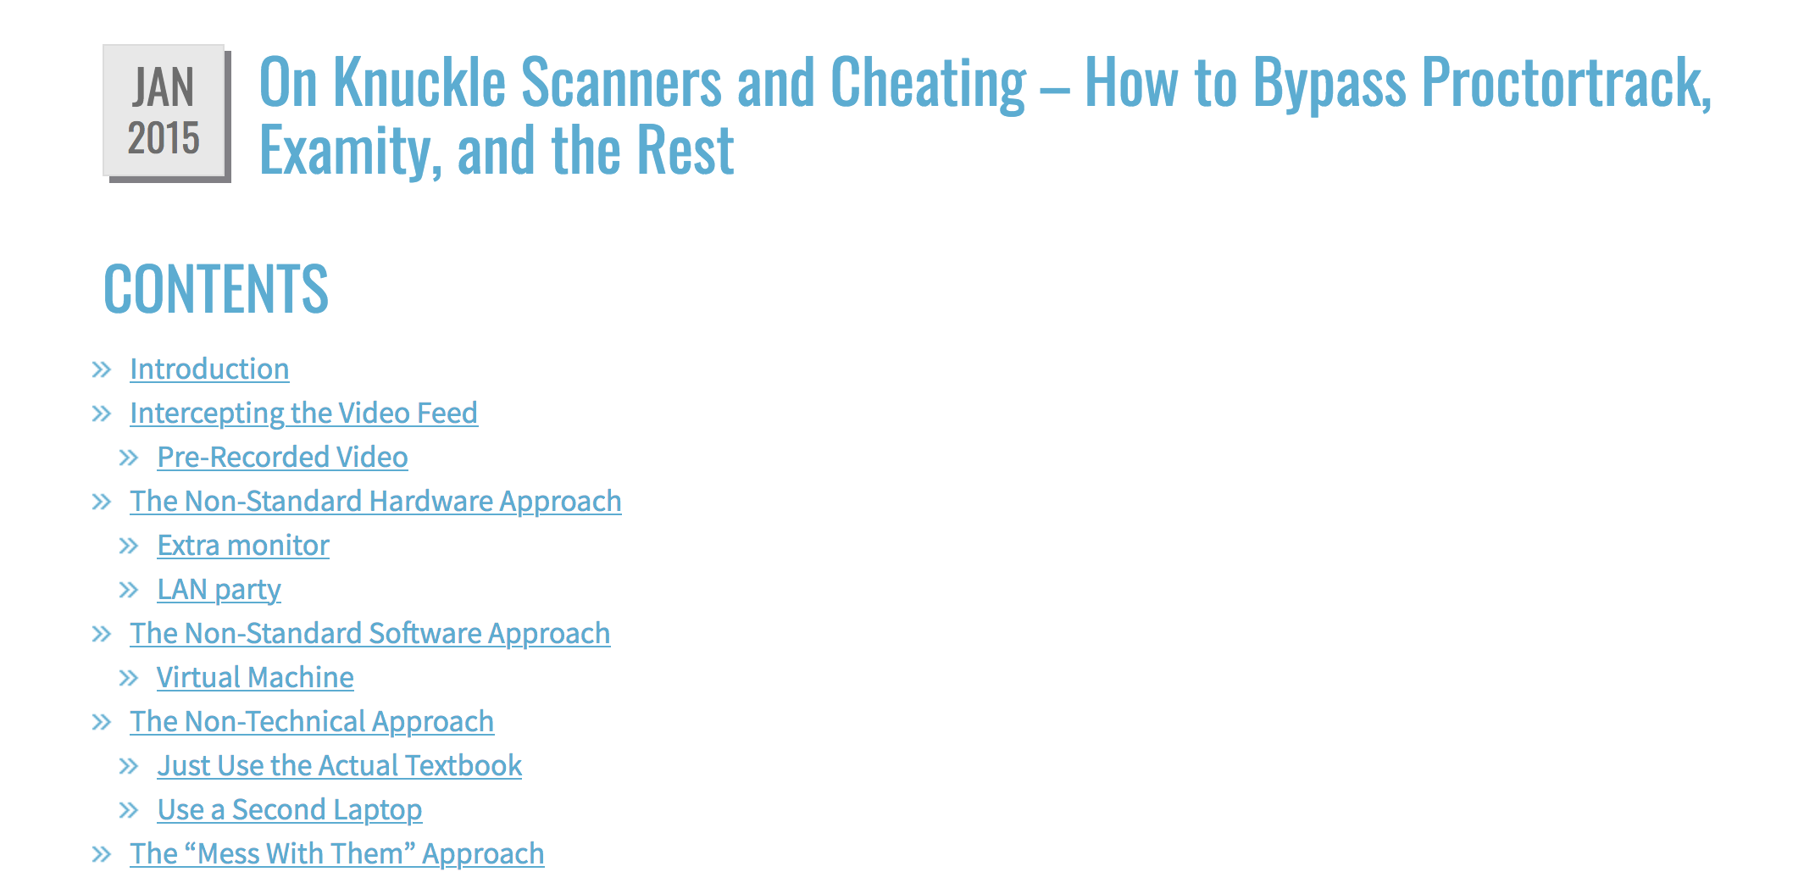
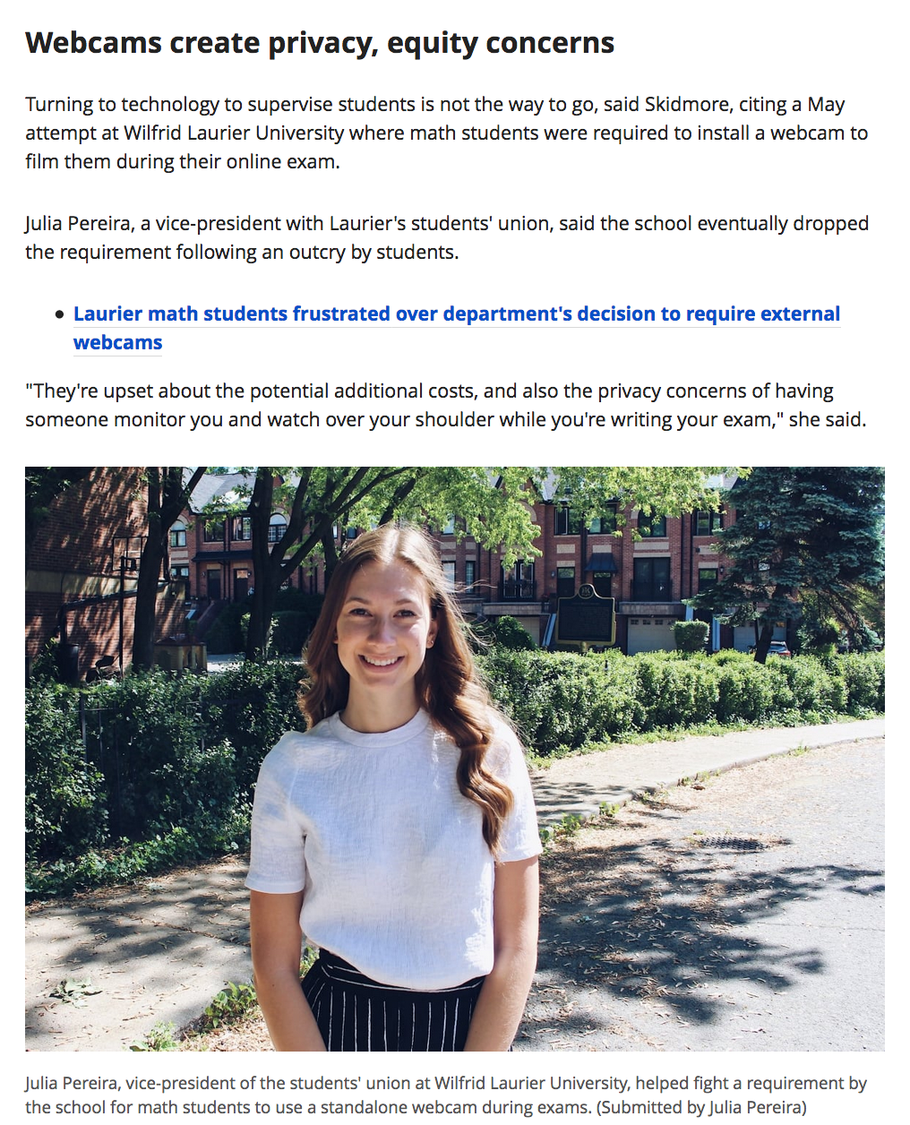
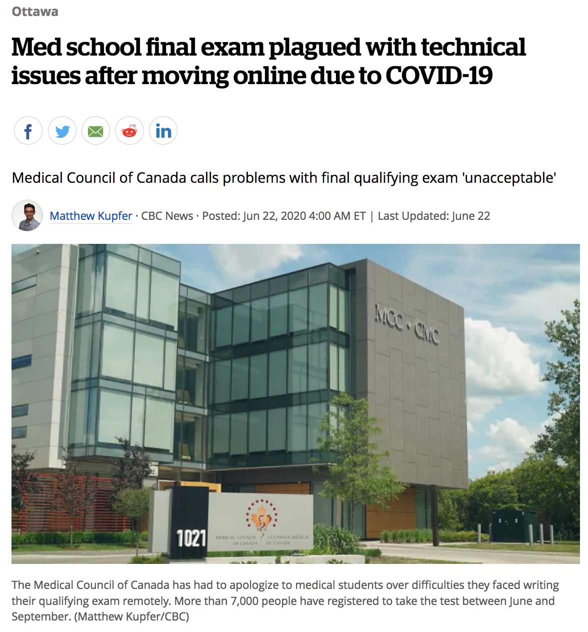
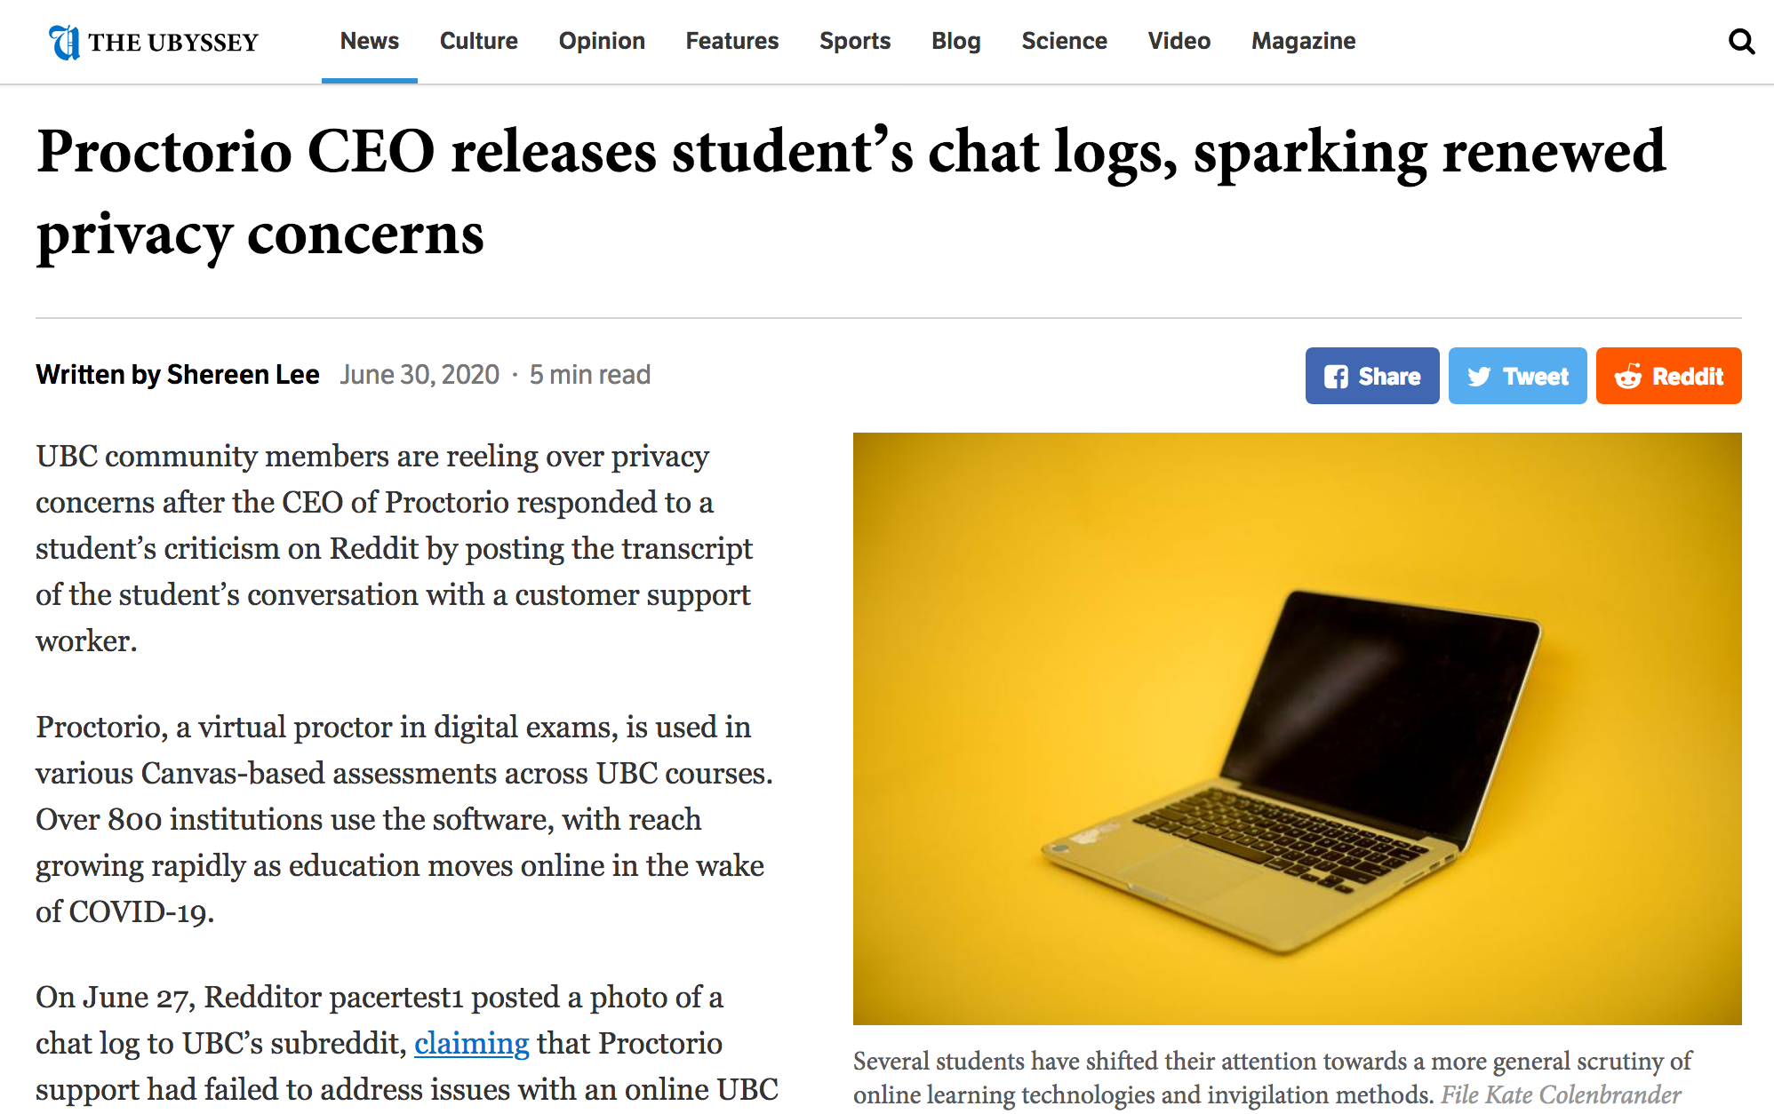
Notes:
Grant will speak to incidents

Slide 7
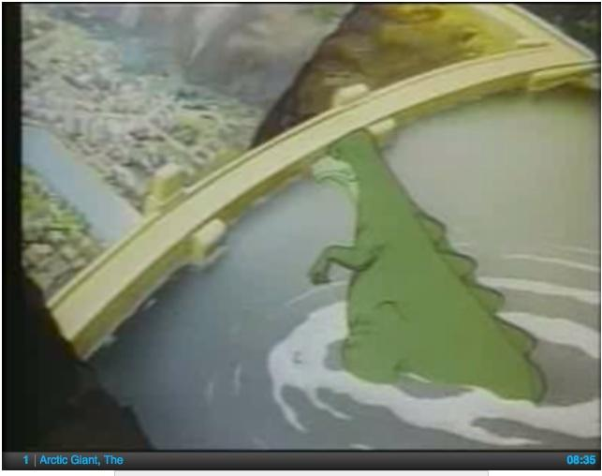
IDENTIFYING THE PROBLEM
Sometimes, what appears to be a TECH problem is actually a problem farther UPSTREAM.
Notes:
Grant will talk about upstream solutions

Slide 8
REFLECTION/PHILOSOPHY
DESIGN
ASSUMPTIONS ABOUT THE LEARNING ENVIRONMENT
ALIGNMENT OF GOALS and PRACTICES
Notes:
Lisa
Assumptions re learning environment:
What are the roles of teachers and students?
What is the nature of knowledge creation in the course?
What is the purpose of class time?
Alignment:
Trust is grounded in the sense that what we SAY and what we DO are are aligned.

Slide 9
Notes:
Lisa
REFLECTION can seem like a ‘waste of time’ when you’re trying to plan a course, but it can be a huge time-saver down the line because it provides a solid basis for decision-making and design that reduces anxiety.

Slide 10
A PROBLEM FOR PHILOSOPHY
What assumptions do we make about the students or the learning environment that influence the KINDS OF SOLUTIONS we turn to in order to resolve our concern?
Notes:
Lisa
EG:
Knowledge production: grounding assumptions determine what you see as viable solutions:
What are the roles of teachers and students?
Authority / novice;
Master / apprentice;
Gatekeeper / candidate
Facilitator / participants
Knowledge creation:
Teachers provide and students receive (transfer)
Teachers and students create knowledge together (co-creation)
What is the purpose of class time?
Space for transfer of knowledge;
Space for application and exploration;
Space for student interaction/collaboration

Slide 11
SYSTEMIC CONSIDERATION
“[It] is worth noting that, where the stress and stakes are high and acutely felt, particularly where outcomes are perceived to have a significant impact on career, cheating is a rational course of action.”
(Tim Fawns, Teaching Matters Blog, University of Edinburgh, 3 June 2020)
https://www.teaching-matters-blog.ed.ac.uk/spotlight-on-alternative-assessment-methods-alternatives-to-exams/
Notes:
FOUR “CONSEQUENCES” OF INSTRUMENTALIZATION AND CONTRADICTION IN THE LEARNING ENVIRONMENT
ACADEMIC DISHONESTY
UNHEALTHY PRACTICES (cramming, lack of sleep, performance anxiety)
COPING BEHAVIOURS (drinking, procrastination etc.)
SELF-SABOTAGE (Pizzolato: students regularly sabotage their LEARNING in order to get the GRADE---> disjunction of LEARNING from GRADES, default to “safe” performances, loss of opportunity for growth and deep learning)

Slide 12
SUPPORT AND TRUST
“[W]e can’t tell our students we will support them as they take risks if they don’t trust that we will indeed do so” (Kevin M. Gannon, Radical Hope: A Teaching Manifesto, 141).
Notes:
Lisa
Cultures of mutual distrust are created in the gap between what we say we want and what we actually ask for.

Slide 13
CREATING AN INTELLECTUAL COMMUNITY
“Giving and taking of orders modifies action and results, but does not of itself effect a sharing of purposes, a communication of interests” (John Dewey, Democracy and Education, 8).
Notes:
Lisa
Cultures of trust can arise only between people who are agents who participate in a community with a shared purpose
I.e. it doesn’t really work well in a situation where one participant feels powerless or lacks investment in the goals and purpose

Slide 14
THINKING TOGETHER
“…the aim is to think together how a community of selves aiming to truth could act freely. In other words, how we, as responsible beings, should behave” (526).
Juha Himanka. “The University as a Community of Selves: Johan Vilhelm Snellman’s ‘On Academic Studies’.”
SURVEILLANCE
CONVERSATION
Notes:
Grant

Slide 15
SHIFTING THE PARADIGM
Notes:
Grant

Slide 16
NOVEL CONDITIONS,
REORGANIZED UNDERSTANDING
“There is an accentuation of personal consciousness whenever our instincts and ready formed habits find themselves blocked by novel conditions. We are thrown back on ourselves to reorganize our own attitude before proceeding to a definite and irretrievable course of action” (John Dewey, Democracy and Education, 368).
Notes:
Lisa
COVID has provided the opportunity to rethink stuff that we do just because that’s how we do it. When we are having to rethink how we do them, it can be helpful to reconsider the why.

Slide 17
QUESTIONS for REFLECTION
Is COMPLIANCE the desired outcome of my teaching?
Do my current practices respect or undermine the DIGNITY of my students?
How can I foster the AGENCY and HUMANITY of students as part of a well-functioning academic COMMUNITY?
Notes:
Lisa
Consider what your foundational values are.
What are your glass balls and which are the rubber ones?
What can’t you compromise on.

Slide 18
REFRAMING THE QUESTION
What about the LEARNING ENVIRONMENT makes cheating a reasonable action on the part of students?”
What could I change in the learning environment or in my practice that would REDUCE THE ANXIETY that leads students to cheating?
What could I change in my assessment model that would allow students to DEMONSTRATE THEIR LEARNING in robust and meaningful ways?
“How do I keep an eye on students to keep them from cheating on an exam?”
Notes:
Lisa
This sort of reflection can begin from looking at the kinds of questions we’re asking and exploring what assumptions are shaping our orientation toward the “problem.”

Slide 19
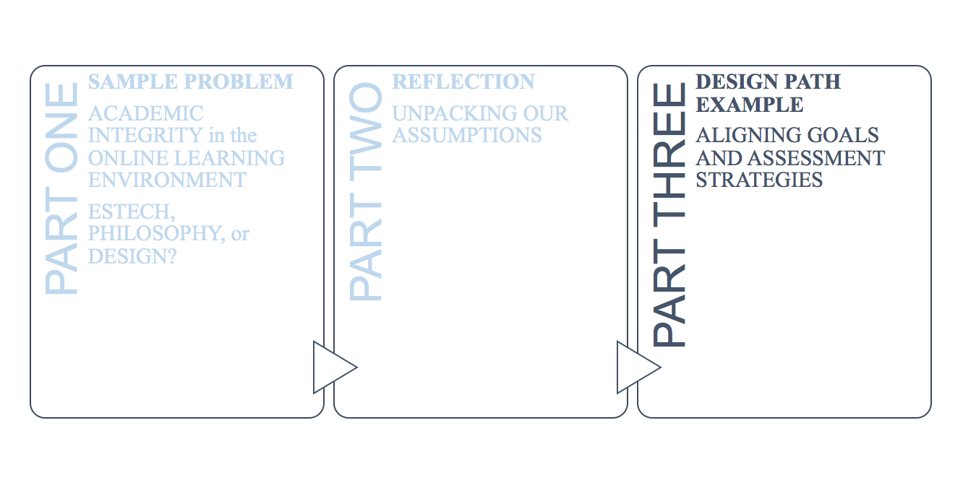
Notes:
grant

Slide 20
A PROBLEM FOR DESIGN
How do my GOALS for the course shape what I see as effective and worthwhile in terms of assessment?
Notes:
grant

Slide 21
MINING THE QUESTION:
If the students are not watched throughout the exam, what is to stop them from conferring with each other or using their textbook or the internet to find the answers?
How can I observe students in an online exam to make sure they aren’t cheating?
UNDERLYING ASSUMPTION:
using these resources is the same as cheating.
Notes:
grant

Slide 22
REFRAMING THE QUESTION
If the students are not watched throughout the exam, what is to stop them from conferring with each other or using their textbook or the internet to find the answers?
Does my assessment strategy enable the PREFERRED BEHAVIOUR of our discipline?
Does my assessment strategy engage with the way knowledge is CREATED and USED in my discipline?
Notes:
grant

Slide 23
A PROBLEM OF DESIGN: Example from IASK
COURSE GOAL: To prepare students to function as part of a scholarly or professional community.
ACTIVITY of the COMMUNITY: debate, shared resources, applied research.
ASSESSMENT: Individual exams with no opportunity for consultation, collaboration or access to resources.
Notes:
Lisa
An example from IASK:
Once the path is drawn out, it’s very easy to see the disjunction between what we were TEACHING and DOING in the courses and what we were actually testing.
We were saying on the one hand that we value research and collaboration as behaviours students should take up as members of our discipline
But on the other hand we tell them that these behaviours are not an appropriate measure of their knowledge.
GAP→ mistrust and anxiety
SO/ we redesigned for collaborative, open book exams which are better suited to the goals of the course.

Slide 24
GOAL
ASSESSMENT
ANXIETY
ACADEMIC DISHONESTY
Notes:
Lisa
It can be helpful to consider that students don’t cheat because they are cheating cheaters but because they are responding to the system in which they are acting.
It may be engine knock. If your engine is making unhappy noises, you don’t assume a moral failing; you do a diagnostic.
Academic dishonesty will never be fully resolved (because humans are humans) but if we recognize that it often arises from design issues, then we can deploy design solutions that don’t involve dehumanizing or demonizing students.

Slide 25
STOP, ASK, REFLECT
Am I actually assessing the KNOWLEDGE & BEHAVIOURS I want to assess?
Can this outcome be demonstrated in circumstances where a student may consult resources or other students?
Notes:
Lisa
If surveillance is fraught with problems, not the least of which is the violation of the dignity and privacy of students, we can rethink our questions. Instead of asking how can I police my students, we could ask, how can we reshape the experience of education so that policing isn’t necessary.
We ask them to trust us every day. What if we started to trust them to make good choices in a healthy environment?

Slide 26
CLARITY OF RATIONALE🡪TRUST
“When students are not just ordered to obey rules handed down from above they will also learn to think about how to construct a well-functioning community” (526)
Juha Himanka. “The University as a Community of Selves: Johan Vilhelm Snellman’s ‘On Academic Studies’.”
TRANSPARENCY
SHARED VALUES
Notes:
Lisa
We can always ensure compliance, but compliance is not necessarily learning.
You can’t beat someone into learning unless what you’re teaching them is how to avoid a beating.
Transparency and shared values create a shared sense of purpose.

Slide 27
DESIGN SOLUTION: Aligning Goals and Assessments
GOAL
ASSESSMENT
Notes:
Grant

Slide 28
GOAL
OUTCOME
What is the purpose of the course in terms of its relation to the students’ role in the DISCIPLINE?
STRATEGY
What do I want students to
DO
KNOW
CARE ABOUT?
How will the students DEMONSTRATE these outcomes in a way that is
SPECIFIC, MEASURABLE, ACHIEVABLE and RELEVANT?
TRUST
Notes:
Grant

Slide 29
GOAL
OUTCOME
To provide skills and knowledge that will allow students to PROGRESS to the next stage of the DISCIPLINE
STRATEGY
SYNTHESIZE information and
APPLY a skill to a problem using discipline-specific ways of thinking and acting
TECHNOLOGY
Open Book exam;
Requirement for accurate and detailed citation of all sources (including each other)
Techniques and approaches
Notes:
Grant

Slide 30
GOAL
ASSESSMENT
TRUST and SHARED VALUES
ACADEMIC INTEGRITY
Notes:
Grant

Slide 31
TAKEAWAYS
In order to find APPROPRIATE SOLUTIONS we can work to
IDENTIFY the source of the problem (Technical, Design, Goals);
INTERROGATE the ASSUMPTIONS we are making about the learning environment;
ALIGN our practices with our GOALS;
CULTIVATE TRUST by thinking of the AGENCY of students as partners.
Notes:
Both
For me, it all comes down to the last point, that we need to consider students to be SELVES, agents, active participants in their own education. Once that becomes your foundation, a lot of other solutions fall into place.

Slide 32
LET’S HAVE THE CONVERSATION
LISA DICKSON: Chair, Pedagogy Visioning Committee
Lisa.Dickson@unbc.ca
GRANT POTTER: eLearning Co-ordinator, CTLT
Grant.Potter@unbc.ca
ANNE SOMMERFELD: Interim Director of the CTLT
Anne.Sommerfeld@unbc.ca

