Slide 1

Student Services September 2020
What students can expect and how to get involved.

Slide 2

Elders In Your Classroom
.
- Elder in Residence, Marcel Gagnon
- Honorariums
- Gifts
Elders are our precious knowledge holders,
we need to keep them safe

Slide 3


Acknowledgments
.
UNBC respects and appreciates the local territories for which we reside, work and play.
- zoom changed the way we acknowledge the land
we can still acknowledge each other and start our
meetings off in a good way

Slide 4


First Nations Centre
.
Student supports
-Staff
-Spencer Hammond, Roxanne Humpherville, Jenn Martin
-Campus Cousins
-Events
-weekly themed zoom meetings to connect with staff
-Elder in Residence
-Space
-different hours/safe space with limited numbers allowed in each space

Slide 5
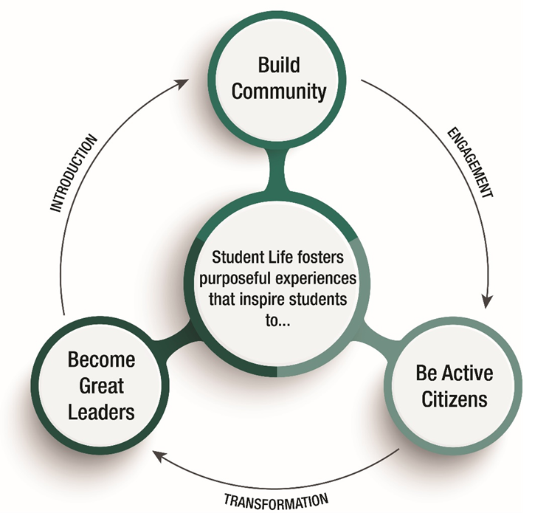
ULEAD
Leadership as a process, not a position
.
A chance to hone leadership skills by creating a customized, self-paced program comprised of experiential learning opportunities including:
workshops,
training,
activities,
event planning and
mentorship.​
We welcome faculty collaboration on any of the workshops, training or other activities.
If you have students interested in planning an event of their own, Student Life can provide logistical and financial support. Full program details and event proposal available at https://www.unbc.ca/current-students/ulead.

Slide 6
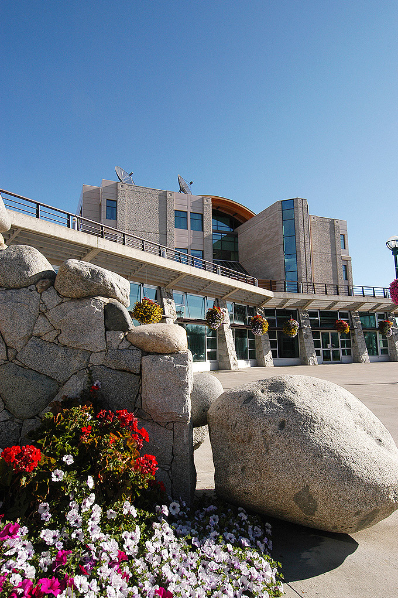
Academic Success Centre
FREE supports for UNBC students!
By-appointment tutoring
  Study skills
  Writing
  Content - math, stats, physics, computer science, economics, and commerce
Online Drop-in tutoring
  available during Fall and Winter semesters, check website for schedules
Asynchronous online writing help
  receive feedback within 48 hours
Supplemental Instruction and PLTL sessions for select courses
Reference materials and online resources
Workshops
First floor of the library, PG campus
250-960-6367 / asc@unbc.ca / www.unbc.ca/asc
Toll-free: 1-888-440-3440 (ask for the ASC)
.

Slide 7
How to Access ASC – Fall 2020
.
Bookable Tutoring: Call 250-960-6367 or email asc@unbc.ca
Drop-in Tutoring: Learning Commons Blackboard shell
Asynchronous online writing help: NO CHANGE follow the instructions on the link https://www.unbc.ca/academic-success-centre/online-writing-tutorial.
Supplemental Instruction (SI) is accessed through the SI Blackboard shell for the specific course.

Slide 8
.
Questions? Comments? Ideas?
Let’s Chat!

