Slide 1
Lighting Projects 2019
A How-To For New Lighting Controls

Slide 2
Control Types & Locations

Slide 3
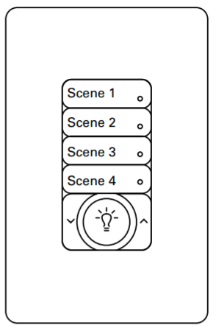
New Controls & Locations
Wavelinx Wallstation
Lecture Theaters 150, 152, 158 (Student Street)
Lecture Theatres 212, 238 (Wintergarden)
Select Research Lab spaces
Bentley Centre meeting rooms

Slide 4
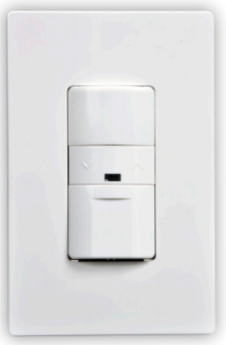
New Controls & Locations
Wall-mount Occupancy Switch
Offices throughout Agora and Research Lab

Slide 5
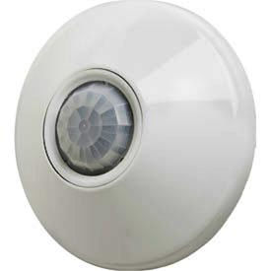
New Controls & Locations
Ceiling-mount Occupancy Sensor
Select common areas throughout Agora and Research Lab

Slide 6
Control Functions

Slide 7
Lecture Theaters 150, 152, 158
Components
Scene’s 1 - 4
Master On/Off button
Up/Down dimming buttons

Slide 8
Lecture Theaters 150, 152, 158
Wavelinx Wallstation Programming
Scene 1 – Chalk board lights
Scene 2 – Pot lights
Scene 3 – 2x2 fixtures over audience
Scene 4 – 50% dim on pot lights and 2x2’s. Board lights off.

Slide 9
Lecture Theaters 150, 152, 158
Function
Users can power Scenes individually, or use the Master button to turn all Scenes on/off.
Up/down arrows can dim a group of Scenes by:
1. First turning on all desired Scenes (or Master button).
2. Holding dim arrows until desired light level is achieved.
3. (optional) Extra Scenes can still be turned off at this point by pressing their respective button once.

Slide 10
Lecture Theaters 150, 152, 158
Function
Users should note that these controls have a minor delay, so please allow 2-3 seconds for a lighting response after pushing a button. Pushing them twice will not achieve the desired result faster.

Slide 11
Lecture Theaters 150, 152, 158
Function
Users may experience an adjustment period in understanding the order to which buttons should be pressed to achieve desired outcome. This is normal, and usually only takes a few minutes of ‘trial and error’ to get used to. Please allow yourself time before a presentation to go through this process.

Slide 12
Lecture Theaters 212, 238
Function
In progress. Location specific information to follow once complete.

Slide 13
Research Lab Spaces
Function
In progress. Each location may have unique programming, though in general, operation will be similar to that described for the lecture theatres along Student Street.

Slide 14
Bentley Centre Meeting Rooms
Function
In progress. Location specific information to follow once complete.

Slide 15
Offices in Agora and Research Lab
Eaton 0 – 10V Dimming Sensor Switch
Integrated occupancy sensor (180º field of view)
Installed primarily in offices and small meeting rooms
Integral daylight sensor

Slide 16
Offices in Agora and Research Lab
Components
Occupancy sensor
Motion indication light
Up/Down dimming buttons
On/Off button

Slide 17
Offices in Agora and Research Lab
Function
Allows individual user control for brightness
Turns lights off after periods of inactivity (20 min)
Memory for last dim level
Dims automatically if enough daylight detected

Slide 18
Select Common Areas
Function
These ceiling sensors are used in areas where wall-mount switches are not practical/applicable
Automatically detect motion and turns on associated lights to full brightness

