Slide 1
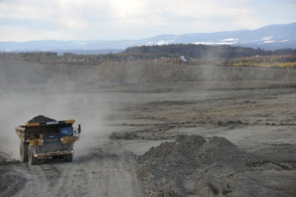
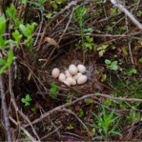
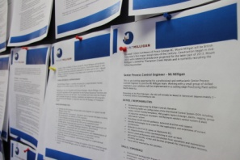
BUILDING A SUSTAINABLE MINE
UNBC April 2012
Notes:
Jocelyn:
Going to start with a brief project overview and update and will focus most of my remarks on what it takes to build a sustainable mine in BC in 2012. Specifically, I want to talk about the steps we are taking to earn a social license to operate and ensure a responsible operation -- by which I mean one that creates value for the communities in which we operate.

Slide 2
CAUTIONARY STATEMENTS
This document contains ‘‘forward-looking information’’ within the meaning of the United States Private Securities Litigation Reform Act of 1995 and applicable Canadian securities legislation which may include, but is not limited to, statements with respect to the future financial or operating performance of the Company, its subsidiaries and its projects, the future price of molybdenum, currency fluctuations, energy price fluctuations, the estimation of mineral reserves and resources, the realization of mineral reserve estimates, the timing and amount of estimated future production, costs of production, capital, operating and exploration expenditures, costs and timing of the development of new deposits, costs and timing of future exploration, requirements for additional capital, government regulation of mining operations, environmental risks, reclamation expenses, title disputes or claims and limitations of insurance coverage. Often, but not always, forward-looking statements can be identified by the use of words such as ‘‘plans’’, ‘‘expects’’, ‘‘is expected’’, ‘‘budget’’, ‘‘scheduled’’, ‘‘estimates’’, ‘‘forecasts’’, ‘‘intends’’, ‘‘anticipates’’, or ‘‘believes’’ or variations (including negative variations) of such words and phrases, or state that certain actions, events or results ‘‘may’’, ‘‘could’’, ‘‘would’’, ‘‘might’’ or ‘‘will’’ be taken, occur or be achieved. Examples of forward looking statements, include, but are not limited to: the ability for the closing conditions to be satisfied in connection with the transactions, the timing for the next steps in the Plan of Arrangement, the fulfillment of the strategic rational behind the transactions, the expected value for Terrane shareholders resulting from the transactions, the production potential at Mt. Milligan, the ability of Thompson Creek to add value to Mt. Milligan, all resource and reserve estimates, the realization of mineral reserve estimates, the ability to adhere to the benchmarks set out in the Mt. Milligan implementation plan, the timing and sources of funds for Thompson Creek’s development of Mt. Milligan, the upside potential at Mt. Milligan, the timing and estimated future production, cash costs and mine life for the Thompson Creek and Endako mines, the timing, estimated future production, cash costs and startup date for production at Mt. Milligan, the estimated annual capacity at Langeloth, Thompson Creek’s pro forma commodity diversity, the market outlooks for molybdenum, copper and gold, the expected mill capacity at Endako following its expansion/modernization and the low sustaining capex for Langeloth over the next decade.
Forward-looking statements involve known and unknown risks, uncertainties and other factors which may cause the actual results, performance or achievements of the Company and/or its subsidiaries to be materially different from any future results, performance or achievements expressed or implied by the forward-looking statements. Such factors include, among others, risks related to general business, economic, competitive, political and social uncertainties including the current global recessionary economic conditions, the associated low molybdenum prices and the levels of disruption and continuing illiquidity in the credit markets; risks related to foreign currency fluctuations; risks related to the volatility of the Company’s share price; changes in environmental regulation; the actual results of current exploration activities; actual results of reclamation activities; conclusions of economic evaluations; changes in project parameters as plans continue to be refined; possible variations of ore grade or recovery rates; impurities and toxic substances in the mined material, failure of plant, equipment or processes to operate as anticipated; the age of the Langeloth Facility; structural integrity and old equipment at the Endako Mine; accidents, labor disputes and other risks of the mining industry; access to skilled labor; relations with employees; dependence upon key management personnel and executives; political instability, insurrection or war; disruption of transportation services; increased transportation costs and delays in obtaining governmental permits and approvals, or financing or in the completion of development or construction activities, as well as those factors discussed in the section entitled ‘‘Risk Factors’’ in the current Annual Report on Form 10-K filed on EDGAR at www.sec.gov and on SEDAR at www.sedar.com. Although the Company has attempted to identify important factors that could cause actual actions, events or results to differ materially from those described in forward-looking statements, there may be other factors that cause actions, events or results to differ from those anticipated, estimated or intended. Forward-looking statements contained herein are made as of the date of this document and the Company disclaims any obligation to update any forward-looking statements, whether as a result of new information, future events or results or otherwise. There can be no assurance that forward-looking statements will prove to be accurate, as actual results and future events could differ materially from those anticipated in such statements. Accordingly, the reader is cautioned not to place undue reliance on forward-looking statements. Readers should refer to Thompson Creek’s current Annual Report on Form 10-K which will be available on SEDAR at www.sedar.com and EDGAR at www.sec.gov and other continuous disclosure documents available at www.sedar.com and www.sec.gov for further information on mineral reserves and resources, which is subject to the qualifications and notes set forth therein.
Cautionary Note to United States Investors Concerning Estimates of Measured, Indicated and Inferred Mineral Resources: This presentation uses the terms “Measured”, “Indicated” and “Inferred” Resources. United States investors are advised that while such terms are recognized and required by Canadian regulations, the United States Securities and Exchange Commission does not recognize them. “Inferred Mineral Resources” have a great amount of uncertainty as to their existence, and as to their economic and legal feasibility. It cannot be assumed that all or any part of an Inferred Mineral Resource will ever be upgraded to a higher category. Under Canadian rules, estimates of Inferred Mineral Resources may not form the basis of feasibility or other economic studies. United States investors are cautioned not to assume that all or any part of Measured or Indicated Mineral Resources will ever be converted into Mineral Reserves. United States investors are also cautioned not to assume that all or any part of an Inferred Mineral Resource exists, or is economically or legally mineable
Darin Labrenz, P. Geo, former Vice President Business Development with Terrane Metals, is the qualified person who prepared or supervised the preparation of the scientific and technical information concerning the Mt. Milligan and Berg projects in this investor presentation.
All currency figures in US$, except where noted.
Notes:
Jocelyn:
As a publicly traded company, this is an important slide, and while the content is difficult to read here on screen, the intent is to alert you to the fact that this presentation may include forward looking information that we believe will come true, but might not.

Slide 3
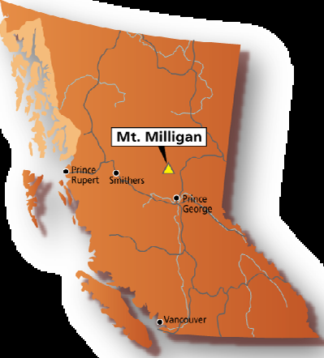
PROJECT OVERVIEW
Copper gold deposit
Conventional truck-shovel, open-pit mine
Production forecast: ~81 million pounds of copper &194,500 ounces of gold annually
Estimated 22-year mine life
Notes:
Jocelyn:
150 km NW Prince George, BC, ~92 km N Fort St. James; west of Mackenzie. Now in our second year of construction with operations starting in the third quarter of 2013.
Sustainability, corporate social responsibility, and social license to operate are all relatively recent terms, originating in the needs of a modern industrial society, and their inclusion in the corporate lexicon reflects a value shift on the part of business in the late 20th century. As a mining company, we’re not keen on the term “sustainability”. Of course we endorse assuming a socially responsible role in the communities in which we operate, but we feel that the best-practice examples of CSR are those addressing the interdependence of business and society; which specify clear, measureable goals; and which track progress over time. For us, successful programs recognize that the more closely tied a social issue is to our business, the greater the opportunity to leverage our resources and benefit society so that the success of the project and the success of the community become mutually reinforcing. That’s our goal with Mount Milligan -- to earn a reputation as a valued partner in the communities in which we operate.

Slide 4
SCHEDULE
 | 2009 | 2010 |  | 2011 | 2012 | 2013 |  | 2014
Environmental assessment/approval
Environmental monitoring
Community engagement
Engineering
Procurement
Construction
Job training
Mine pre-strip/TSF construction
Plant commission/Production
Notes:
Jocelyn:
Two activities that have and will run through the life of the project are environmental monitoring and community engagement. We anticipate we will get lots of input from the community as we move through the various stages of LOM: and that on going feedback will support our social license to operate. Our hope is that we will earn a reputation as a valued partner in the communities in which we operate and that our “legacy” will be to contribute to the sustainability of the region.
One of the tangible demonstration of our commitment to share information and report on aspects of the mine that are of interest to our communities will be the publication of our first sustainability report . . .

Slide 5
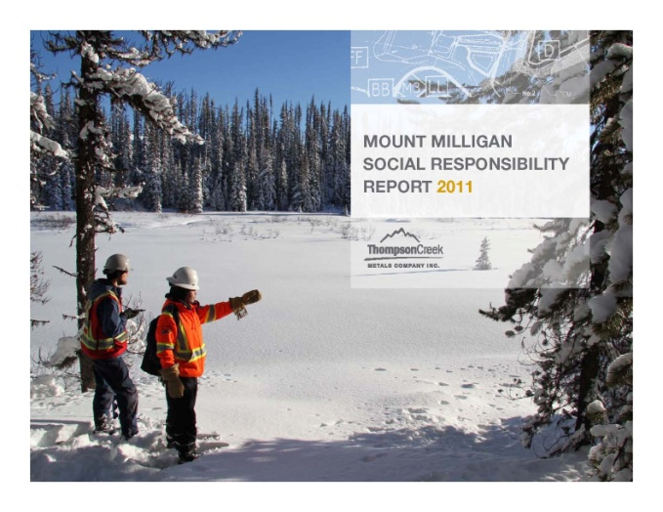
REPORTING
First report:
Published April
www.mtmilligan.com
EA commitment
Volunteered to start reporting during construction.
Notes:
Jocelyn:
Our first report was published April 1. We have not followed any specific reporting requirement but have taken guidance from MAC’s TSM, from the Global Reporting Initiative and from the UN Global Compact.
The report will be available on our web sites . . . Both our corporate site and our Mount Milligan project site

Slide 6
PROGRESS PHOTOS
CONSTRUCTION CAMP
Notes:
Jocelyn:
Construction camp – photo from June
At hits height later this year, camp accommodation will total close to 1000
Original intention was that camp would be temporary. Given critical skilled labour shortage, and concerns about road safety, travel time and work/life balance – will file EA amendment to site ops camp (accommodation for about 300 of the 400 ops jobs). Will provide bus service for remainder from FSJ or Mackenzie. Ops camp allows us to expand the employment catchment to include communities such as PG and Vanderhoof
One of the key areas of construction activity is the plant site . . .

Slide 7
PLANT
Notes:
Jocelyn:
Slide 8 – Plant Jan 2012
The plant will be made up of a 40’ SAG mill, one of only three mills of its kind in the world, and the largest in North America.
Our technical experts tell me, that the SAG mill will be powered by a 23.5 MW gearless motor drive capable of handling 2717 tonnes per hour at 92% availability.
Fine grinding will be done using an IsaMill™ -- the most energy efficient, highest intensity large scale grinding machine on the market. The Mount Milligan IsaMill will be the largest in Canada and Thompson Creek’s second IsaMill in British Columbia. (Endako is also using IsaMill technology).
For those with an interest, I would encourage you to visit the Mount Milligan web site where you can see an animation that flies you through the plant.

Slide 8
PLANT – FEBRUARY 2012
Notes:
Jocelyn:
This shot taken in early January – four months later -- shows the steel erection. North American is the main contractor for steel erection
Once in production, concentrate will be trucked to a local load out facility for rail transport to the Lower Mainland. From there the concentrate will be shipped overseas for final processing
To being plant operations we will need to have accumulated 10 million cubic metres of water in the TSF . . .

Slide 9
TAILING STORAGE FACILITY
Notes:
Jocelyn:
In 2011, water accumulated 4 m cubic metres and with the heavy snowfall this past winter we are optimistic that this year’s freshet will allow us to capture additional water in the TSF
In this photo, you can see the start of the 10 km TSF perimeter road
Project footprint 4 km x 3 km very small footprint is enabled by the compact design
Unique feature of the project no waste dumps – waste rock will be used for the ongoing construction of the TSF as we raise the elevation of the dam

Slide 10
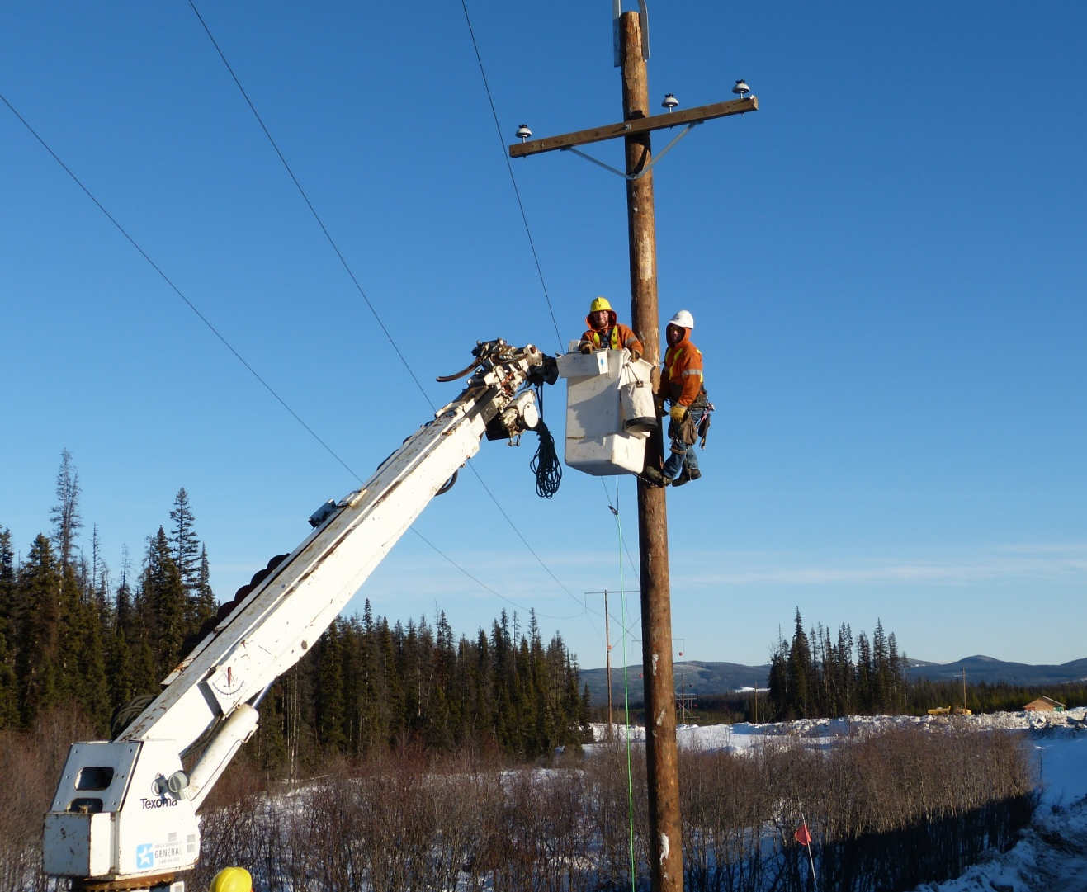
POWERLINE
POWERLINE
Notes:
Jocelyn:
Power to the site will come from a PL connected to the Kennedy substation just outside of Mackenzie.
Grid power is currently scheduled to be available on site at the end of May 2012
A key consideration during the power line ROW clearing was a commitment to restrict certain activities , such as logging, during songbird nesting periods.
(Segue to environmental monitoring)

Slide 11
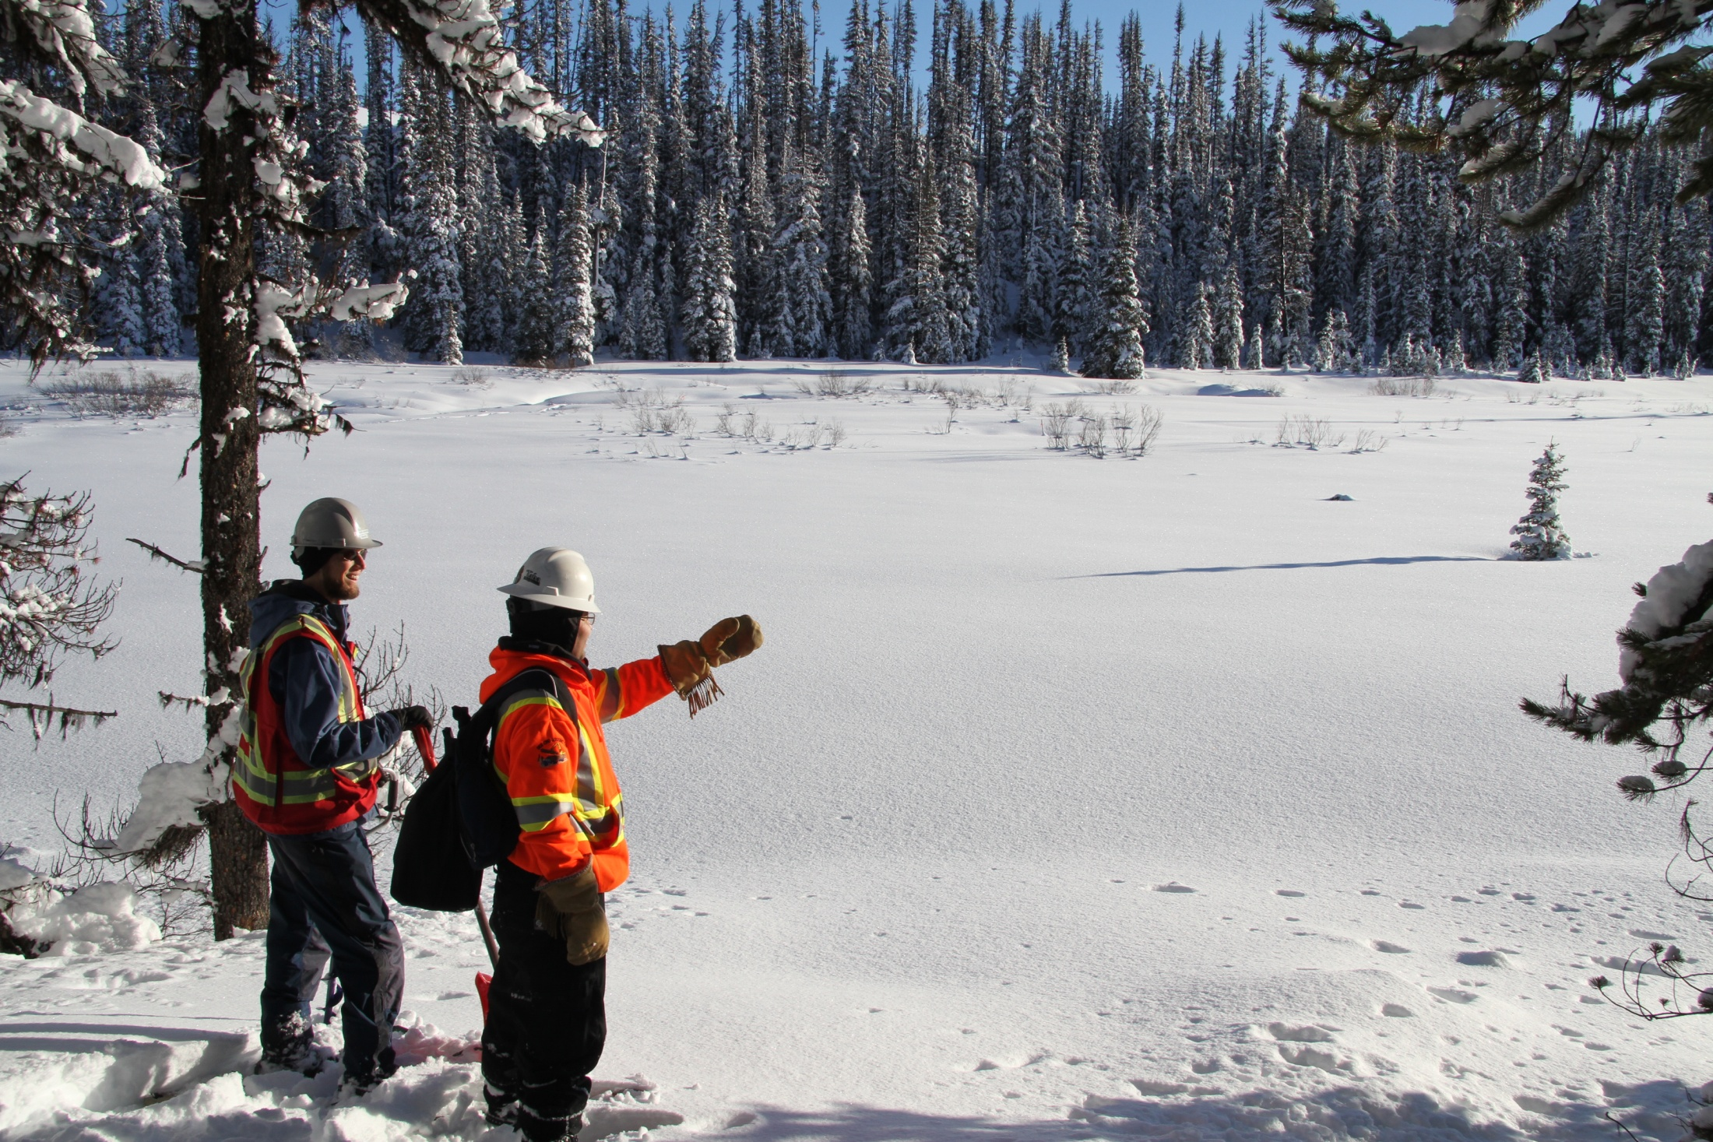
MONITORING
MONITORING
Notes:
Jocelyn:
Mount Milligan benefits from almost 20 years of rigorous environmental study.
Best practices were integrated into project planning, ranging from the design of the waste-rock management plan and energy conservation programs, through to initiatives to protect wildlife, and reclamation planning.
One of three First Nations environmental monitors is on site every day to review construction work and ensure compliance with environmental management plans. Two of our environmental monitors are from the McLeod Lake Indian Band and one is from the Nak’azdli First Nation.
Our Construction Environmental Management Plan (CEMP) outlines our commitment to the protection of the environment and describes how we will apply best management practices to enhance environmental protection and minimize environmental risk. This plan is shared with all contractors working on site.
Many of our contractors come from the local region as providing jobs and opportunities locally is one way to support regional sustainability.

Slide 12
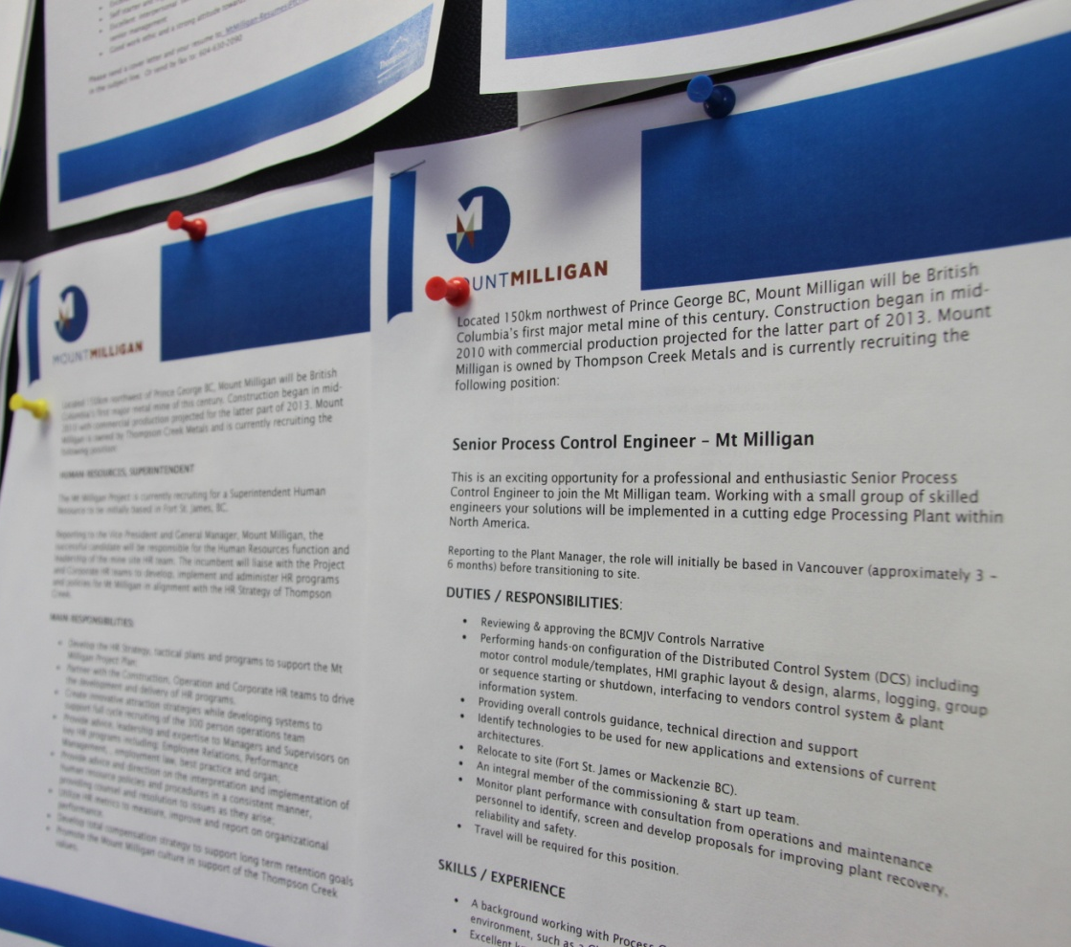
JOBS & OPPORTUNITIES
Notes:
As of the end last week, 780 people were working on the Mount Milligan project. Personnel work in three teams: the BC Mining Joint Venture, a partnership between AMEC and Fluor, tasked with engineering management; the owner’s team, made up of Thompson Creek’s construction personnel; and, the operations team, the group that will run the mine.
Segue way to Christy

Slide 13
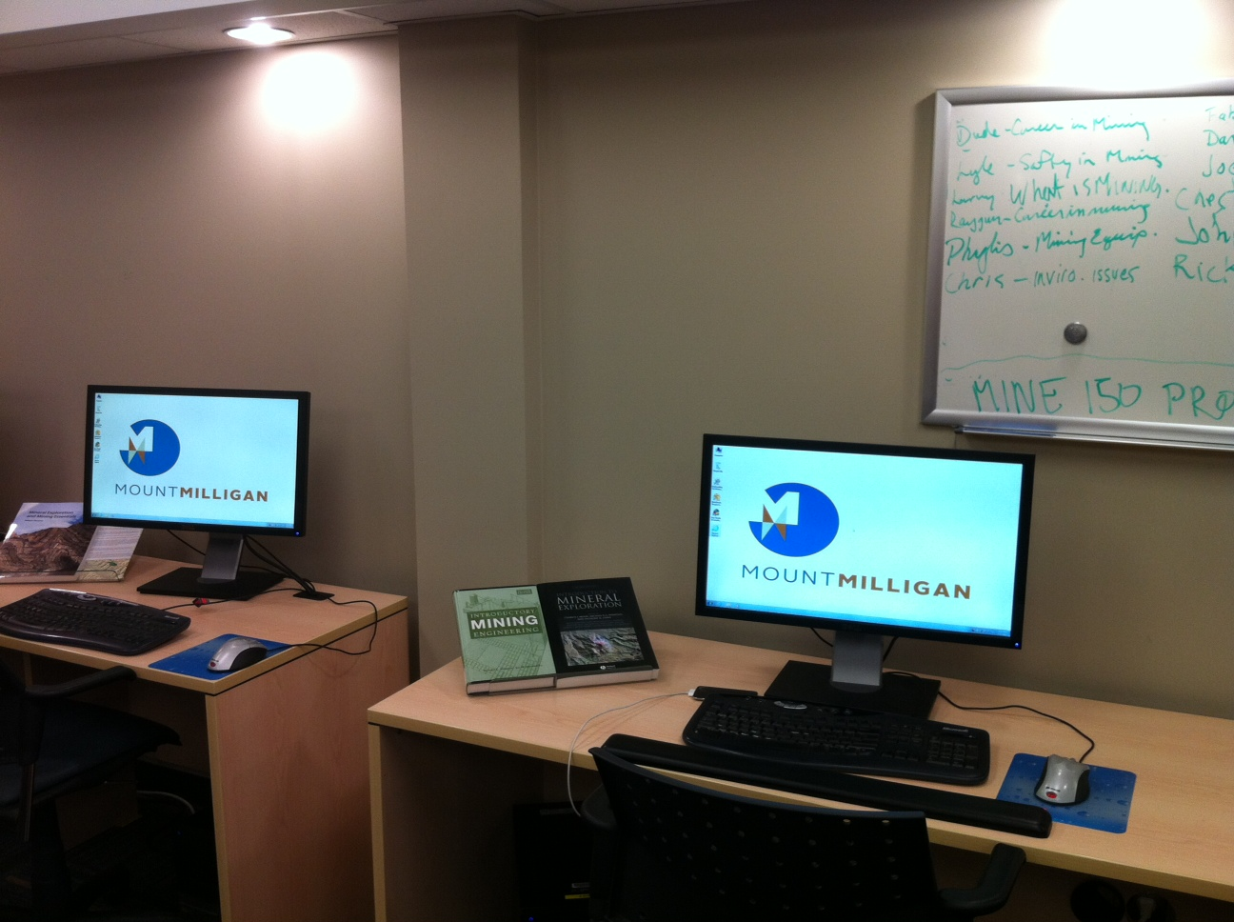
POST SECONDARY TRAINING
Notes:
Christy
As Jocelyn noted, We are committed to hiring as many people as possible from the local region,.
Currently we are working closely with College of New Caledonia and the University of Northern British Columbia to develop and deliver training programs that will help local people acquire the skills necessary to work at the mine.
Mine Certificate Program - This 16-week course has been presented four times. The course includes safety courses, mining processes and upon our advice, has added a welding component. Each graduate will be offered an interview.
Mill Operator Course - This course, under development, is a 16-week course that will prepare the candidate to work in the Mill at either Milligan or Endako. The program is sponsored by Thompson Creek Minerals, rather than either mine. The course will include computer use, mill processes, and general education. This class will begin in September, 2012 and a second session is scheduled for January, 2013. This course can be used to obtain Canadian wide certification through the Mining Industry Human Resources (MIHR).
Continuing Education Courses - This program includes eight evening sessions of three hours in length. It is designed for those people in the communities currently in the workforce who want to “upgrade” their resume. The courses are free to the public and include, WHIMIS, Fall Protection, Mining 101, Communications, Team Problem Solving, Dealing with Conflict, resume writing, and interviewing skills.
We have three rounds of these courses in FSJ and one round in mackenzie. The offerings were well received.

Slide 14
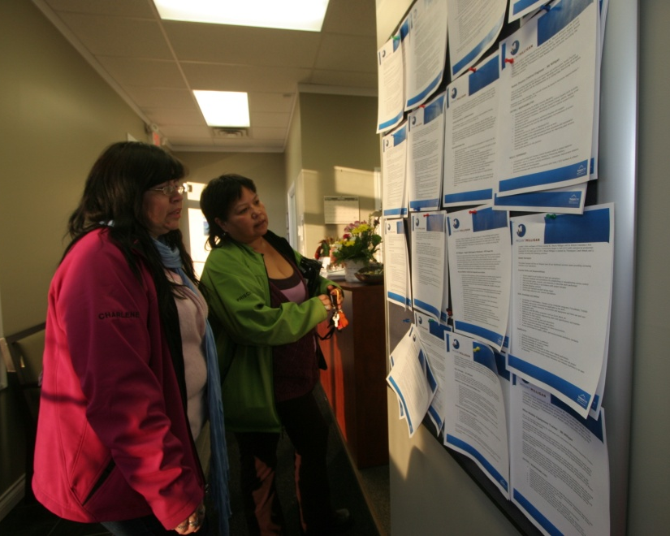
ELEMENTARY & HIGHSCHOOL TRAINING
Notes:
Christy
In addition to immediate training we recognize the need to begin educating about mining at the elementary and highschool level.
Elementary Schools:
Mackenzie Elementary Minerals Education - Mackenzie Elementary schools will present a Mining unit that is currently under development. This is expected to be presented in the 2012- 2013 school years.
Secondary Schools:
Mackenzie Secondary School Minerals Education Course - In Mackenzie, a staff member is currently developing a semester long minerals education course. Mackenzie Secondary School intends to market this course throughout the Province using video-conference technology. The school sees a niche for themselves with mining and minerals.
Secondary School Apprentices - In September, Mt. Milligan is scheduled to begin the first Secondary School Apprentices. This is an established Provincial program. This will include four students (ideally one each from FSJ, Mackenzie and each First Nation band.)

Slide 15
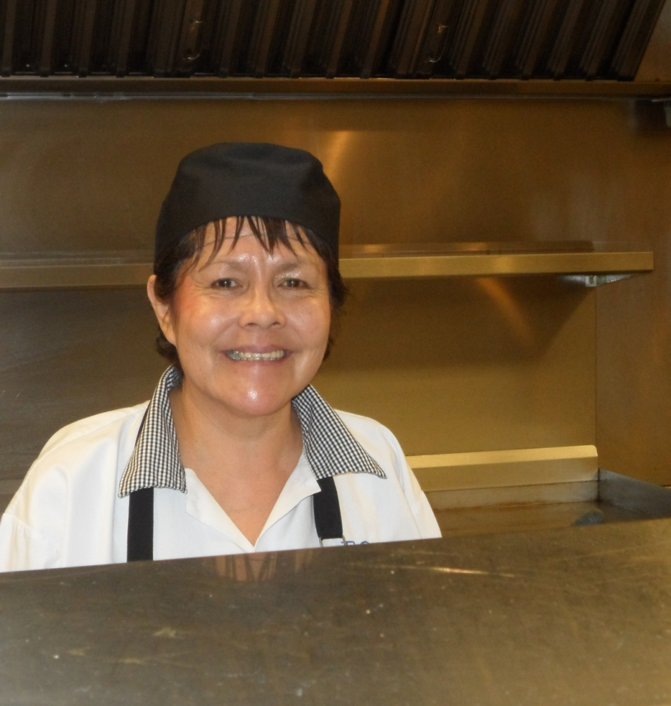
FIRST NATIONS
Working most closely with the McLeod Lake Indian Band, and the band’s member companies
And with the Nak’azdli First Nation and companies owned by Nak’azdli members
Notes:
Christy
Within our EA we recognize seven First Nations with an interest in the area.
Currently, we have FN members from a variety of Nations working in environmental monitoring, road maintenance, office administration, camp services including housekeeping and food services, and community relations
Cultural Awareness Training…
We supported the curriculum development of a cultural awareness program for the traditional territories of Nakazdli and McLeod Lake. An important aspect is that we honoured the proprietary ownership of the curriculum (talk about importance of oral ownership) and makes provisions to have this workshop delivered to all staff and employees.
We also attempt to hire as many local contractors as possible – something which further extends the economic benefits of the project to the region. . .

Slide 16
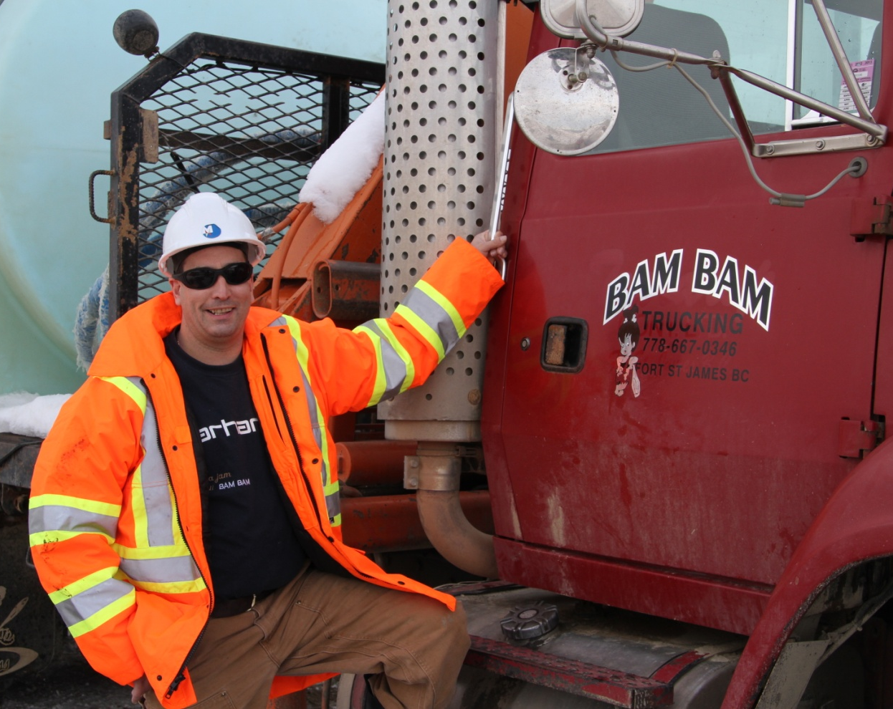
LOCAL CONTRACTS
JOBS & OPPORTUNITIES
Notes:
Christy
Building a project such as Mount Milligan requires the skills and expertise of many professionals. Local contractors and suppliers play an important role. We work in partnership with a number of local contractors with skills in a variety of areas. Some of our contractors include Duz Cho construction and logging, companies owned by the MLIB, Taba Enterprise, owned by a member of the Nak’azdli First Nation, and Bam Bam Trucking out of FSJ. As a result of working at Milligan Brad’s company Bam Bam Trucking has grown from 2 employees to more than 20 – all local hires. One of the ways we work with the local communities to create jobs and opportunities and support local business development.
Personal Story (worked with Brad to fill in his paperwork for the BCMJV)
Working in co-operation with local communities is best achieved when there is a opportunity for two way communication and engagement . . .

Slide 17
ENGAGEMENT
Notes:
Christy
CSC - Established in May 2008, the Mt. Milligan Community Sustainability Committee (CSC) is an advisory group composed of representatives of area municipalities, regional districts, First Nations, educational institutions and economic development organizations. The CSC is a vehicle for sharing information about the project with key opinion leaders, who in turn share this information with their constituencies. The Committee also serves as a forum for communities of interest to raise questions and concerns for the consideration of the mine management. The CSC is seen here at the Committee’s September 2011 meeting held on site at Mount Milligan.
Not always easy. We get asked tough questions and are sometimes pushed for information.
Important work and we value the honest feedback
Some of the other initiatives we use to build awareness of the project within the COI include Tours & community information sessions – want to keep people informed, answer questions before they become issues and give people an opportunity to see for themselves what is happening at site
Questionnaires help us measure trust and confidence and the work done in 2011 gives us a benchmark against which to measure our future performance.
Enews – monthly to key contacts
Newspaper columns
Speaking engagement locally, regionally
Project website that generates ~3000 – 5000 unique visits/month
Monitor media coverage
Risk registry that looks at risk through the lens of public perception as well as the typical operational, financial and legal assessment
Goal is to find the points where the interests of society and business intersect – this creates shared value and is the measure of success
All tools that we utilize to keep the project on track and on schedule . . .

Slide 18
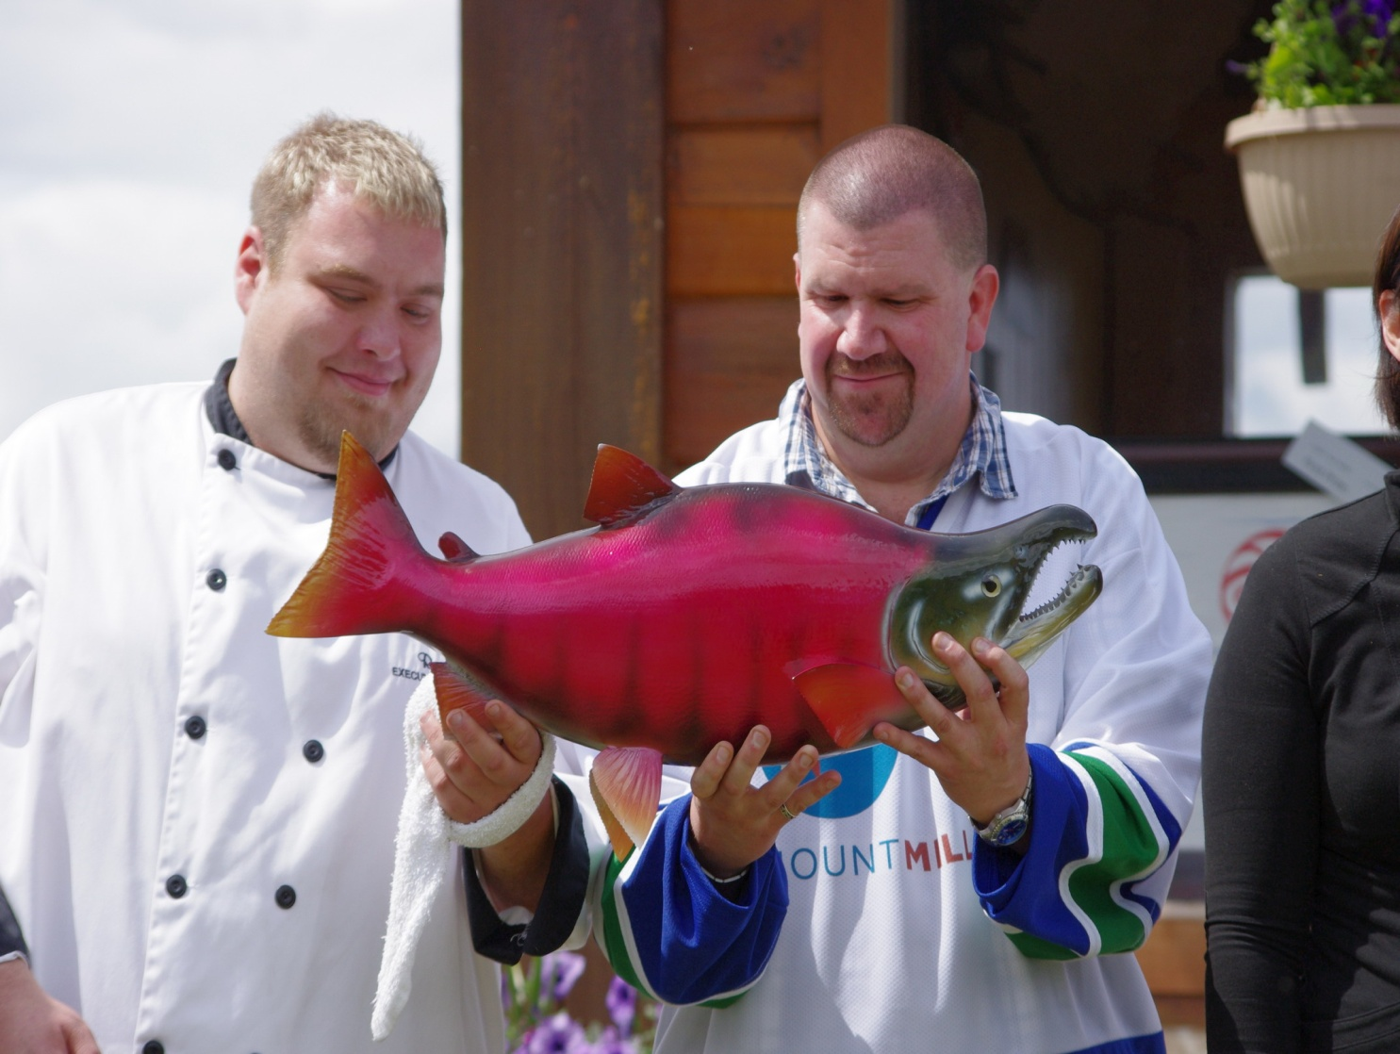
COMMUNITY INVOLVEMENT
Notes:
Christy
Explain picture…It is with these relationships built, and our commitment and involvement in the communities that give us the opportunity to succeed in our goal to become a valued partner in the communities that surround Mt. Milligan.

Slide 19
FOR MORE INFORMATION
Mount Milligan
www.mtmilligan.com
Thompson Creek Metals
www.thompsoncreekmetals.com
Notes:
Where you can also find additional information, not only on Mount Milligan but also on our other properties and corporate initiatives.
In closing, building a successful project today takes more than a viable deposit, good planning, engineering design and construction management. It also requires a commitment to work with local communities to find place where the interests of the business and the interests of the communities intersect. Mining itself may not be sustainable but we can make a valued contribution to the sustainability of the region and build a reputation as a valued partner in the communities in which we operate and from which we draw our employees, suppliers and contractors.
Thank you and I’d be pleased to answer any questions on our social license to operate initiatives.

