Slide 1
3M NATIONAL TEACHING FELLOWSHIP
INFORMATION SESSION FOR
NOMINATORS AND NOMINEES
Lisa Dickson,
Project Leader, 3M NTF National Mentoring Network

Slide 2
TODAY’S SESSION
ABOUT the 3M National Teaching Fellowships
ELIGIBILITY;
NOMINATORS and NOMINEES;
NOMINATION DOSSIER;
TIMELINE AND SUPPORTS.

Slide 3
WHAT IS THE 3M FELLOWSHIP?

Slide 4
WHAT IS THE 3M NATIONAL TEACHING FELLOWSHIP?
Est. 1986 to celebrate and support EDUCATIONAL LEADERSHIP and TEACHING EXCELLENCE in Higher Education;
Jointly administered by STLHE (Society for Teaching and Learning in Higher Education) and 3M Canada;
10 National Teaching Fellows selected annually.

Slide 5
FELLOWS RECEIVE
Life-time STLHE membership;
Cohort retreat at Montebello Resort, QC (expenses paid);
Membership on 3M NTF Council.

Slide 6
3M Fellowship
MULTIDISCIPLINARY
NATIONAL in scope;
CONNECTS Educational Leaders to improve the CULTURE and PRACTICE of higher education in Canada.

Slide 7
3M FELLOWSHIP SUPPORTS
Advocacy;
Communities of Practice;
Experimentation, exploration, innovation;
Mentoring;
Reflection;
Scholarship.

Slide 8
FIND YOUR PEOPLE
WYRD SISTERS
Shannon Murray, UPEI
Lisa Dickson, UNBC
Collaborative Research,
Inter-Institutional Team Teaching,
Mentoring,
Professional Development,
Cheerleading,
Educational Leadership.
Jessica Riddell, Bishop’s University

Slide 9
WHO IS ELIGIBLE?

Slide 10
ELIGIBILITY
“The Fellowship is open to any individual currently teaching at a Canadian university or college, regardless of discipline, program, level, or term of appointment. All post-secondary institutions in Canada (universities, colleges, cégeps, polytechnics, and so on) are included” (3M NTF website).
Undergraduate teaching as regular part of workload;
Any stage of career.

Slide 11
NOMINATORS

Slide 12
NOMINATORS ARE BOOSTER ROCKETS
Nominating someone is an act of
EDUCATIONAL LEADERSHIP

Slide 13
WHO CAN NOMINATE?
FELLOW FACULTY;
ADMINISTRATORS;
CHAIRS/DEANS;
FORMER STUDENTS;
COMMUNITY MEMBERS;
TEAMS of any of the above.

Slide 14
HOW CAN I BE A GOOD NOMINATOR?
KNOW your nominee:
speak IN DETAIL and with CONVICTION;
Be PART OF THE PROCESS:
Work with the nominee on your nomination letter as the dossier develops;
SYNTHESIZE the dossier:
Create a succinct and meaningful statement for the adjudicators.

Slide 15
NOMINEES

Slide 16
NOMINEES ARE
REFLECTIVE PRACTITIONERS;
ENTHUSIASTIC EXPLORERS;
ENGAGED LEARNERS;
ENABLERS OF OTHERS;
ABLE TO CONNECT COMMITMENTS TO PRACTICE TO APPLICATION BEYOND THE CLASSROOM;
STORYTELLERS;
HOPEFUL, CRITICAL, INNOVATIVE, THOUGHTFUL.

Slide 17
EDUCATIONAL LEADERSHIP
UNIQUE to you and your institution;
DEFINED by you.
An intervention in the culture of your institution that creates change or opportunity for others and that supports the efforts of others to become their best selves.
Educational leadership imagines ways to go beyond the individual classroom.

Slide 18
NOMINATION DOSSIER
YOUR VOICE, YOUR STORY

Slide 19
YOUR STORY IN YOUR VOICE
Your dossier is a NARRATIVE grounded in EVIDENCE and REFLECTIVE PRACTICE:
1) WHY you do what you do to support teaching and learning;
2) WHERE: the scope, context and impact of your contributions,
3) WHAT you have learned from these experiences;
4) HOW you hope to continue growing and improving into the future.

Slide 20
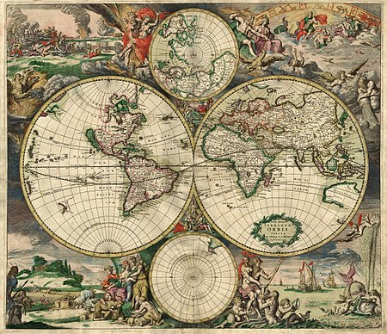
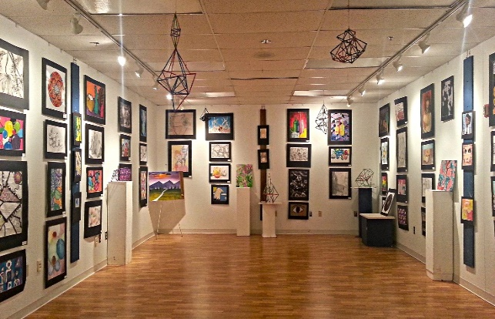
YOUR DOSSIER IS
A STORY about who you are as a teacher and a leader, how you got here and where you want to go.
A CURATION of materials that demonstrates how you have put your values and leadership into action.
Notes:
Your values;
Your experiences;
Your commitments;
Your actions;
Your lessons and how they have changed you.

Slide 21
THE THROUGH-LINE
BUILD your story around a CENTRAL THEME, idea or experience that will help you to TIE TOGETHER all of your statements and supporting evidence.

Slide 22
ALIGNMENT, CURATION, REFLECTION
BELIEFS
STRATEGIES
IMPACT
Notes:
HORIZONTAL ALIGNMENT: how one’s beliefs about teaching and learning relate to
the strategies one uses in practice;
evidence of one’s impact.
It is important that you carefully select and curate the most important evidence to demonstrate:
the teaching, learning and educational leadership strategies you use to put your beliefs into practice;
the impact that these strategies have had on others.

Slide 23
TIMELINE and SUPPORTS

Slide 24
BENCHMARK DATES
Mid-MAY: initial nominations;
Mid-JUNE: consultations with nominees, decision to move forward, recommendation to Provost;
Mid-JULY: draft nomination package;
Mid-AUG: revised draft nomination package;
End of AUG: nominator’s final letter;
SEPT 6: Final nomination package submitted to CTLT;
SEPT 12: nomination package to Provost for supporting letter;
SEPT 30: SUBMISSION OF DOSSIER to the Adjudication Committee.

Slide 25
SUPPORT
3M NTF NOMINATIONS INFORMATION PACKAGE (available from the CTLT);
Your Centres of Teaching and Learning;
3M NTF website: https://www.stlhe.ca/awards/3m-national-teaching-fellowships/
Individual Consultations for UNBC nominees: Lisa.Dickson@unbc.ca
Dossier Workshops/Retreat;
3M NTF NATIONAL MENTORING NETWORK

Slide 26
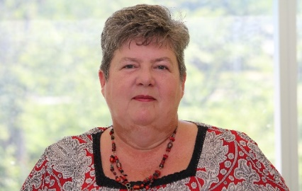
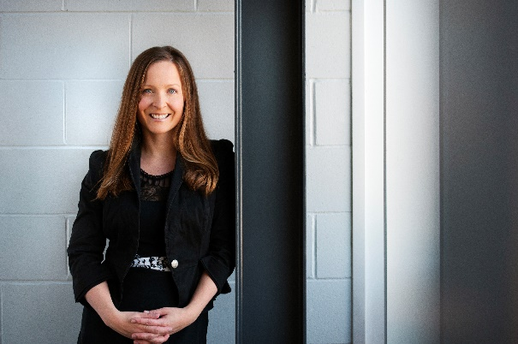
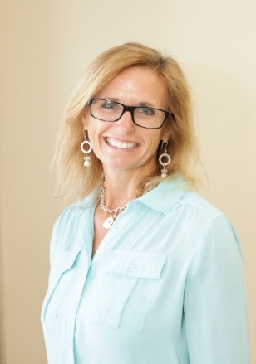
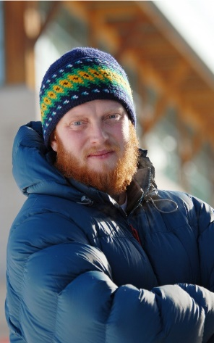
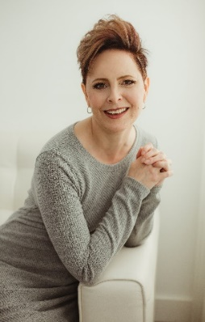
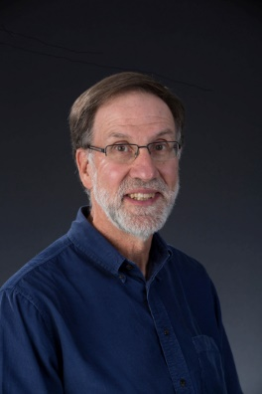
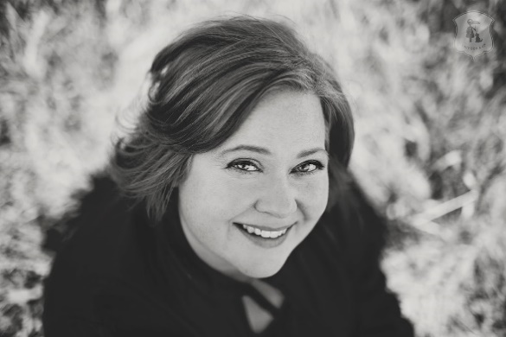
3M NTF NATIONAL MENTORING NETWORK
3M FELLOWS;
MULTIDISCIPLINARY TEAM;
RANGE OF INSTITUTIONAL CONTEXTS;
MENTORING & ADJUDICATION EXPERIENCE;
ONE-ON-ONE CONSULTATIONS (email, skype/phone, site visits);
CONTACT 3MNTFMentoring@stlhe.ca

Slide 27
REVIEW LATER
This session will be archived:
https://video.unbc.ca
Under the CTLT tab.

Slide 28
QUESTIONS?

