Slide 1
Real Estate and Land Use Considerations in Building Communities
Jack Wong, CEO
Real Estate Foundation of BC
for Building the Future: Foundations for Sustainable Prosperity – April 2012
Notes:
This is Main Street in Smithers. Taken in June 2011.

Slide 2
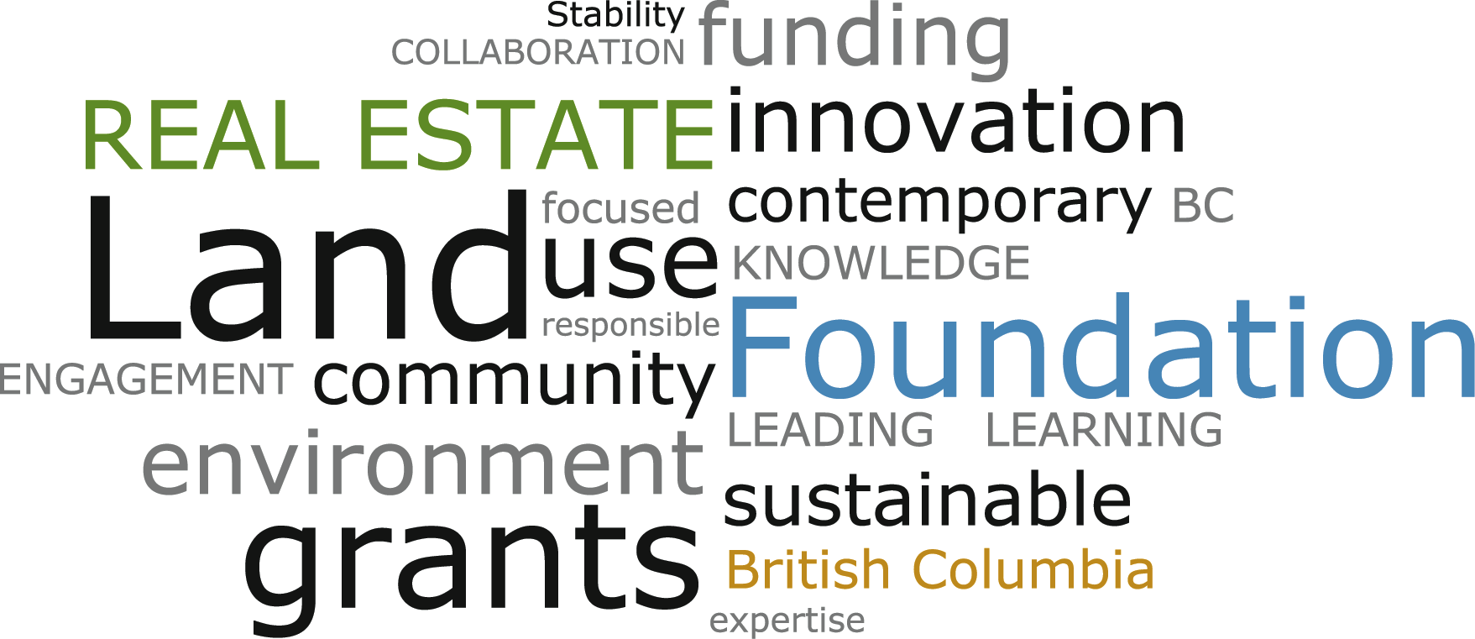
Notes:
What the REF is about. (Here’s where I’m coming from.)
Mission is to support sustainable real estate and land use practices for the benefit of British Columbians.
We believe that the use of land – as well as its conservation – can contribute to community well being.
Bit of a wordy quote that describes, in general, the Foundation’s philosophy on “land use.”:
The use of land employs human resources and capital to achieve community well being and the creation of wealth.
As a finite resource, some lands must be conserved.
Decisions about the use of public and private land, in myriad circumstances, should be based on objective and current information.
This is in the interest of the public trust.

Slide 3
BC Town
Shops
Houses
Church
School
Doctor
Fire, Police
Town Hall
Shops
H.S.
Mill
C/Centre
Rink
Businesses
Park
Mall
Hospital
College, etc.
Notes:
Been asked to talk to you about real estate. Cover some real estate AND land use issues…they fit together.
Structure my presentation, and discussion of the issues, around this fictional place [CLICK] BC Town. This is the story of BC Town.
Located here because there’s a great river and the railway was going to be put through. [CLICK]
Originally, people built what they needed…what constituted a permanent “town” for them. Probably included [CLICK]
Town would have had a fairly small footprint since the car was not the primary mode of transportation.
Of course, not everyone could work in these places—they needed another place to work. A sawmill was ideal. [CLICK]
Over time, more people moved to BC Town because the jobs were good and it was a great place to raise a family. Over many years, housing subdivisions sprung up (larger homes out in the country—you had to drive there from the main part of town… [CLICK]
And with them, more roads and an expanded sewer system—and even a bridge. (Could mention other infrastructure like street lights, sidewalks, etc.) [CLICK]
There was also a community centre and ice rink, a park with ball fields, a new high school [CLICK]
…and various other services and businesses. [CLICK]
Some other services—like the hospital and the college—are out of town, but only an hour or so away. [CLICK]
Pretty nice town, right?
To re-cap (in a simplified way), BC Town developed in a certain way for certain reasons. The land uses met the needs of the people at certain times…they made the best decisions they could based on their resources (land, money, human resources); their preferences; and the information they had at their disposal. They probably didn’t project what the place would be like in 25 or 50 years—maybe that would have been unrealistic, or maybe not.
Everything wasn’t planned at once—the transportation infrastructure, the housing, the shops and industry, the public buildings and amenities like parks—it evolved over time…piecemeal.
And while that IS the way towns and cities develop—over time, piecemeal—problems and issues can and do arise.
Let’s look at a few factors at play.

Slide 4
Social & Demographic Factors
Aging individuals, aging populations
Baby booms
Income diversity
Cultural diversity
Personal needs and preferences
Notes:
People are the core of any town or city.
Just as individual people age, so do populations—as is happening in BC now.
Families have children, who need schools; and when they grow up—if they want to stay in town—they might want a place of their own to live, and somewhere to work.
Students, seniors, people with different educational backgrounds, skills, abilities, preferences, and income levels all need appropriate places to live, work, and engage with the community.
In BC Town, the people who have stayed over time, maybe even over generations, as well as newer arrivals, have needs that impact community planning, land use and real estate.
For example, there is a family who bought a house in an outlying subdivision to raise a family, are now retired empty nesters. They can’t drive as much as they used to. One of them needs to visit the hospital once a month. It’s hard to clear the driveway when it snows. And doing the grocery shopping is a real chore. They feel kind of cut off from their community because their needs aren’t being met. If there were some nice apartments in town, they would probably move, but the town developed around a mainly younger population that drove everywhere and did not foresee what might happen when many residents got older and their needs and preferences changed.
That’s just one example of a natural change in a community that has land use and real estate implications.

Slide 5
Residential Land Use Factors
Large houses on large lots
Cost of servicing
Time, money spent in the car
Some community members not well served by this model
Notes:
We already touched on some of this.
Except for some housing “in town”, many BC communities—and BC Town—have relatively large houses on large lots. They are designed for middle class folks, or people with even higher incomes. They’re for families with children. Often, they are located far from the grocery store, the doctor, dentist, school, museum, ballet lessons, skating rink, etc. and people have to drive.
Spread out housing means long, expensive sewer pipes, new roads and sometimes sidewalks, and all that goes with servicing homes.
While some individuals can afford to live this way, others cannot:
People on fixed income – seniors, students, people with a disability
And some would choose not to, if there were an option to be close to shops, services, cultural amenities, public transportation, and more of their neighbours.
And even if many people can afford this lifestyle—which we have come to see as ideal in many ways—can we as towns and cities of taxpayers continue to afford it?

Slide 6
Infrastructure Factors
Roads
Sidewalks
Water & waste
Electricity
Gas
Telephone
Internet
Notes:
All the pipes, wires, and roads that connect property (real estate) is the infrastructure.
While we have companies like BC Hydro that own and manage certain infrastructure services, local governments, and their tax base, are responsible for roads, sewer pipes, town light standards and sidewalks in their jurisdiction.
According to Asset Management BC, the capital, up-front cost of infrastructure is 15-20% of the overall cost. The rest is ongoing operating costs paid by taxpayers. So, even if a developer pays to put in some of the local roads and pipes, it’s everyone in the community who will be paying over time.
Since there is very little money from senior governments to help with upgrading our old, falling apart infrastructure, the local taxpayers must figure out a way to make our infrastructure work. At this time, BC communities cannot afford the current levels of infrastructure…that we have come to expect. (In our BC Town example, if sidewalks hadn’t been installed on both sides of the street in those outlying subdivisions, the town wouldn’t have to maintain them.)
The cost and ongoing risk of our infrastructure is another issue that’s not going away.

Slide 7
Industrial Land Use Factors
Income and jobs but concerns about:
Air quality
Water quality
Contaminated sites
Noise
Road impacts
Notes:
In BC Town, the mill was built close to the river and the town—and pretty close to the railway. That was smart for transportation reasons.
Over time, though, as with many issues, pollution issues emerged: water, air, noise, dust. Some people in town weren’t too happy about that…some even left. And others didn’t want to live near the town centre where most of the amenities were because of those issues.
With industry in general, sometimes businesses that attract workers also cause ecological and other problems, not just in a local area, but “downstream” (literally and figuratively). Heavily laden trucks might rumble through town and prevent the outdoor café and the music school from thriving. They might wear down the pavement so quickly that road building and infrastructure costs go up.
There are often unintended consequences.

Slide 8
Public Land Use Factors
Separate locations for each purpose
Lack of integration
Schools
Libraries
Community and recreation centres
What would serve community best?
Notes:
The way we have tended to build our communities, we have a different building, a different location for everything. We have a city hall, a provincial government building—or a few, a federal building (or one for each department). We separate our schools from our public libraries from our community or rec centres. And we do this even though the services they provide, or the reasons they are there, may be similar and would benefit from thoughtful integration.
In our BC Town example, the new high school was pretty close to the ice rink and community centre—good for them! But the athletic park was across the tracks and out of town. Not too convenient.
And what about new technologies? Do all our buildings need to be “wired” for high speed internet connectivity? Does it make sense to make upgrades on a community-wide basis or not?
Thinking about why we do what we do and co-locating services to maximize their “serving” potential could make sense. Does BC Town need a retrofit?

Slide 9
Commercial Land Use Factors
Historic downtowns vs. stores and services on the outskirts
Walkable vs. car-oriented
Close to existing infrastructure vs. extensions required
Notes:
And then what about shops and services? Towns start with a core where most important things are located. Over time, though, as towns grow and companies identify demand for a mini-mall or a big box store, they find that larger parcels of less expensive land is available on the outskirts. Since almost everyone drives, this isn’t seen to be a problem.
However, large, car oriented stores and facilities on the edge of town are designed for young, able-bodied people. They impact:
The viability of downtown businesses
The people who cannot get there for mobility reasons, or because they don’t have a car and there’s no bus…or infrequent bus service
Water and sewer infrastructure, which has to be extended a relatively long way (more pipe, more cost, more risk in the long term).
Once again, there are benefits, but there are also very real costs to the community.

Slide 10
Solutions
Long term thinking
Working with natural processes (e.g. water)
Integrated plans and service delivery; partnerships
Inclusive planning processes
Smart investments
Notes:
Often, when problems crop up, we address them one at a time. We put band-aids on individual problems rather than taking a step back and looking at the whole picture.
This is certainly true of many decisions in our towns and cities. It takes time, money, and expertise to assess the situation, come up with recommendations, and implement solutions. However, an integrated, long-term approach serves towns well—economically, and in terms of and social and environmental aspects that are part of people’s quality of life.
Here are some considerations that I believe can be part of any land use decision making process, whether it pertains to industrial, residential, commercial, or public land uses:
In general, I would say that we need long-term thinking: 50, 100 years. Will our decisions today serve our children, our grandchildren, future workers, seniors, and students?
The environment—or ecosystem—or just The System that we were born into…whatever you want to call it…the healthier it is, the healthier we are. If we want healthy resilient communities, we have to take care of water, air, and land, and all the plants and animals that live there. That might mean we build an eco-industrial park where waste heat or wastewater from one company feeds into another. Or it might mean we have grassy swales at the side of the road instead of curbs and gutters, to ease the burden on our creeks when water from a big rainfall flushes down a pipe, eroding banks and damaging fish habitat. There are many ways we can work with natural processes in our land use decisions.
Creating plans to integrate services delivered from existing locations—schools, libraries example—or designing new buildings and community spaces with the bigger picture in mind can help us deliver the services better, and save money.
Local governments are required to include residents in planning processes. While they might not engage everyone who should, or would like to have input, the diversity of “end users” need to be included up-front. In the Lower Mainland, there’s an online public participation tool called PlaceSpeak. Time will tell if this is a valuable way to engage more community members in important, local decisions.
Taking a realistic, big picture view of what a community needs—and is likely to need in the future—along with a realistic assessment of how much money there is/will be to meet those needs will help the decision makers make smart investments in infrastructure. It will identify trade-offs, and the research involved will identify new technology, new possibilities.

Slide 11
Our Role
Grants
refbc.com/grants
Pivotal connector
BC-wide connections
Notes:
The Real Estate Foundation is often part of communities working on solutions for themselves.
Can support practical real estate and land use related research, public and professional education, and law and policy reform projects that will improve sustainable land use.
Fund any non-profit, including local government. However, do not support the regular responsibilities of a government body.
We have approved over $60 million in grants since 1988, in more than 100 BC communities. Visit our website for information on the grants program, including the three current focus areas:
Built Environment
Fresh Water Sustainability
Sustainable Food Systems

Slide 12
Thank you!
Jack Wong
jack@refbc.com
Toll free 1.866.912.6800 ext 104
Local 604.688.6800
Notes:
Aboriginal Mother Centre – fall 2011
Many hands are needed to get the job done!

